Slide 1
Nervous System: Part VI
Specialized Receptors:
Eyes and Ears

Slide 2
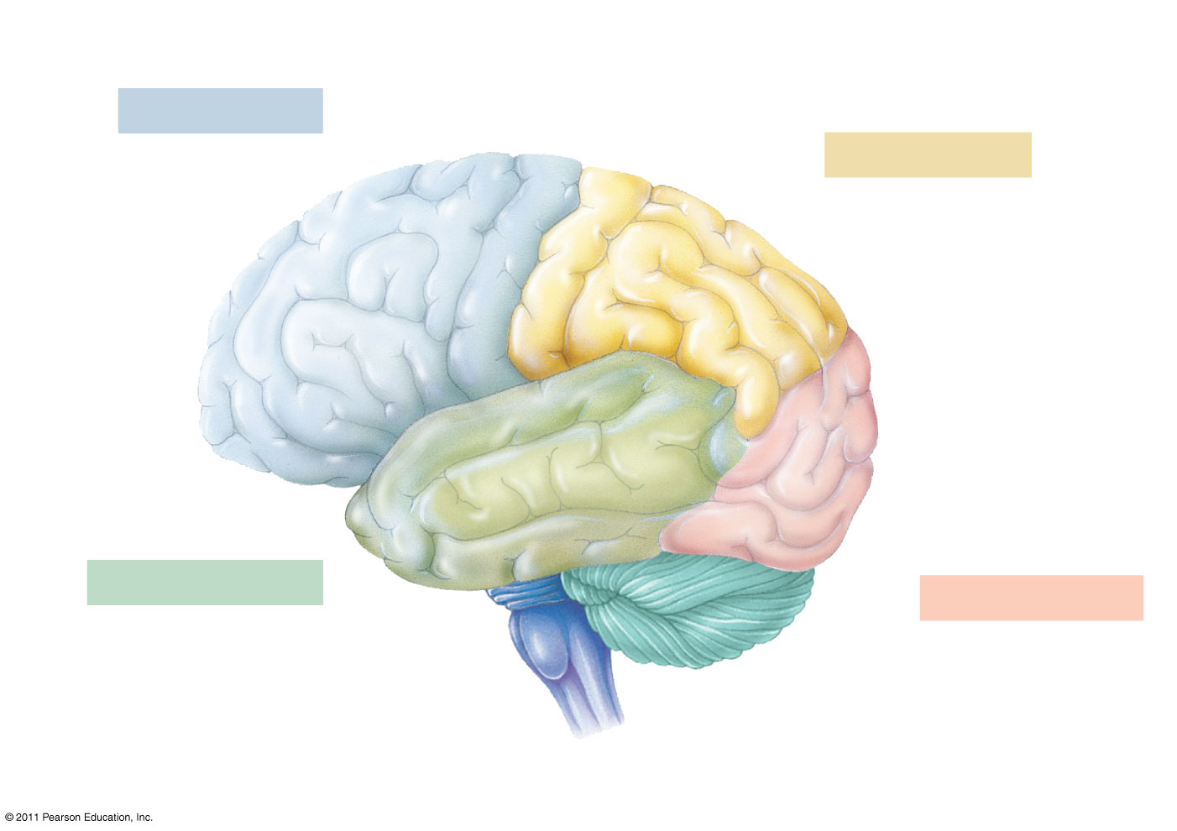
Motor cortex (control of skeletal muscles)
Somatosensory cortex (sense of touch)
Frontal lobe
Parietal lobe
Prefrontal cortex (decision making, planning)
Sensory association cortex (integration of sensory information)
Visual association cortex (combining images and object recognition)
Broca’s area (forming speech)
Temporal lobe
Occipital lobe
Auditory cortex (hearing)
Visual cortex (processing visual stimuli and pattern recognition)
Cerebellum
Wernicke’s area (comprehending language)
Notes:
What parts of your cerebrum help you see and understand what you are seeing? (occipital lobe & parietal lobe)
What parts of your brain help you hear and make sense of what you are hearing? (temporal lobe)
Today we will look at the structural features that allow eyes and ears to function as receptors of stimuli.

Slide 3
The Human Eye
The two chambered organ which takes in light waves, translates them into signals, and sends these signals to the brain.

Slide 4
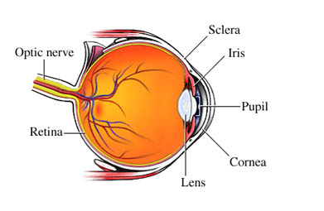
Notes:
Point out that it is the retina that contains the photoreceptors that collect visual stimuli.

Slide 5
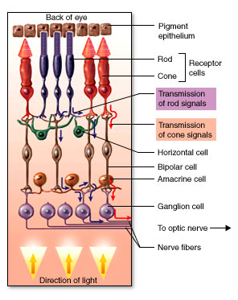
Notes:
Point out that the rods and cones are the cells that respond the to light stimulus. After light strikes the rods and cones they start a chemical reaction that turns the image focused on the retina into electrical impulses that are then sent to the brain through the optic nerve.

Slide 6
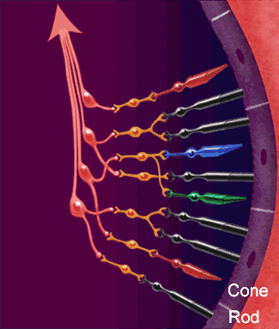
Notes:
Move the cursor over the image to show the pathway of light, to rods (black), cones to brain (red, green and blue cones—which happen to be properly represented since those are the primary colors of LIGHT [RGB] as opposed to pigment (red, blue, yellow).
Students may ask you why folks say that dogs are colorblind. Like most mammals, dogs are dichromats and have color vision equivalent to red-green color blindness in humans. Dogs are less sensitive to differences in grey shades than humans and also can detect brightness at about half the accuracy of humans.
The dog's visual system has evolved to aid proficient hunting. While a dog's visual acuity is poor, their visual discrimination for moving objects is very high; dogs have been shown to be able to discriminate between humans (e.g., identifying their owner) at a range of between 800 and 900 m, however this range decreases to 500–600 m if the object is stationary.
http://en.wikipedia.org/wiki/Dog

Slide 7
Why do you have a
Blind Spot?
Notes:
Ask students to answer the question using their understanding of the anatomy of the eye.
Interesting note: Cephalopods (like squid and octopi) have excellent complex eyes, but they do not have a blind spot. Why not? Their eyes evolved independently and their retinas are not “backwards” like ours so there are receptors even where the optic nerve exits the back of the eye.

Slide 8
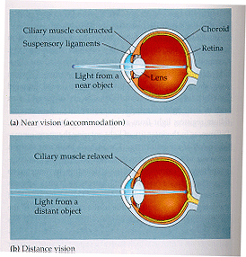
The Lens
Near Vision
-spherical lens
Distance Vision
-flattened lens

Slide 9
The Human Ear
The three part organ which takes in sound waves, translates them into signals, and sends these signals to the brain.

Slide 10
Notes:
The structure of the ear allows a mechanical receptor to detect sound waves.

Slide 11
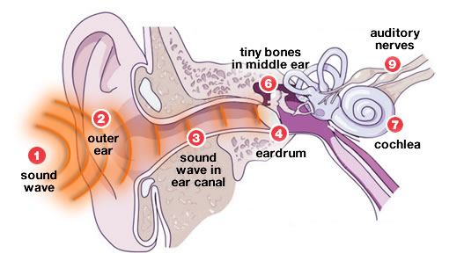
Notes:
1 Something vibrates and creates a sound wave.
2 The sound wave travels to the ear and is collect by the outer ear.
3 The sound wave then moves into the ear canal.
4 When it reaches the end of the ear canal, the sound waves bump up against the eardrum.
5 The ear drum vibrates with these sound waves.
6 The vibration moves tiny bones in the middle ear.
7 These bones carry vibrations into the inner ear to a fluid-filled tube called the cochlea.
8 The fluid inside the cochlea vibrates a series of tiny hairs called cilia, which are attached to auditory nerves.
9 The movement of these cilia stimulates the nerve cells, and they send signals to the brain via the auditory nerve.
The brain processes these signals into the sounds we hear

