Slide 1
Nervous System: Part V
Interactions With The Muscular System

Slide 2
Enduring Understanding 4.A.4.b Interactions among systems
Interactions and coordination between systems provide essential biological activities
Illustrative example:
Nervous and muscular
Notes:
The nervous and muscular system may not be specifically tested on the AP Biology Exam but have been chosen as the pair of systems that can clearly demonstrate functions of the nervous system which ARE on the Exam. See Learning Objectives 3.43 through 3.50 and 4.10.

Slide 3
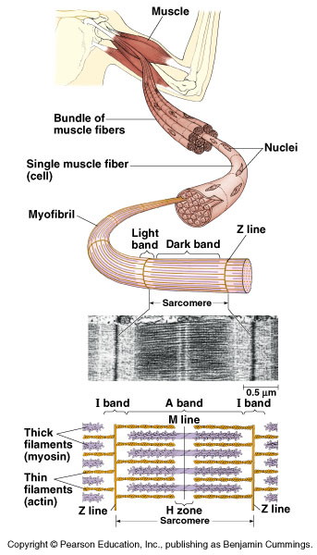
The contraction of a muscle is a typical response generated by the nervous system.
Muscle contraction demonstrates the interdependence of the nervous and muscle systems.
Notes:
Today we will consider a very specific mechanism for a RESPONSE generated by the nervous system: Muscle contraction. We will learn how a muscle contracts when stimulated by a chemical signal.

Slide 4
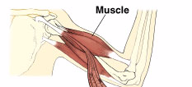
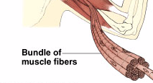
organ
tissue
cell
Notes:
Describe the system to cell hierarchy.

Slide 5
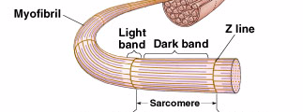
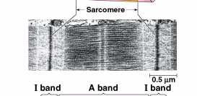
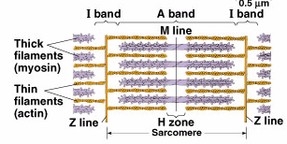

Slide 6
Arrange These In A Decreasing Hierarchy:
Muscle
Muscle fiber cell
Actin
Myofibril
Muscle fibers in bundle
Sarcomere
Myosin
Notes:
Answers follow on next slide…

Slide 7
CORRECTLY Arranged Into a Hierarchy:
Muscle
Muscle fibers in bundle
Muscle fiber cell
Myofibril
Sarcomere
Myosin
Actin

Slide 8
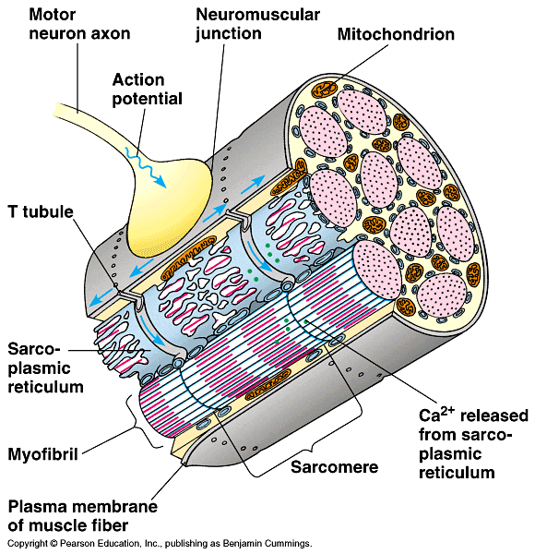
The arrival of the action potential causes the sarcoplasmic reticulum to release calcium
Notes:
All of this action is stimulated by the arrival of the action potential from the motor neuron! Take some time to tie together the nervous system’s role in stimulating the contraction.

Slide 9
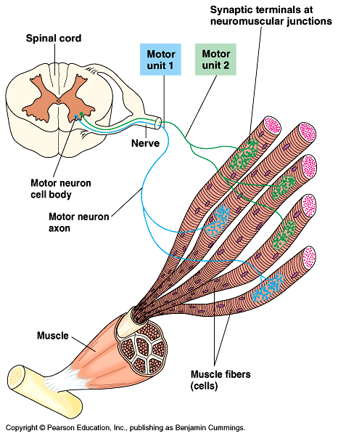
Notes:
This image shows how you can have a graded response, contracting a muscle a little or a lot. The more motor units that receive the stimulus, the more contracted the muscle will become.

