Slide 1
Laboratory Introduction
What is a protocol?
What is an enzyme?
Why do scientists use protocols?
What are some examples of enzymes in our lives?
Now let’s practice pipetting!
Notes:
What is a protocol? A set of rules, instructions, how to perform a procedure…
Why do scientists use protocols? So they know how to do something, to ensure accuracy, for REPEATABILITY – must be able to make comparisons between labs.
What is an enzyme? A protein that speeds up a chemical reaction.
What are some examples of enzymes in our lives? Lactase, hemoglobin, lysozyme, proteases…
For pipetting practice, the students practice using the disposable pipettes, pipetting different volumes including 0.1mL. Cups or beakers of water are great for this.

Slide 2
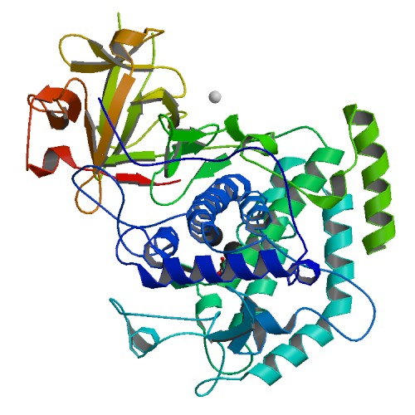
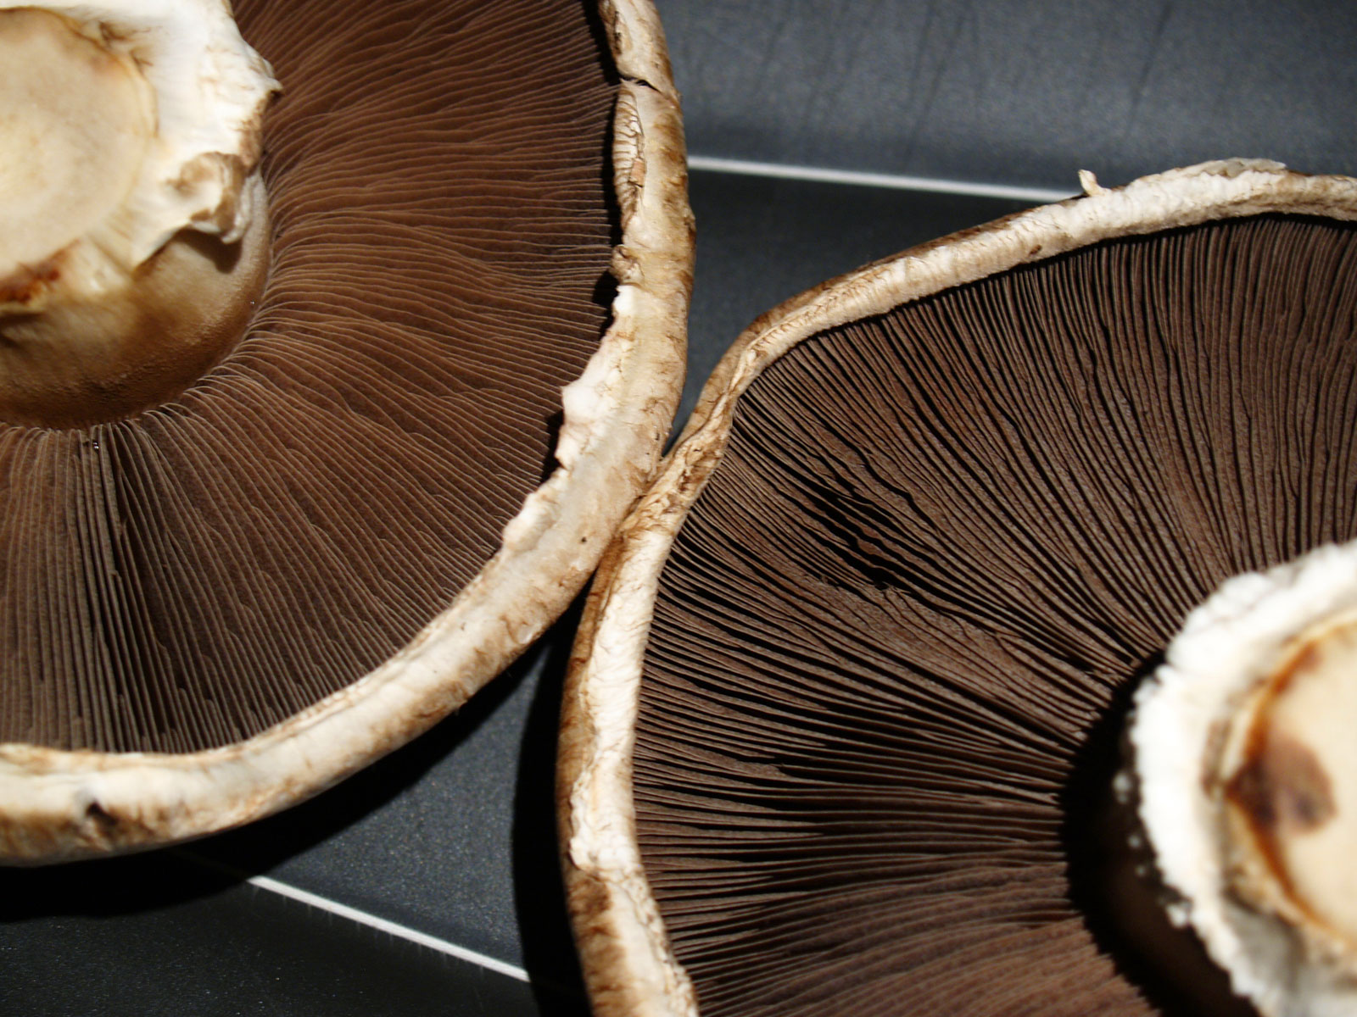
Enzyme/Substrate Reactions
Using Mushroom Tyrosinase
Notes:
Intro slide for tyrosinase – portabella mushroom on the left, mushroom tyrosinase protein on the right.

Slide 3
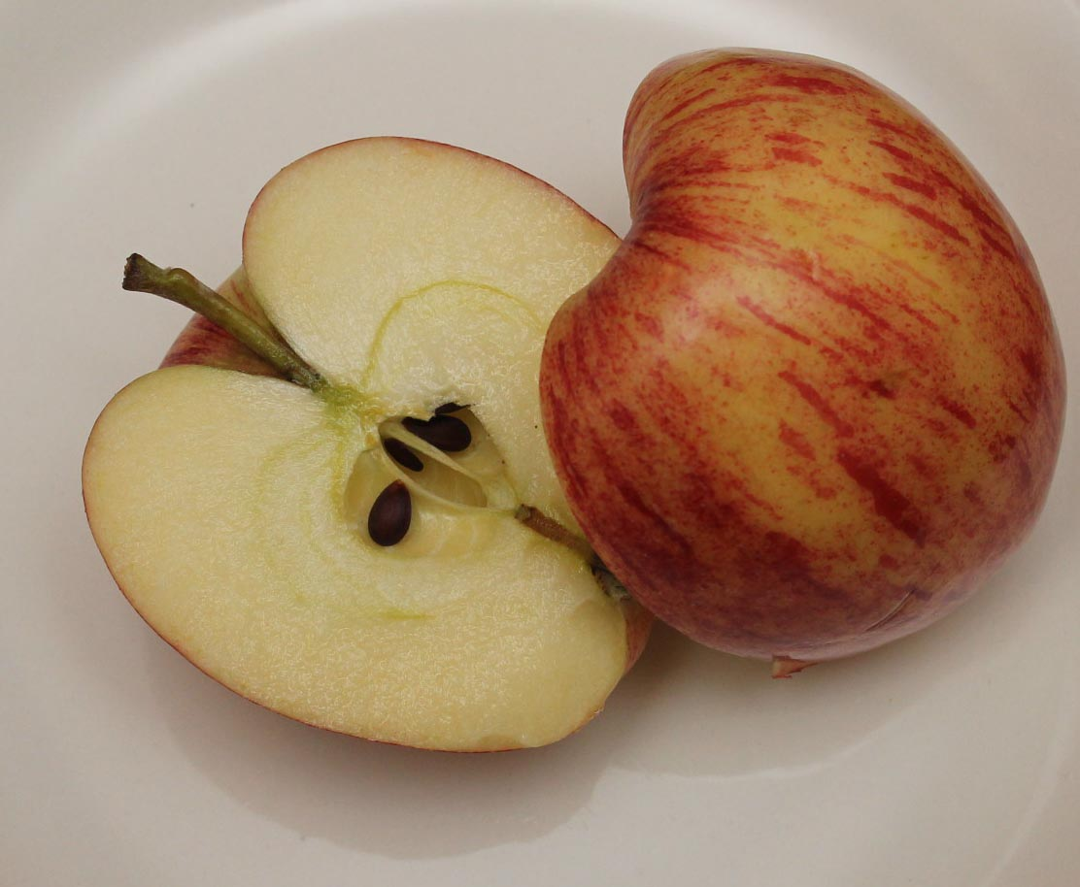
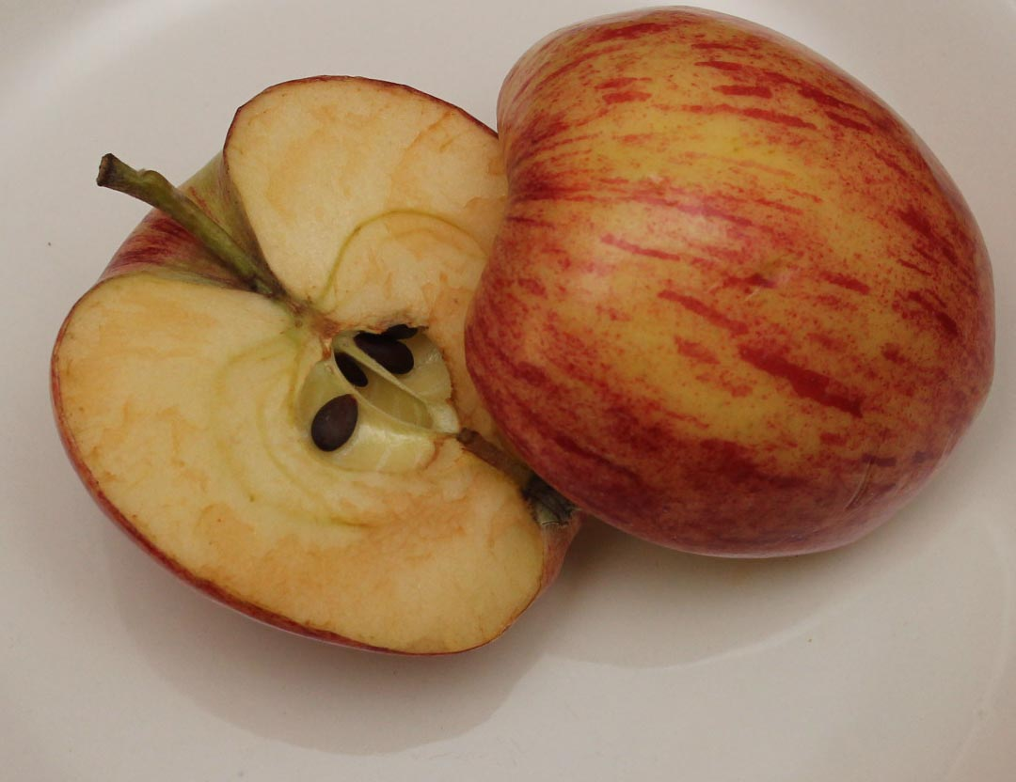
What will happen?
Can it be prevented?
How?
Notes:
We cut a fresh apple and opened a bag of pre-cut (McDonald’s) apples at the same time. What will happen to the different apples? Can this process be prevented? If so, how?

Slide 4
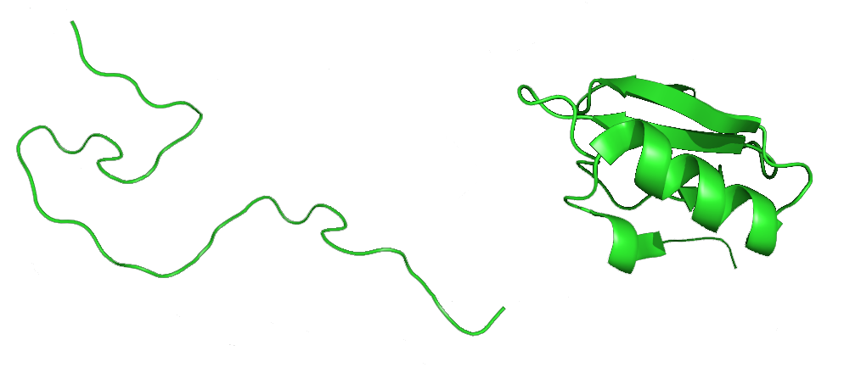
Enzymes are Proteins
DNA → RNA → Protein
Notes:
Proteins are coded by your DNA. They are a sequence of amino acids folded into a 3-D shape that determines its function. Enzymes are different from other proteins because they have an “active site” that allows them to catalyze (speed up) a specific reaction.

Slide 5
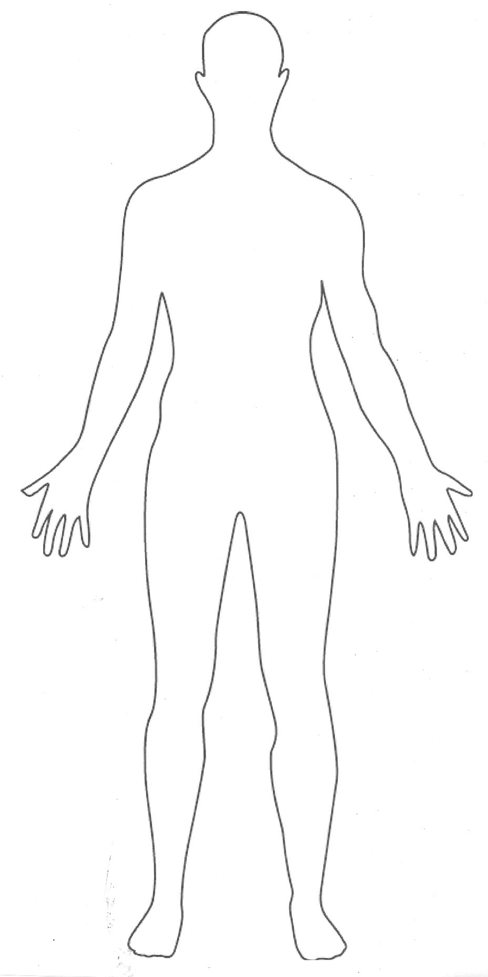
Organisms produce proteins, each having a different function…
Hair and Nails
Hormones
Structural Support
Muscle Contraction
Receptors, membrane channels
Enzymes
Antibodies
Nutrient Storage
Notes:
Have students give examples of human proteins within these categories.
Hair and nails: keratin.
Hormones: insulin, adrenaline.
Structural support: cytoskeletal filaments.
Muscle contraction: actin and myosin.
Enzymes: lactase.
Receptors: acetylcholine receptor.
Antibodies: AgG.
Nutrient storage: amino acids.

Slide 6
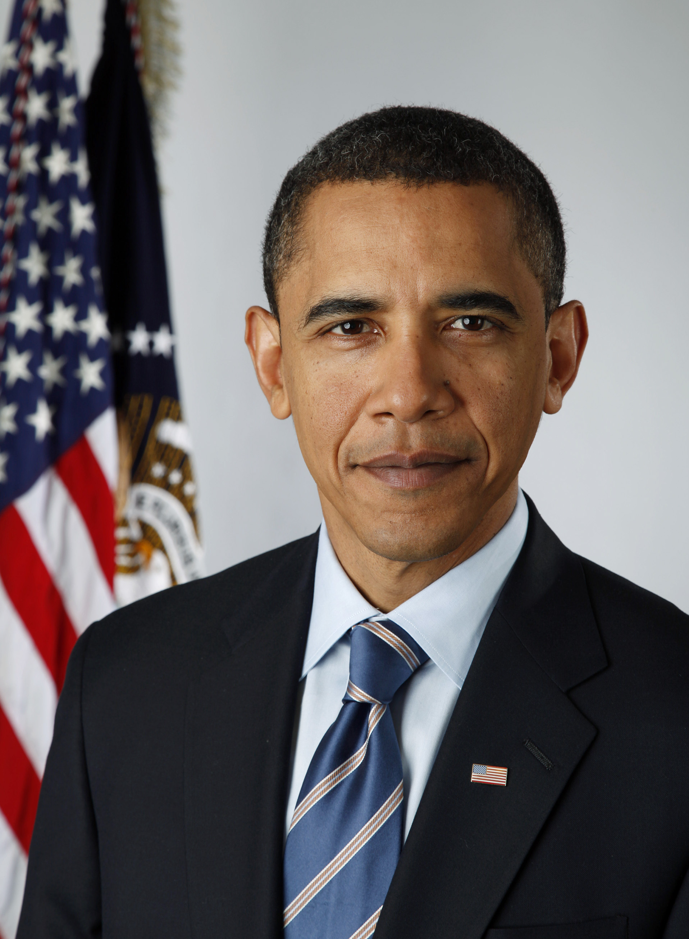
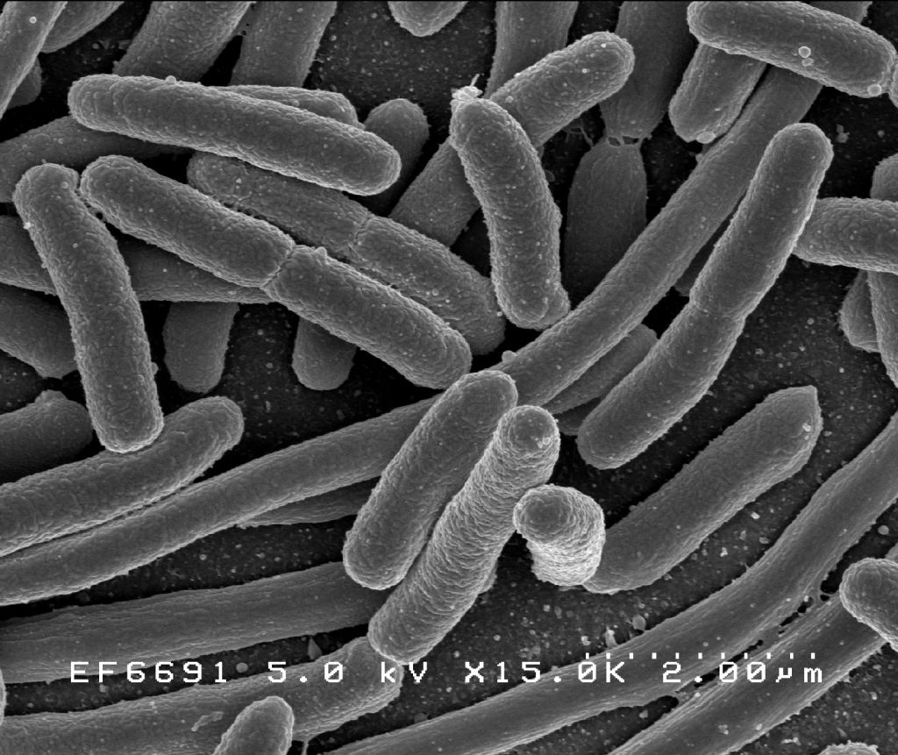
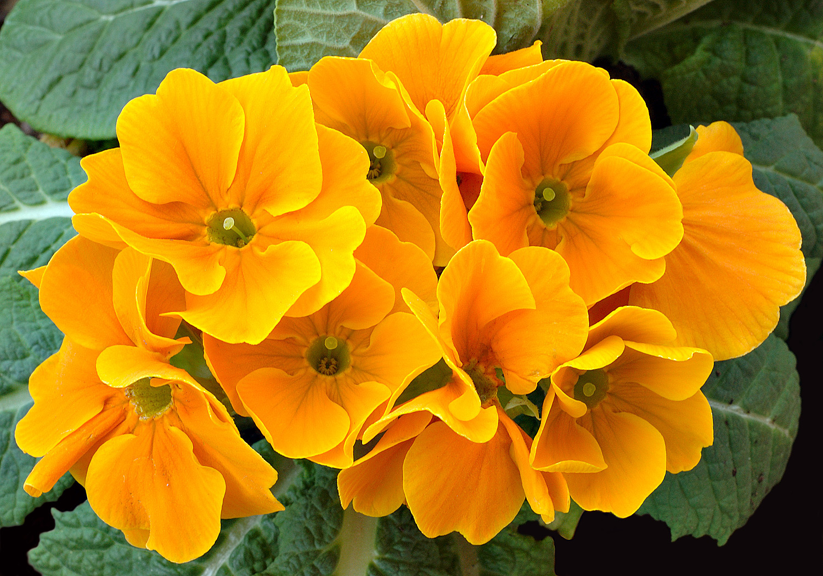
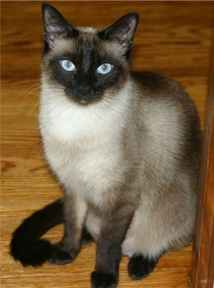
All living things produce enzymes…
Notes:
From bacteria to human beings, every living thing produces and depends on enzymes.
Clockwise from top left: E. coli, primrose, President Obama, a Siamese cat, portabella mushrooms.

Slide 7
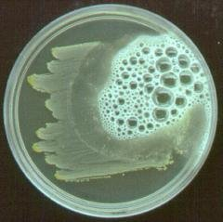
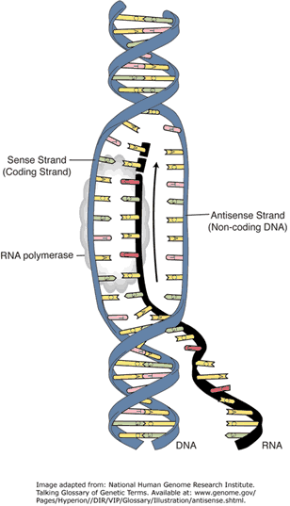
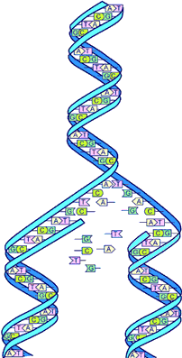
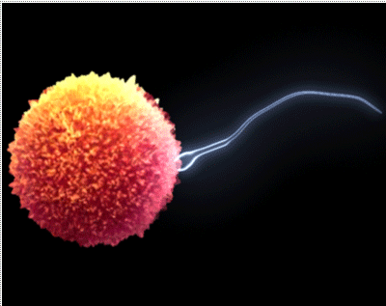
Enzymes in our bodies have special jobs, too.
Metabolism
Digestion
RNA Synthesis
DNA Replication
Reproduction
Notes:
What are some examples of enzymes in these categories?
Metabolism: phosphofructokinase.
Digestion: pepsin, trypsin.
RNA synthesis: RNA polymerase.
DNA replication: DNA polymerase, helicase, ligase.
Reproduction: digestive enzymes that allow sperm to penetrate egg.

Slide 8
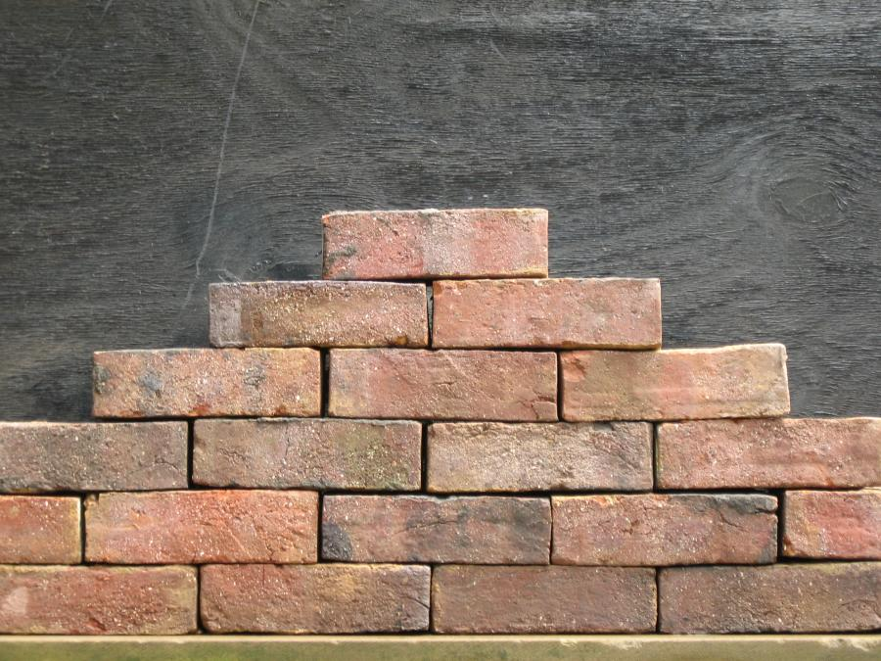
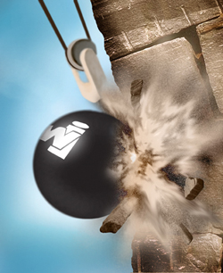
Enzymes are the Construction Workers of the Cell…
Enzymes help
BUILD UP or BREAK DOWN
molecular structures
Notes:
Enzymes are the construction workers of the cell. They build up molecules in anabolic reactions, and break down molecules in catabolic reactions.

Slide 9
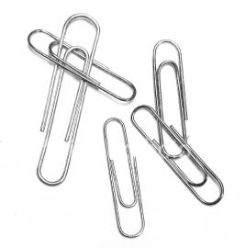
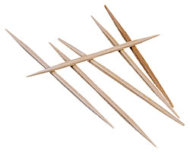
Enzymes are usually named with the suffix –ase added to the name of the substrate or reaction
Inhibitors slow down enzymes!
Paperclipase
Toothpickase
Notes:
Many enzymes end with the suffix –ase. In the student hands-on activity, students act as paperclipase, which attaches two paperclips together, or toothpickase, which breaks a toothpick in half. Students see how many of their specific reaction they can perform in 5 minutes. Then, they repeat the process with their fingers taped together, to see the effects of an inhibitor on enzyme function.

Slide 10
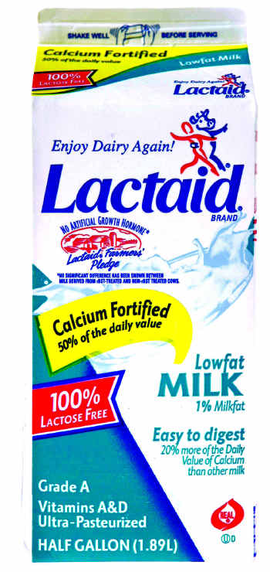
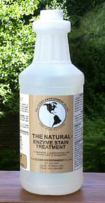
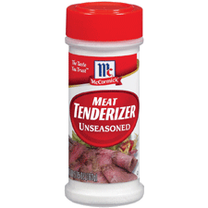
Enzymes in our daily lives:
HYDROLASE
LACTASE
PROTEASE
Notes:
We use many different enzymes in our daily lives. Hydrolase is the active enzyme in Beano. Lactase helps people break down milk sugar (lactose). Proteases are used to treat stains or help tenderize meat.

Slide 11
How do enzymes speed up reactions?
The enzyme creates a favorable environment for the reaction.
Substrate binds enzyme in active site.
Substrate
Active site
Enzyme
Enzymes can be used again and again!
Notes:
Enzymes speed up reactions by creating a favorable environment for the reaction to occur. The substrate binds to the enzyme’s active site, and this puts it in the most favorable conformation to allow the reaction to proceed. The stabilization of the substrate lowers the activation energy of the reaction. Because the enzyme is neither altered nor consumed by the reaction, it can be used over and over again to speed up the same reaction repeatedly.

Slide 12
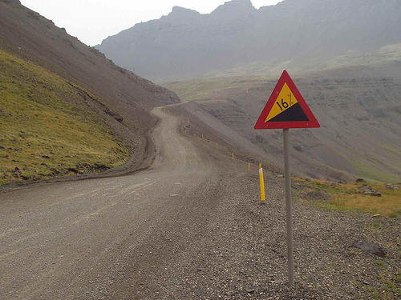
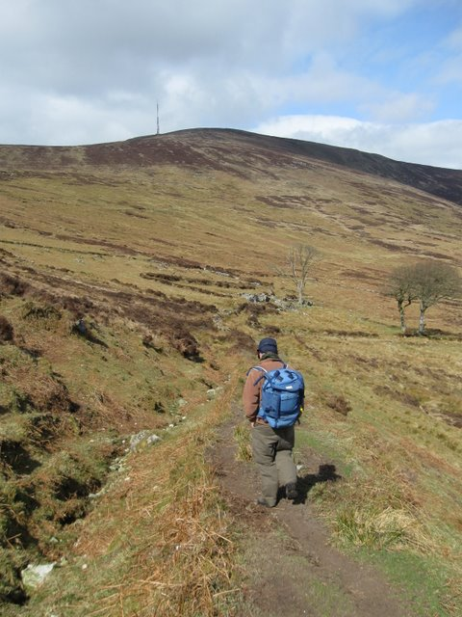
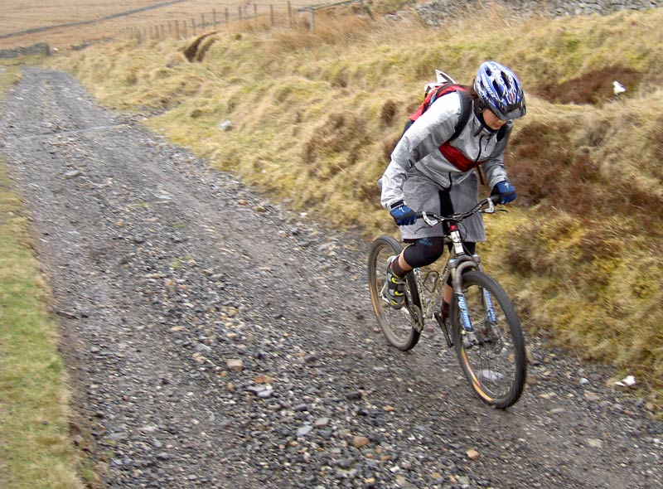
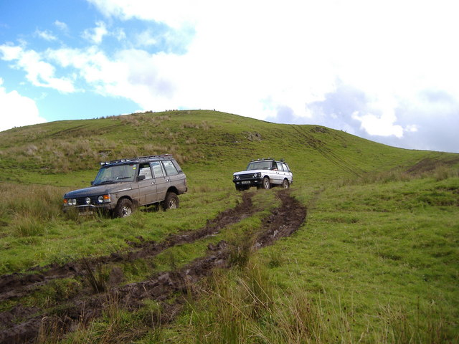
Enzymes “catalyze” reactions
They increase the rate of a chemical reaction by lowering the energy requirement.
Chemical Reaction:
CROSSING A STEEP
MOUNTAIN ROAD
Normal Rate
Weak Catalyst
Strong Catalyst
By FOOT
Time: Days
BIKING
Time: One Day
DRIVING
Time: Hours
Notes:
If we think of crossing a steep mountain road as our chemical reaction, the normal reaction rate (on foot) might take several days. However, riding a bike would only take about a day, and driving a car might take a few hours. The use of human-powered wheels speeds up the reaction rate relative to walking, and the use of an electric motor speeds it up even more.

Slide 13
What happened?
Can it be prevented?
How?
Notes:
So what happened with the apples? The fresh cut apple turned brown, while the pre-cut apples look exactly the same. Why were they different? How were the pre-cut apples prevented from browning? The preservative in McDonald’s apples is ascorbic acid – Vitamin C.

Slide 14
Enzymatic Browning
a series of reactions involving the enzyme tyrosinase
Notes:
Enzymatic browning occurs because of a series of reactions catalyzed by the enzyme tyrosinase. This is the same process that happens to avocado when you make guacomole. Citric acid (from limes, for example) helps to slow the process because it inhibits the enzyme tyrosinase.
How else do we keep foods fresh/last longer? refrigeration (temperature), sealed (oxidation), preservatives, cooking (heat, acid, beating)

Slide 15
Write one thing about enzymes that you can share with family or friends back in the classroom.
Remember to share interesting facts about enzymes with your classmates during the lab!
Notes:
Have students share interesting facts they learned or already know about enzymes. If they don’t know any, we are about to give them some ideas to write down…

Slide 16
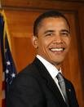
Tyrosinase is produced in
Bacteria • Fungi • Plants • Animals
Notes:
Tyrosinase is produced in many different organisms, including bacteria, fungi, plants, and animals.

Slide 17
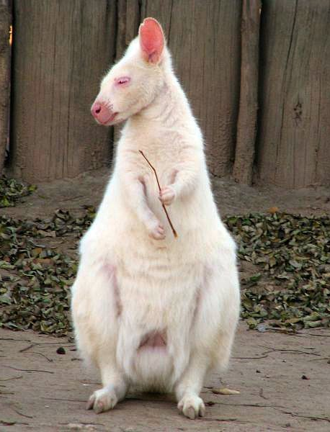
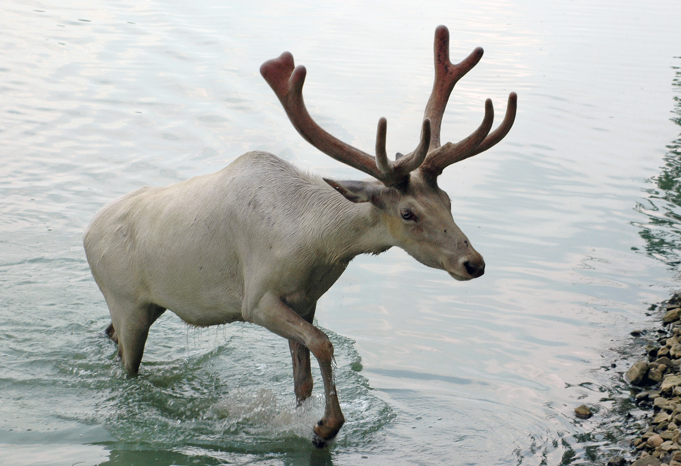
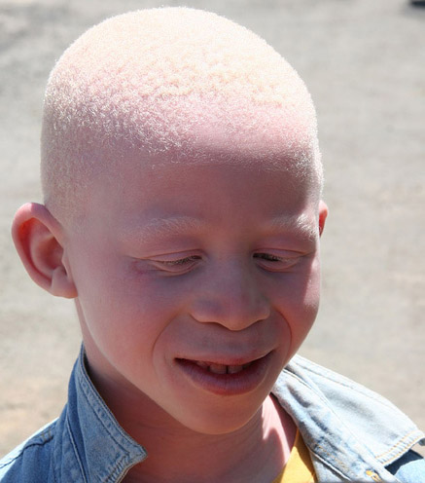
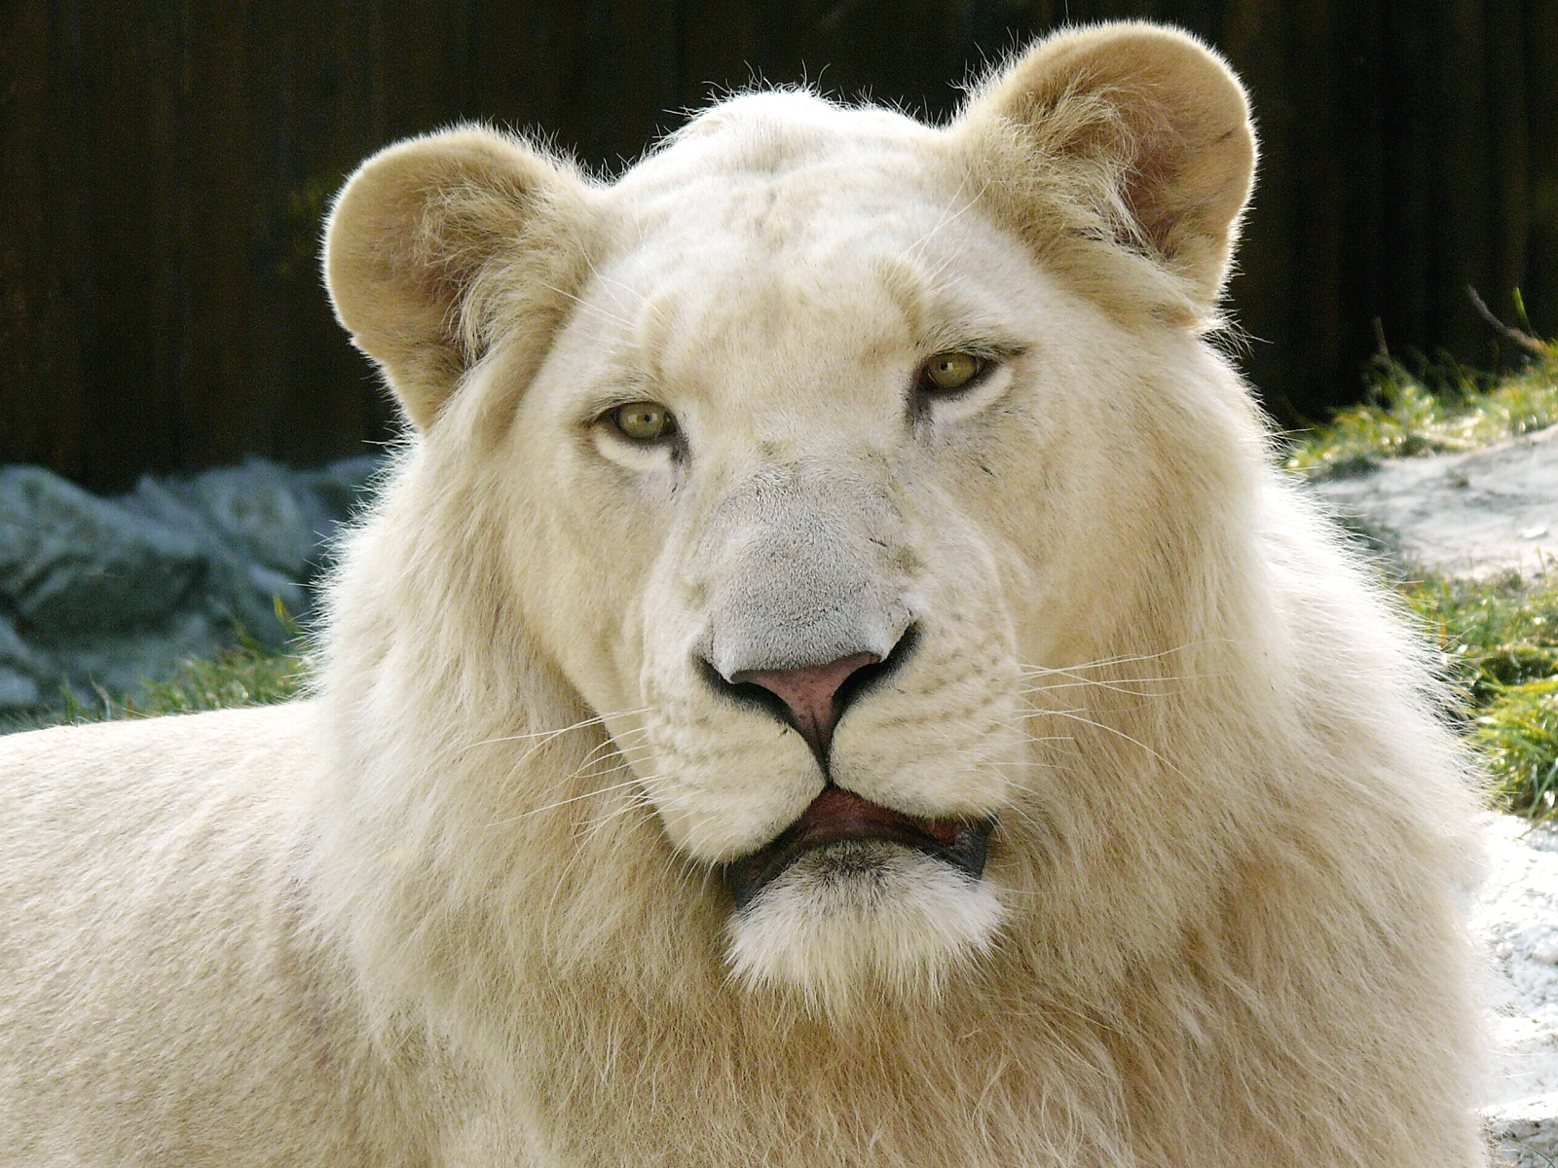
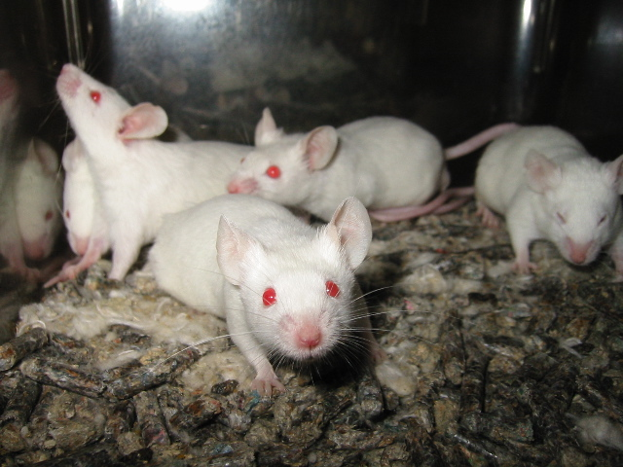
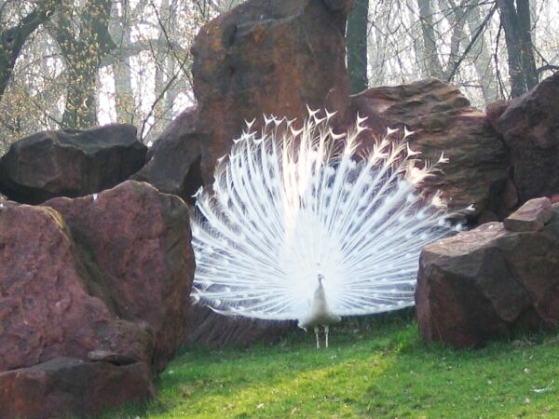
Tyrosinase & Albinism
Notes:
A lack of tyrosinase leads to the inability to make pigments, which causes albinism in animals.

Slide 18
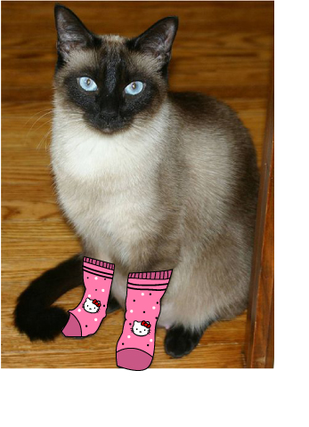
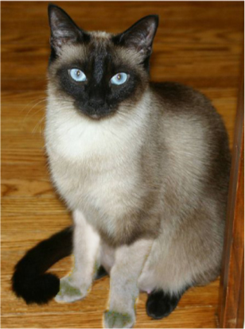
Heat-Sensitive Tyrosinase
Notes:
Tyrosinase is responsible the beginning process of fur pigmentation. In Siamese Cats, tyrosinase is heat sensitive and activates at temperatures slightly lower than body temperature. The areas of the cat that are cooler, which are the extremities (tail, paws, ears, face) are darker because tyrosinase functions better at those cooler temperatures. The warmer parts of the cat (including the back and belly) are lighter because tyrosinase is inhibited by the cat’s body heat. What do you think would happen if we put socks on the cat for several months, allowing the fur on the paws to grow at a warmer temperature?

Slide 19
Mushroom Tyrosinase Lab Protocol Overview
What’s a protocol again?
Notes:
Now we will look at the protocol for the Enzyme/Substrate Reactions lab with tyrosinase. Recall that a protocol is a set of instructions that scientists use to ensure the repeatability of experiments.

Slide 20
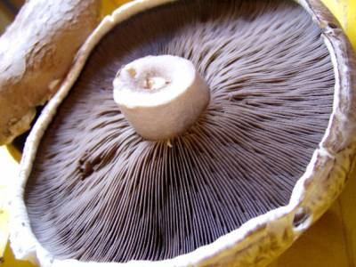
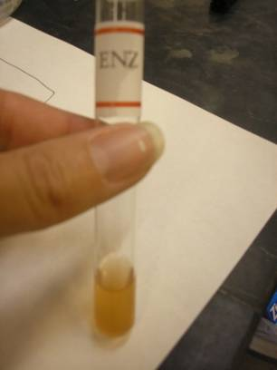
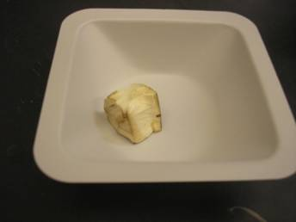
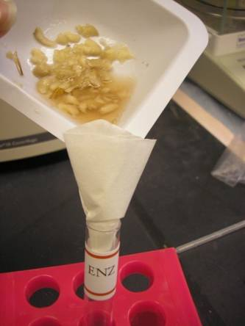
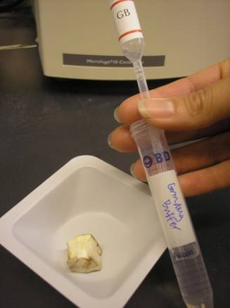
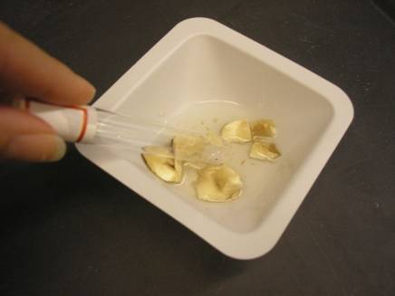
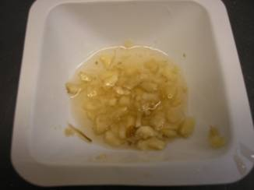
STEP 1: Extract Enzyme
Tyrosinase
Notes:
20
The first part of the procedure is to extract the enzyme from a portabella mushroom. You will take a cube of the white part of the mushroom, add a buffer solution, grind the mushroom piece, and filter out the enzyme from the crushed bits of mushroom. The filtered liquid contains your enzyme, which you broke out of the mushroom cells.

Slide 21
STEP 2: Add Enzyme to Substrate
L-DOPA
Notes:
To get the reaction started, you will add your enzyme to a solution containing its substrate, called L-DOPA.

Slide 22
STEP 3: Measure Product
Enzyme
+
Substrate
=
Product
Tyrosinase + L-DOPA = Dopachrome (pigment)
Notes:
22
Once the reaction begins, you will measure the production of the colored product (dopachrome) over time.

Slide 23
STEP 4: Graph Data Over Time
Amount
of product
Time
Notes:
You will then graph your results.

Slide 24
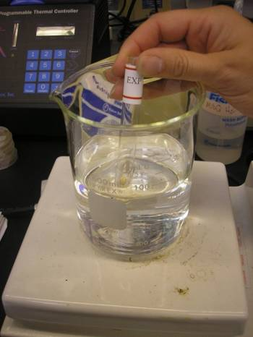
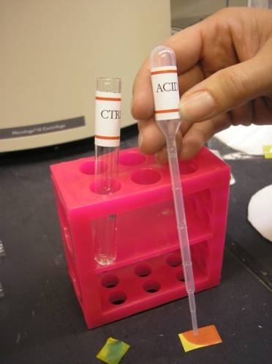
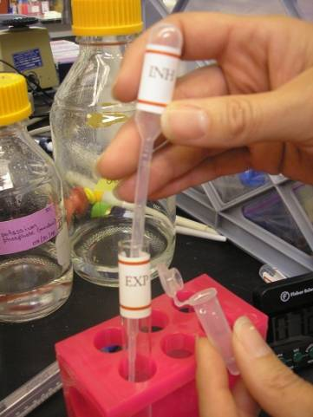
STEP 5: Test Enzyme Activity Under Different Conditions
TEMPERATURE
pH
INHIBITOR
Notes:
24
Finally, you will repeat the experiment with one of three experimental treatments: under acidic (low pH) conditions, under high temperature, or in the presence of an inibitor.

Slide 25
Summary of Protocol
Assign roles
Extract enzyme from mushroom
Add enzyme to substrate
Measure product
Test experimental conditions
- pH
- Temperature
- Inhibitor
Graph data over time
Compare treatments
Notes:
Here is a summary of the protocol. Remember to compare treatments at the end!

Slide 26
What happened?
What did you do in this lab?
Let’s review the steps!

Slide 27
STEP 1: Extract Enzyme
Tyrosinase
Notes:
27

Slide 28
STEP 2: Add Enzyme to Substrate
L-DOPA

Slide 29
STEP 3: Measure Product
Enzyme
+
Substrate
=
Product
Tyrosinase + L-DOPA = Dopachrome (pigment)
Notes:
29

Slide 30
STEP 4: Graph Data Over Time
Amount
of product
Time

Slide 31
STEP 5: Test Enzyme Activity Under Different Conditions
TEMPERATURE
pH
INHIBITOR
Notes:
31

Slide 32
Laboratory Follow-up
Obstacles during the lab
Solutions
Give details! What was hard and why?
How can we make this lab easier to understand?
Now it’s time for your proposals!

