Slide 1
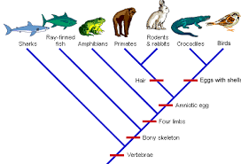
Chapter 20
Phylogeny and the
Tree of Life
Notes:
Figure 18.1 What regulates the precise pattern of expression of different genes?

Slide 2
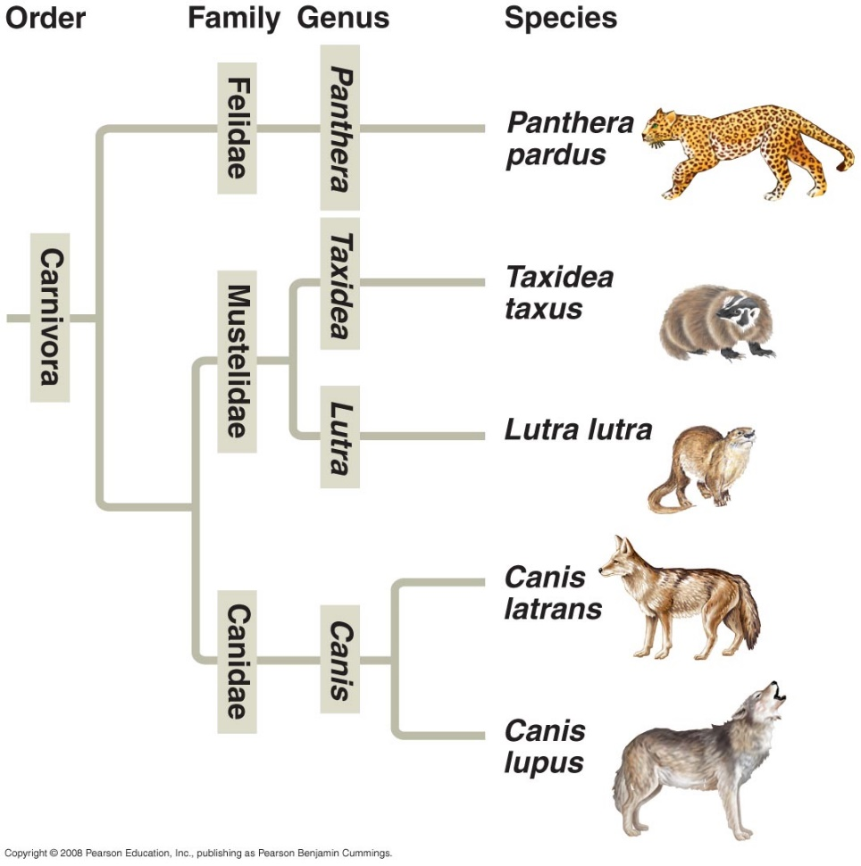
Overview: Investigating the Tree of Life
Evolutionary theory is so important to modern biology that it is how biologist organize the modern world
Phylogeny is the evolutionary history of a species or group of related species usually organized into a phylogenetic tree
Phylogenetic trees and cladograms (also tree shaped) seek to arrange organisms based on common ancestry

Slide 3
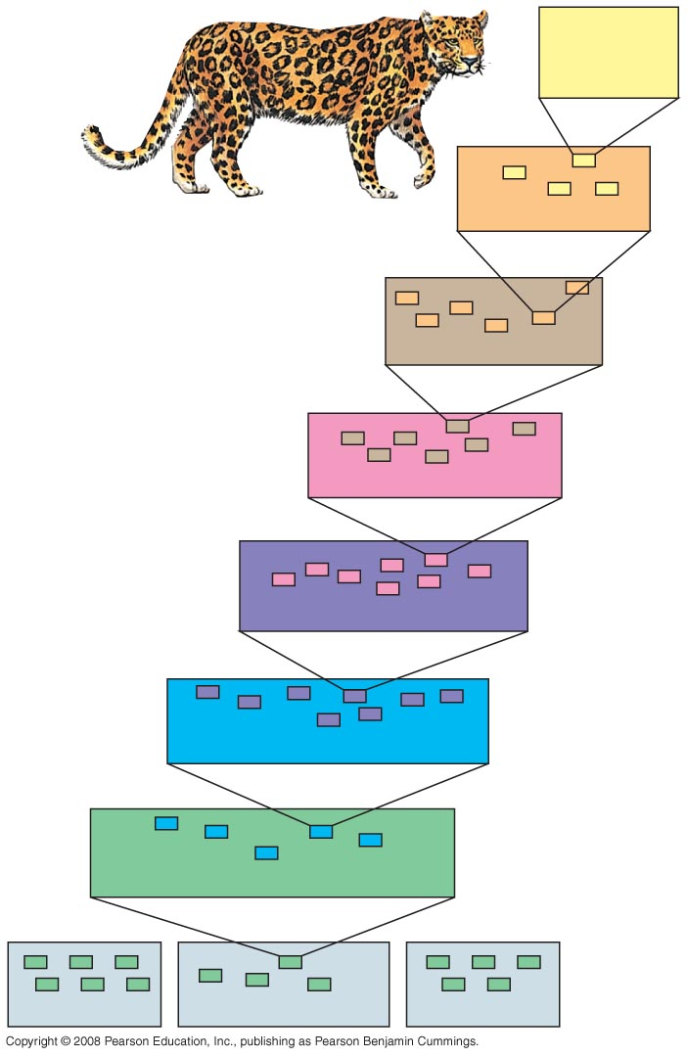
Binomial Nomenclature
The old way of classifying organisms
In the 18th century, Carolus Linnaeus published a system of taxonomy based on resemblances
Two key features of his system remain useful today: two-part names for species (e.g. Panthera pardus) and hierarchical classification
King Phillip Came Over For Good Soup
Domain

Slide 4
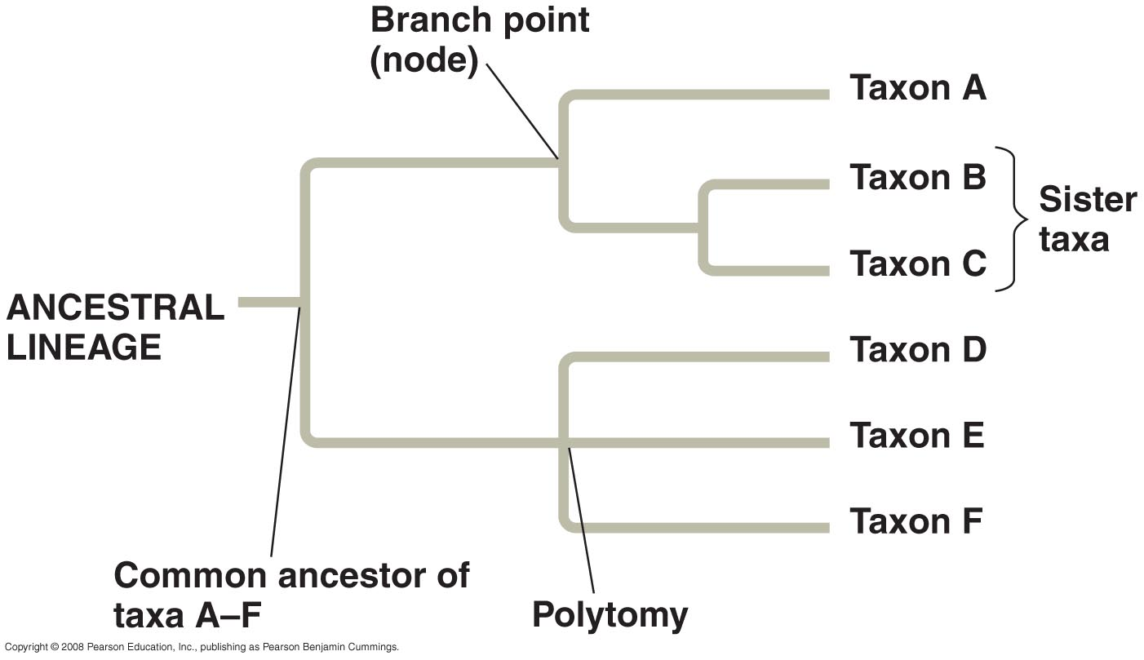
Phylogenetic Trees and Cladograms
Keep in mind phylogenetic trees and cladograms represent a hypothesis about evolutionary relationships and are ever-changing based on new evidence
Each branch point represents the divergence of two species
Sister taxa are groups that share an immediate common ancestor
A rooted tree includes a branch to represent the last common ancestor of all taxa in the tree
A polytomy is a branch from which more than two groups emerge

Slide 5
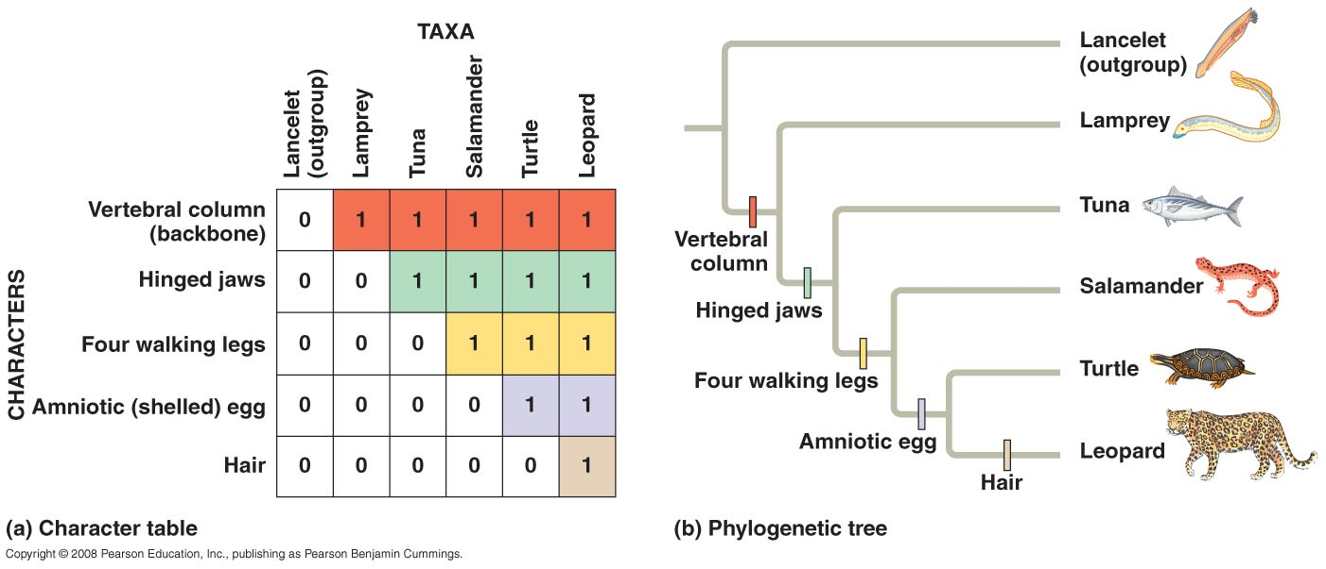
What We Can and Cannot Learn from Phylogenetic Trees
Phylogenetic trees do show patterns of descent
Phylogenetic trees do not indicate when species evolved or how much genetic change occurred in a lineage
It shouldn’t be assumed that a taxon evolved from the taxon next to it

Slide 6
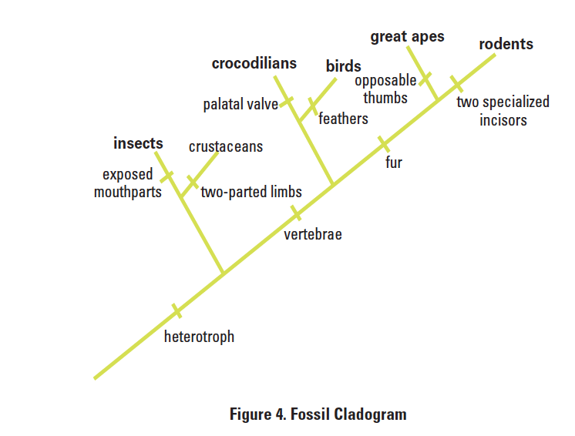
What is the difference between a phylogenetic tree and a cladogram
Many biologists use these terms interchangeably
Both are based on ancestral relationships
Some scientists associate phylogenetic trees with true evolutionary history
Some scientists consider cladograms to represent hypotheses about a group of organisms’ ancestry

Slide 7
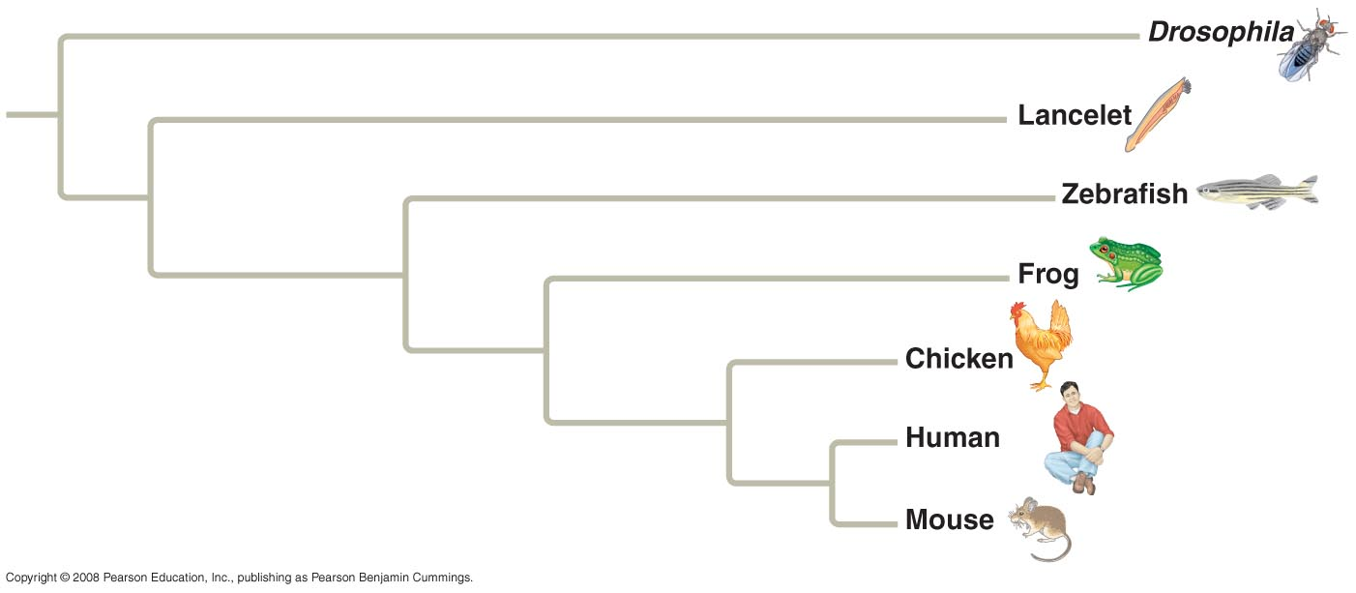
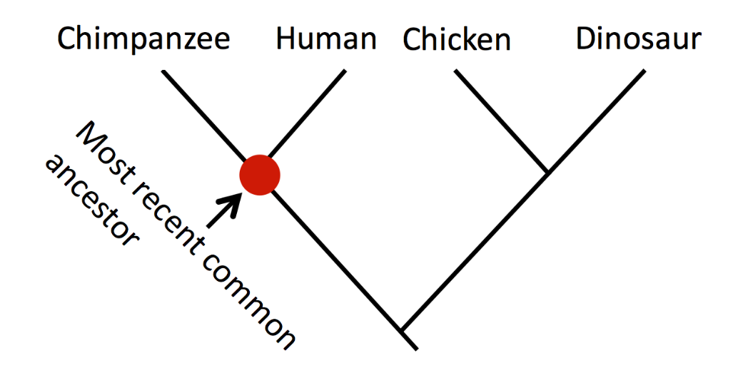
What is the difference between a phylogenetic tree and a cladogram?
Phylogenetic tree – branch length based on relative genetic change in each lineage
In phylogenetic trees branch lengths can represent the amount of genetic change or are proportional to time
In cladograms the branch lengths are usually considered to be arbitrary
Cladogram

Slide 8
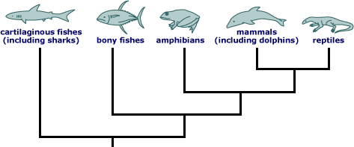
What evidence are phylogenetic trees and cladograms based on?
Morphologies, genes, and biochemistry of living organisms
Organisms with similar morphologies or DNA sequences are likely to be more closely related
Must distinguish whether a similarity is the result of homology or analogy
Homology is similarity due to shared ancestry
Analogy is similarity due to convergent evolution (shark/dolphin)

Slide 9
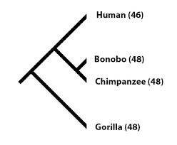
How to Read Cladograms
Look at the cladogram at the
right. What conclusions can be
drawn about the relationship
between humans and chimps?

Slide 10
How to read a cladogram
This diagram shows a relationship between 4 relatives. These relatives share a common ancestor at the root of the tree.
Note that this diagram is also a timeline. The older organism is at the bottom of the tree.
The four descendants at the top of the tree are DIFFERENT species. This is called SPECIATION.

Slide 11
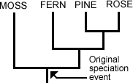
How to read a cladogram
Branches on the tree represent speciation
The event that caused speciation is shown as a fork on the tree.

Slide 12
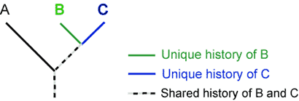
How to read a cladogram
Species B and C each
have characteristics
that are unique only to
them.
• But they also share
some part of their
history with species A.
This shared history is
the common ancestor.

Slide 13
How to read a cladogram
Write a sentence that summarizes the relationship between A and B. What is the only thing A and B have in common?

Slide 14
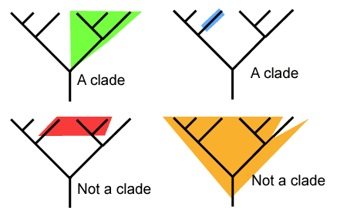
How to read a cladogram
A CLADE places species into groups that includes an ancestral species and all of its descendants.
If you cut a branch of the tree you could remove all the organisms that make up a clade

Slide 15
Check your understanding:
Consider the original diagram.
Did humans evolve from chimps?
How would you describe the chimp side of our family?
Are humans more highly evolved than chimpanzees?
Cladogram Digital Practice

Slide 16
