Slide 1
Nervous System: Part IV
The Central Nervous System
The Brain

Slide 2
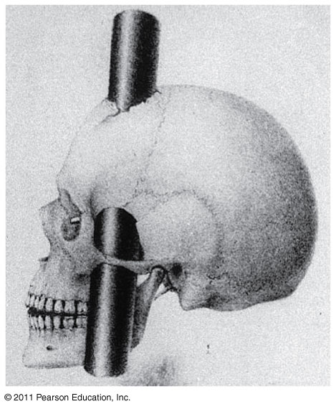
Can you survive when part of your brain is destroyed?
Notes:
Now that you have their attention, explain this drawing to students.
Phineas P. Gage (1823–1860)^{[B]} was an American railroad construction foreman now remembered for his improbable^{[C]} survival of an accident in which a large iron rod was driven completely through his head, destroying much of his brain's left frontal lobe, and for that injury's reported effects on his personality and behavior, effects so profound—for a time, at least—that friends saw him as "no longer Gage"

Slide 3
2. Cells communicate with each other through direct contact with other cells or from a distance via chemical signaling.
Essential Knowledge 3.D.2
Notes:
Neurotransmitters act as chemical signals

Slide 4
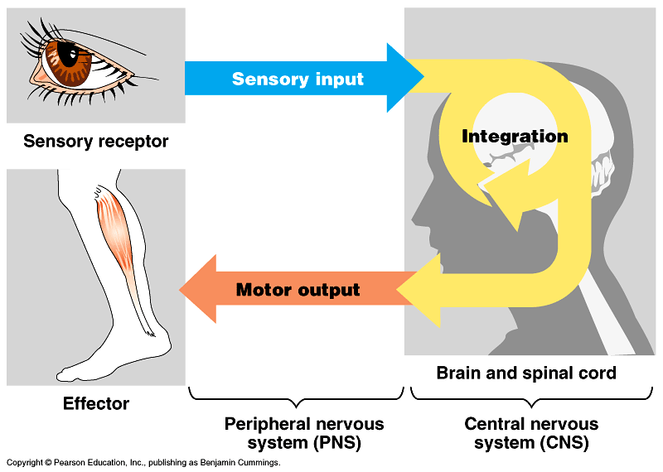
Notes:
Review the primary functions of the nervous system pointing out that today we will be focusing on the structures associated with the processing of the input.

Slide 5
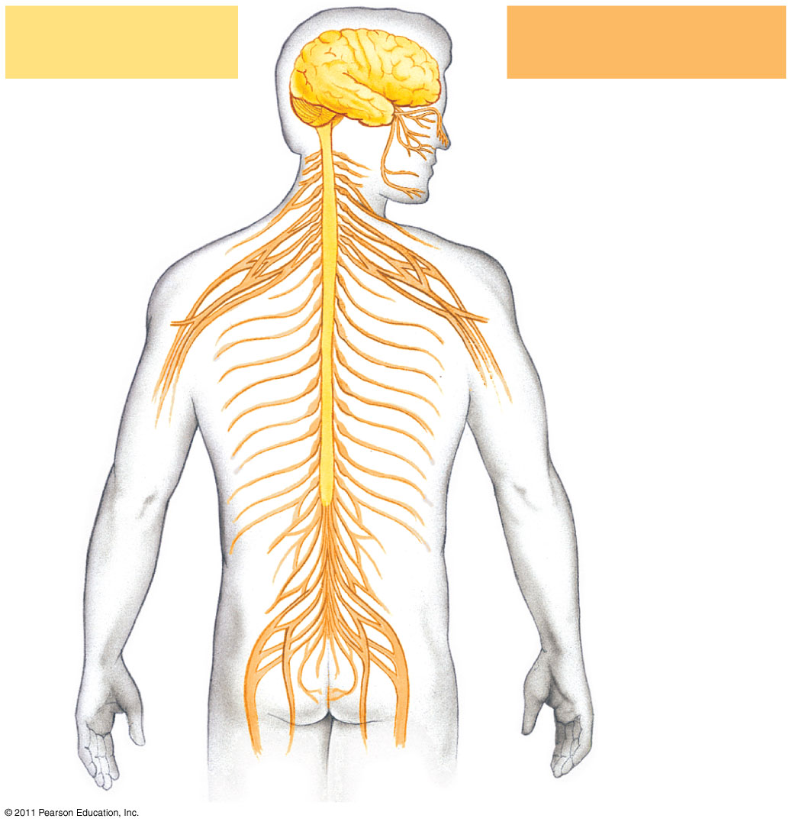
Central nervous system (CNS)
Peripheral nervous system (PNS)
Brain
Cranial nerves
Spinal cord
Ganglia outside CNS
Spinal nerves
Notes:
The vertebrate nervous system.

Slide 6
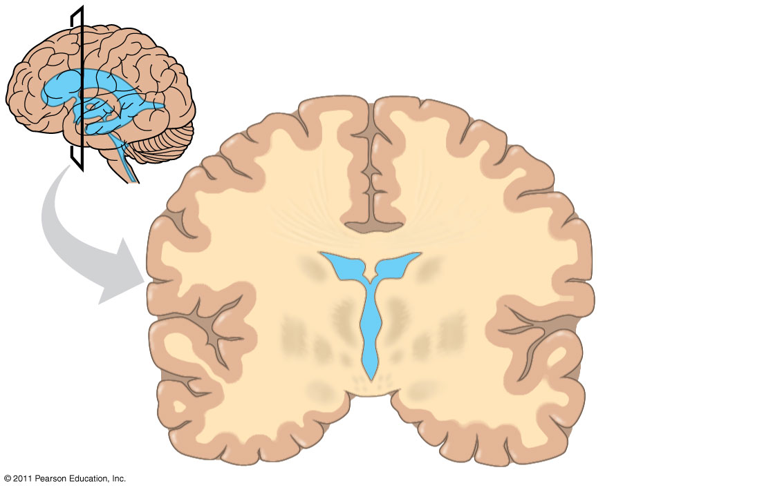
What accounts for the difference between white and gray matter?
Gray matter
White matter
Ventricles
Notes:
Point out the ventricles, gray matter, and white matter. Emphasize that the gray matter is made of unmyelinated neurons while the white matter contains myelinated neurons.
More than students need to know, but just in case you are asked…White matter, long thought to be passive tissue, actively affects how the brain learns and dysfunctions. Whilst grey matter is primarily associated with processing and cognition, white matter modulates the distribution of action potentials, acting as a relay and coordinating communication between different brain regions. http://en.wikipedia.org/wiki/White_matter

Slide 7
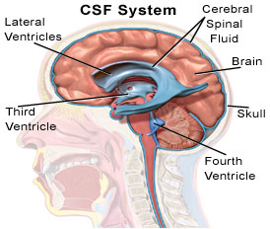
Cerebrospinal Fluid
The central canal of the spinal cord and the ventricles of the brain are hollow and filled with cerebrospinal fluid
The cerebrospinal fluid is filtered from blood and functions to cushion the brain and spinal cord as well as to provide nutrients and remove wastes

Slide 8
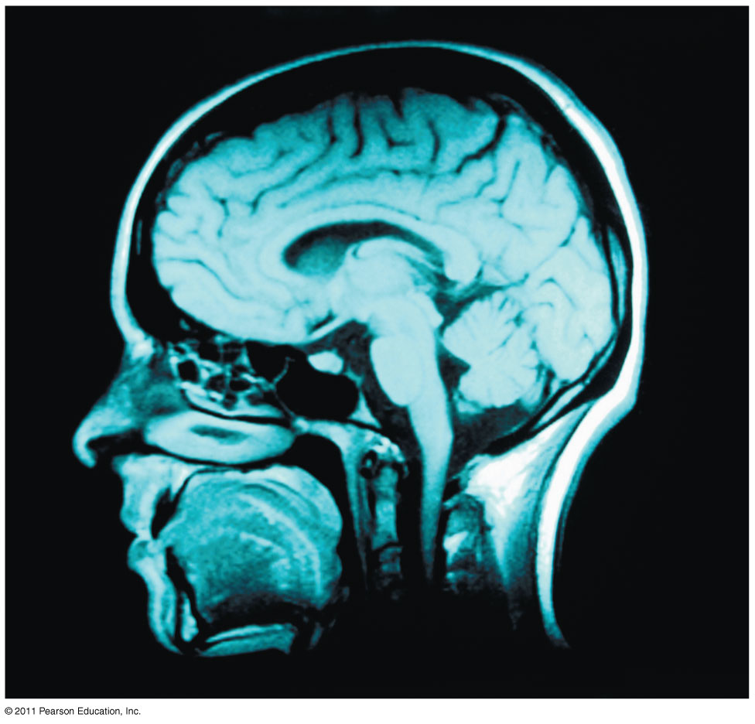
The Vertebrate Brain Is Regionally Specialized
Specific brain structures are particularly specialized for diverse functions
These structures arise during embryonic development

Slide 9
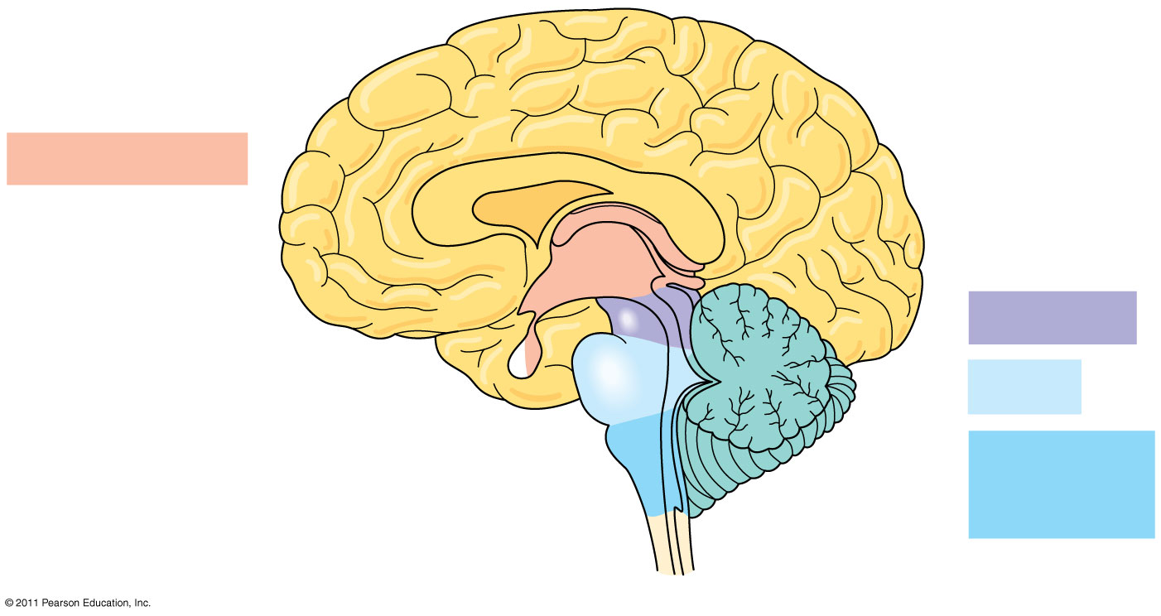
Diencephalon
Thalamus
Pineal gland
Brainstem
Hypothalamus
Midbrain
Pituitary gland
Pons
Medulla oblongata
Spinal cord

Slide 10
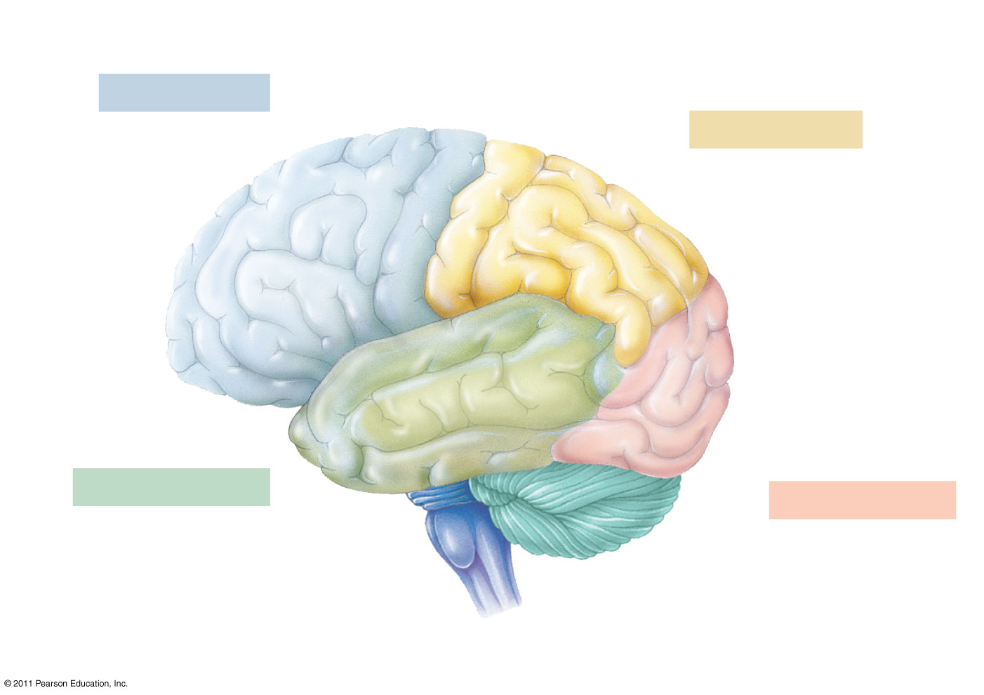
Motor cortex (control of skeletal muscles)
Somatosensory cortex (sense of touch)
Frontal lobe
Parietal lobe
Prefrontal cortex (decision making, planning)
Sensory association cortex (integration of sensory information)
Visual association cortex (combining images and object recognition)
Broca’s area (forming speech)
Temporal lobe
Occipital lobe
Auditory cortex (hearing)
Visual cortex (processing visual stimuli and pattern recognition)
Cerebellum
Wernicke’s area (comprehending language)

Slide 11
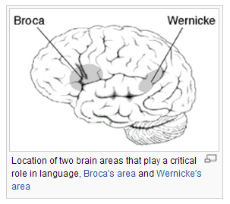
Language and Speech
Studies of brain activity have mapped areas responsible for language and speech
Broca’s area in the frontal lobe is active when speech is generated
Wernicke’s area in the temporal lobe is active when speech is heard
These areas belong to a larger network of regions involved in language
Notes:
Just interesting: The first language area within the left hemisphere to be discovered is Broca's area, named after Paul Broca, who discovered the area while studying patients with a language disorder. Broca's area doesn't just handle getting language out in a motor sense, though. It seems to be more generally involved in the ability to process grammar itself, at least the more complex aspects of grammar. For example, it handles distinguishing a sentence in passive form from a simpler subject-verb-object sentence — the difference between "The girl was hit by the boy" and "The boy hit the girl.“
The second language area to be discovered is called Wernicke's area, after Carl Wernicke, a German neurologist who discovered the area while studying patients who had similar symptoms to Broca's area patients but damage to a different part of their brain. These people had damage to an area of the brain that affected speech comprehension called receptive aphasia. People with receptive aphasia also have difficulty recalling the names of objects, often responding with words that sound similar, or the names of related things, as if they are having a hard time recalling word associations.

Slide 12
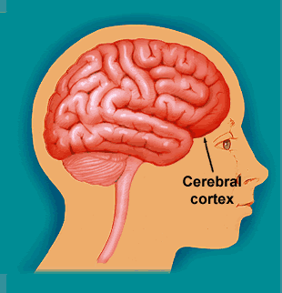
Information Processing
The cerebral cortex receives input from sensory organs and somatosensory receptors
Somatosensory receptors provide information about touch, pain, pressure, temperature, and the position of muscles and limbs
The thalamus directs different types of input to distinct locations

Slide 13
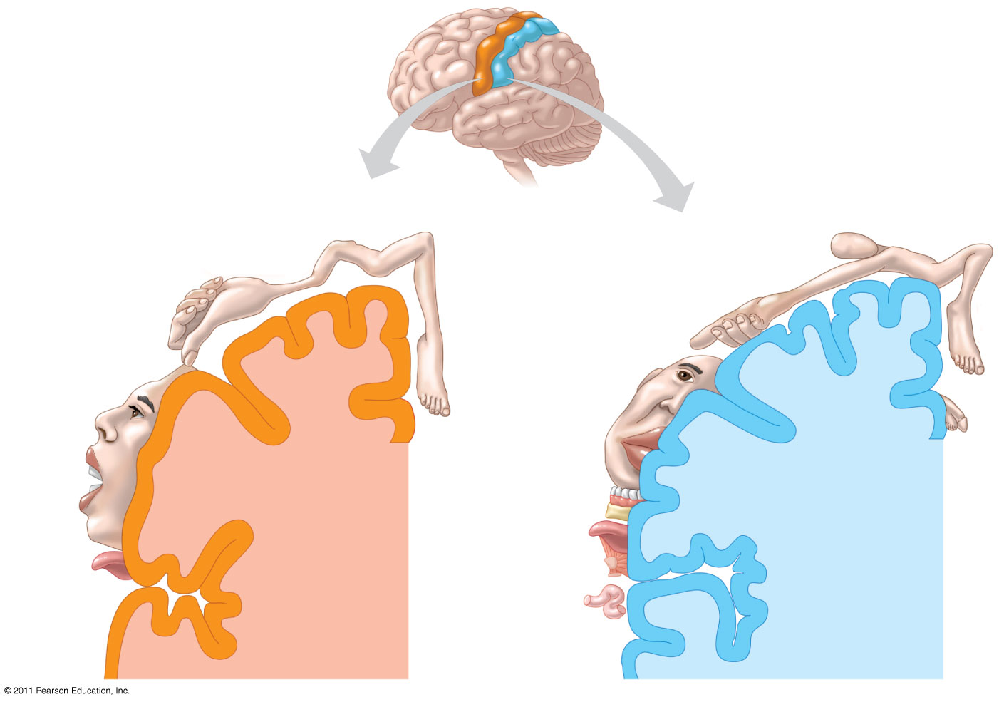
Frontal lobe
Parietal lobe
Shoulder
Upper arm
Trunk
Elbow
Trunk
Head
Forearm
Knee
Neck
Hip
Leg
Hand
Wrist
Hip
Elbow
Forearm
Fingers
Hand
Thumb
Fingers
Thumb
Neck
Eye
Brow
Nose
Eye
Face
Face
Toes
Lips
Genitalia
Teeth
Lips
Gums
Jaw
Jaw
Tongue
Tongue
Pharynx
Primary motor cortex
Primary somatosensory cortex
Abdominal organs
Notes:
Body part representation in the primary motor and primary somatosensory cortices.

Slide 14
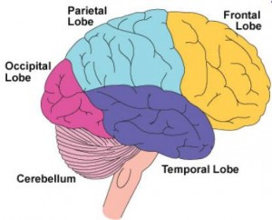
Frontal Lobe Function
Frontal lobe damage may impair decision making and emotional responses but leave intellect and memory intact
The frontal lobes have a substantial effect on “executive functions” of thinking making decisions.

