Slide 1
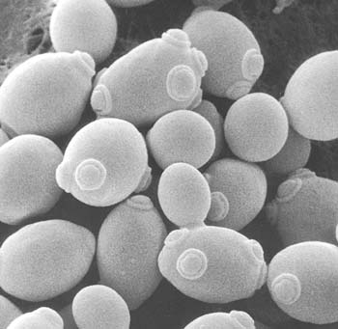
Cell Communication

Slide 2
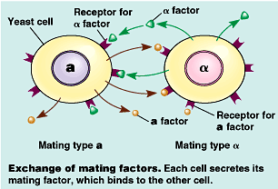
Communication Between Cells
Yeast Cells Signaling
Two mating types
α cells have receptor sites for the a factor and also produce α factor
a cells have receptor sites for the α factor and also produce the a factor.
When mating factors are exchanged, it causes the two cells to fuse and meiosis to occur.
Notes:
Cell-to-cell signaling is important to both multicellular and unicellular organisms. It helps to coordinate the activities and events necessary for a multicellular organism to develop from a zygote into a mature organism with trillions of cells. In unicellular organisms signaling is important in finding different mating types for sexual reproduction.
Yeast cells have two distinct mating types- “a cells” and “alpha cells”. “a type cells” secrete a chemical called “a factor” and called “ αλπηα factor”. The both of these cells have receptor sites for each other’s factors.

Slide 3
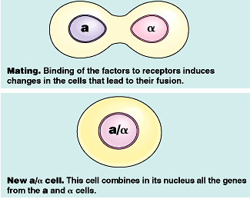
Communication Evolved Early
When mating factors are exchanged, it causes the two cells to fuse and meiosis to occur.
Notes:
Once each cell receives the other mating factors, these mating factors cause the cells to grow toward one another and bring about other changes. Inside the cells there are a series of chemical changes that cause the response. This series of chemical events that occur is called the signal-transduction pathway. The new a/alpha cell has all the genes from both the different haploid yeast cells. These pathways are common to both humans and yeast cells suggesting that this strategy evolved very early on.

Slide 4
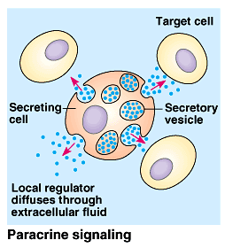
Local Communication
Local signaling
Paracine signaling involves a cell secreting a chemical that induces the differentiation or behavior of nearby target cells. A cell may release a growth factor that may cause surrounding cells to grow and multiply.
Notes:
Communication between cells can occur between cells that are very close to one another (local, or paracrine, signaling) or between cells that are some distance away (e.g. hormonal and pheromone) signaling.

Slide 5
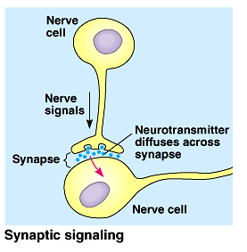
Neurons Communication
Neurons secrete neurotransmitters that diffuse across an intercellular space (synapse) and interact with another neuron.
Notes:
Note-
Local signaling in plants is not as well understood because of the plant cell wall, plants must use different mechanisms than those operating in animals.

Slide 6
Communication through Direct Contact
Direct contact can occur between cells that have cell junctions. These junctions allow direct contact between the cytoplasm of adjacent cells.
Notes:
Cellular junctions allows for signaling substances in the cytosol to pass feely between the adjacent cells. Animal cells can also communicate via direct contact between molecules on the surface of their cell membranes. This is common in embryonic development and the immune system (secretion of interleukin when macrophage and virgin-T cell make a match).

Slide 7
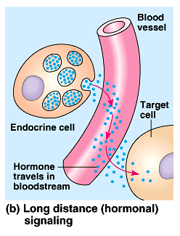
Long Distance Signaling
Long distance signaling
This involves the use of hormones. Animals release hormones into the circulatory system. The hormones travel to target cells. Plants release hormones that travel in their transport system or diffuse into the air as a gas.
Notes:
A hormone is a chemical secreted by one cell but exerts its effect on another cell(s) some distance away. Hormones may vary in their size and molecular structure.
Another example of long distance communication: Pheromones are chemicals secreted by one animal to affect the behavior of another animal.

Slide 8
Types of Hormones
Types of Animal Hormones
Steroid Hormones- For example, testosterone and estrogen
Modified amino acids- For example, thyroxine is a hormone modified from the amino acid tyrosine
Proteins-For example, insulin is a large protein.

Slide 9
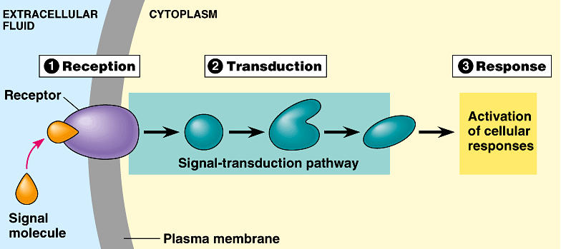
Stages of Cell Signaling
The three stages of cell signaling are:
Reception
Transduction
Response

Slide 10
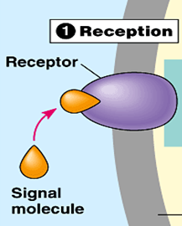
Reception
Reception- Begins with the signal (non-steroid) interacting with a receptor site located on the outside surface of the plasma membrane. The non-steroid signals never enter the cell. When the signal attaches to the receptor, it will cause a change in the shape of the receptor site. Receptors are usually proteins inserted into the plasma membrane.
Notes:
A ligand is a signal triggering molecule that binds to a site on a target protein. Ligands tend to be small molecules.
***Note-- ligands in cell communication can be hormones, neurotransmitters, growth factor or some other small molecule that can attach to the receptor site.

Slide 11
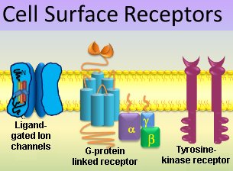
Types of Membrane Receptors
Three major types of membrane receptors are
G-protein linked receptors
Tyrosine-kinase receptors
Ligand-gated ion channels

Slide 12
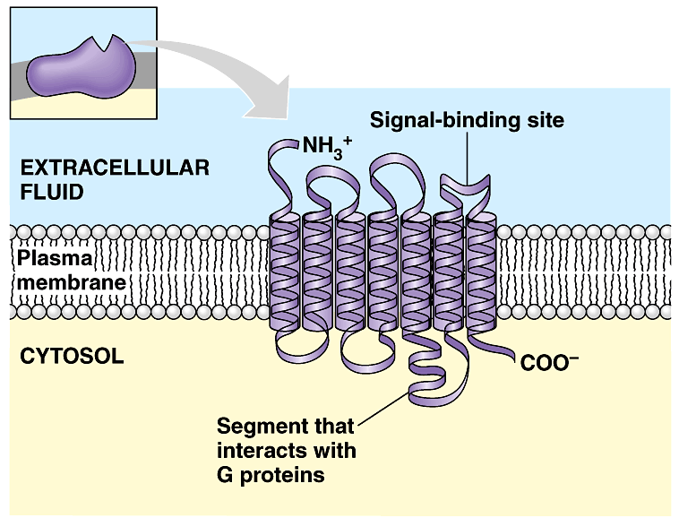
G protein-linked Receptors
G-protein linked receptors vary in their binding sites and recognize and activate different G proteins.
G-proteins are also found in the plasma membrane.
Notes:
Most have seven alpha helices penetrating the plasma membrane. When a G-protein-linked receptor binds with a signal or ligand, it becomes activated and interacts with a G-protein.
Yeast mating factors, epinephrine, neurotransmitters and other hormones use G-protein-linked receptors.
G-proteins are activated when the G-protein linked receptors cause GTP to replace GDP on the G-protein.

Slide 13
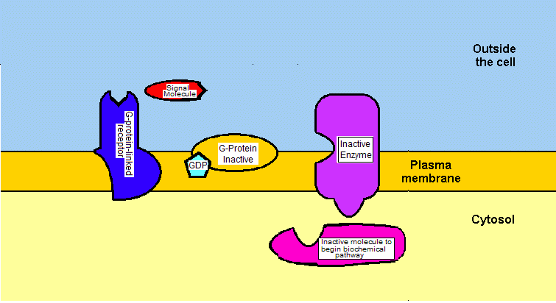
G protein-linked Receptors
Notes:
The activated G-protein now moves laterally to interact with a given enzyme also located in the plasma membrane which causes a certain biochemical pathway to be activated. Once this occurs, the G-protein cleaves a phosphate group from GTP and makes it GDP and thus the G-protein becomes inactivated. These biochemical pathways include developmental pathways, sensory perception in vision and smell.
Bacteria will often cause disease by secreting toxins. These toxins may interfere with G-protein functions. It is estimated that 60% of all medicines exert their effect by influencing G-protein pathways.
Cholera, pertussis (whooping cough) and botulism are examples of bacterial diseases that interfere with G-protein pathways.

Slide 14
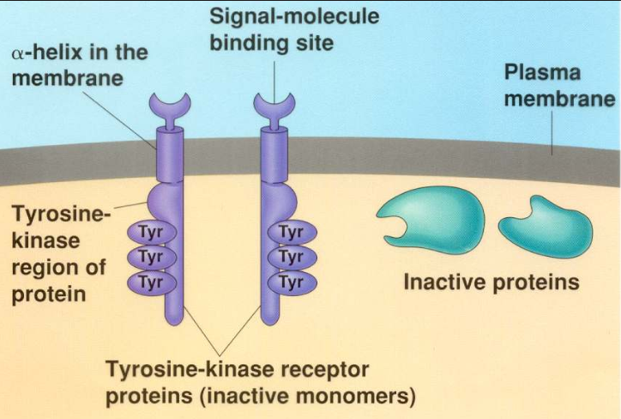
Tyrosine-kinase Receptor
Tyrosine-kinase receptors can activate more than one signal-transduction pathway at one time. This is important when an event like cell reproduction requires multiple pathways to be activated.
Notes:
Notes
The tyrosine-kinase receptor in the inactive form is composed of two separate polypeptide chains forming alpha helices that span the membrane. Inside the cell, the two polypeptides have tyrosines (an amino acid) on the “tails” that extend into the cytoplasm. These “tails” have receptor sites for a signals or ligands. Once both receptors are activated, the polypeptides move toward one another and bond with one another forming a dimer.

Slide 15
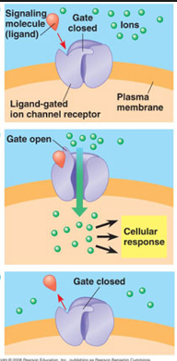
Ligand-gated Channels
Ligand-gated ion channels are protein pores in a membrane that open or close in response to a chemical signal. This will allow or prevent the flow of ions into or out of the cell (or organelles).
Notes:
Examples include Na⁺ or Ca++ channels. Once the signal attaches to the gated channel, the protein changes shape and a pore opens or closes. This allows for an immediate change in the concentration of ions.

Slide 16
Cyclic AMP
cAMP is a derivative of ATP. An enzyme, adenylyl cyclase found in the plasma membrane, coverts ATP into cAMP.

Slide 17
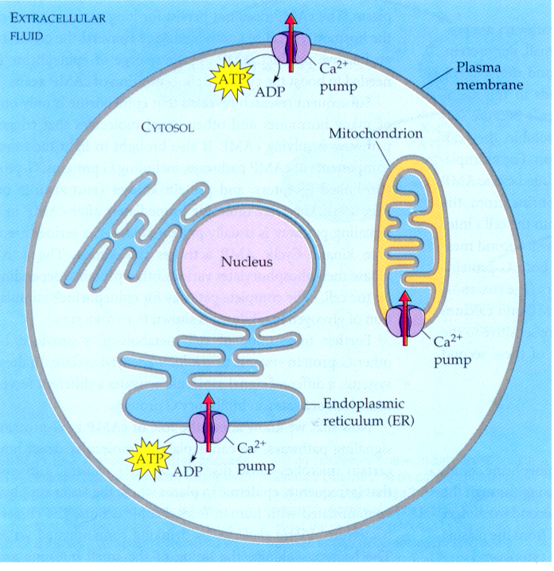
Calcium Ions Removed from the Cytosol
Most of the time Ca⁺⁺ in the cytosol is low because it is pumped into the E.R., the mitochondria and also pumped outside of the cell.
When Ca⁺⁺ ions flood the cytosol,they can be used as second messenger.

Slide 18
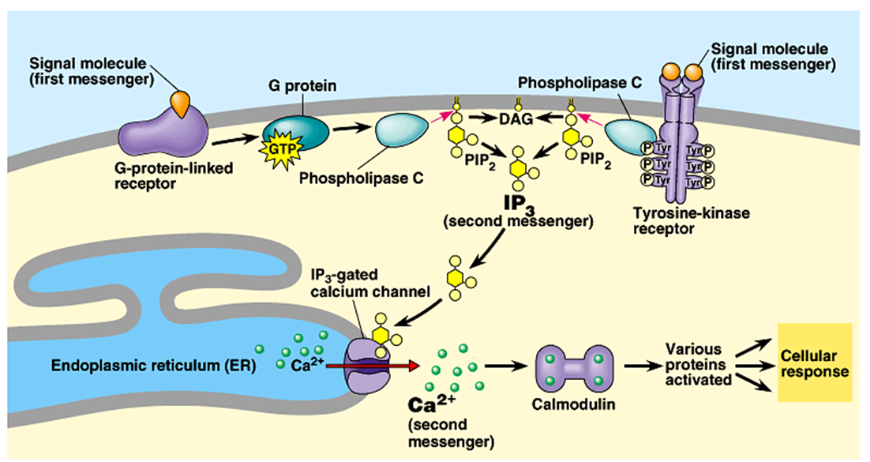
Ca⁺⁺ and IP₃ used as Second Messengers
Notes:
Calcium ions and Inositol Triphosphate (IP₃)
Some signal molecules in animals induce responses by increasing the amount of Ca⁺⁺ in the cytosol. This is used in the muscles, nerve,s and certain hormones. The amount of Ca⁺⁺ in the cytosol is low because it is pumped into the E.R., the mitochondria and also pumped outside of the cell. The release of Ca⁺⁺ from E.R. reservoirs involves diacylglycerol (D.A.G.) and inositol triphosphate (IP₃). These two messengers are made by the cleavage of a certain kind phospholipid in the plasma membrane. This is done when the G protein activates an enzyme, phospholipase C. Phospholipase C cleaves a plasma membrane in two to make D.A.G. and IP₃. IP₃ will then move to the E.R. and bind with a IP₃-gated calcium channel to allow Ca⁺⁺ to flow out.
Ca⁺⁺ combines with a protein called calmodulin. Calmodulin combined with Ca⁺⁺ initiates a certain biochemical pathway. This is done by usually by calmodulin triggering a kinase or phosphatase as the first step in the biochemical pathway.

Slide 19
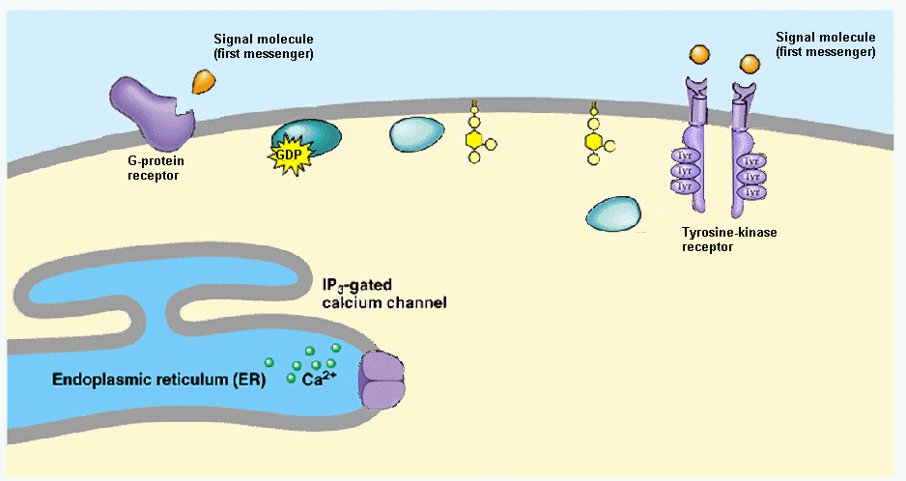
Ca⁺⁺ and IP₃ used as Second Messengers

Slide 20
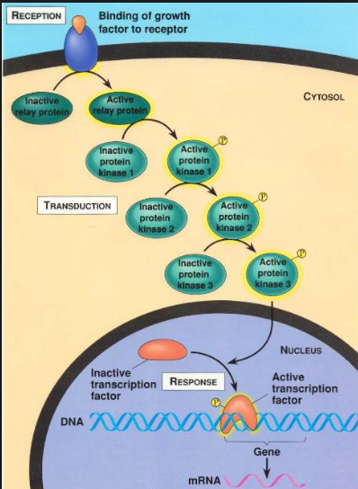
Transduction
Transduction-This occurs after the reception, the cell needs to process the signal. The biochemical pathway or transduction pathway quite often results in a cascading effect which amplifies each product.
Notes:
The term transduce means to convert from one form to another. In this case, transduction refers to the conversion of the signal that is outside the cell into a form that can produce a response inside the cell.
Usually the molecules that are processing the signal are proteins that are activated by phosphorylating them. Protein kinases are proteins that transfer phosphate groups from ATP to other proteins. Serine and threonine are the two amino acids that commonly receive the phosphate group on the receiving protein kinase. This cascading effect increases the number of proteins activated, amplifying the effect very quickly.
These protein kinases are extremely important. Approximately 1% of all human genes code for various protein kinases. Protein phosphatase is a protein that will remove a phosphate group from proteins and can deactivate a protein kinase.
https://www.youtube.com/watch?v=U6uHotlXvPo\
https://www.youtube.com/watch?v=yKW4F0Nu-UY

Slide 21
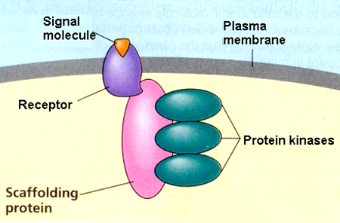
Role of Scaffolding Proteins
Scaffolding proteins are large relay proteins to which other relay proteins are attached
Scaffolding proteins can increase the signal transduction efficiency by grouping together different proteins involved in the same pathway.

