Slide 1
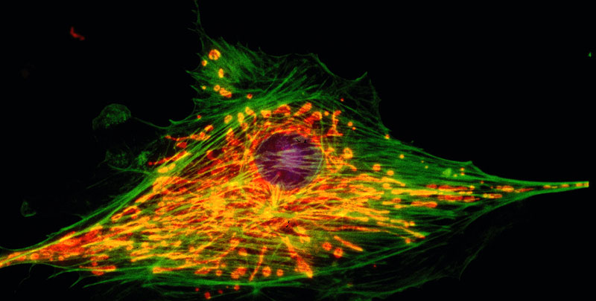
The Structure of
Cell:
Part II

Slide 2
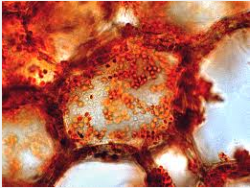
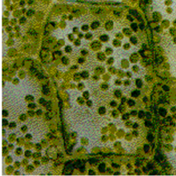
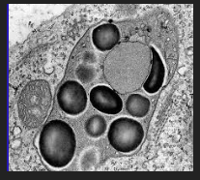
Plastids
Plastids
Chromoplasts
Chloroplasts responsible for photosynthesis.
Leukoplasts responsible for storage of starch.
Notes:
Plastids are organelles that are found in certain plant cells. They arise from unspecialized plastids called proplastids. There are 2 different types of plastids- chromoplasts that contain pigments and leukoplasts that store starch. Chromoplasts contain pigments such as xanthophylls and carotenes. Chloroplasts are a type of chromoplast that contain chlorophyll and other pigments. They convert light energy into chemical energy and are found in leaves and stems.

Slide 3
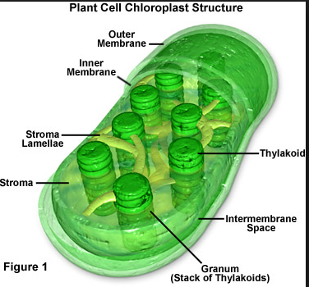
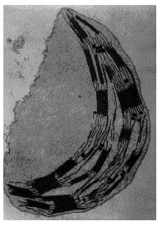
Structure of Chloroplast
Chloroplasts have three membranes. The outer two are smooth and the inner one makes stacks of thylakoids or grana. The chlorophyll and other pigments are found in the thylakoid membrane where light energy is converted into chemical energy.

Slide 4
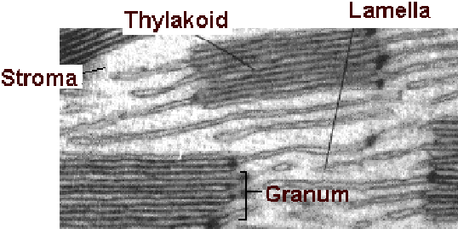
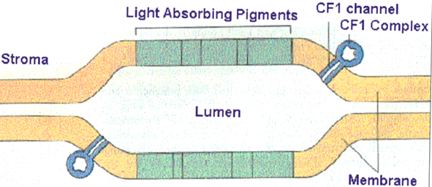
Thylakoid
A stack of thylakoids is a granum. The matrix found around the thylakoid is called the stroma. It contains enzymes for carbohydrate synthesis.
Notes:
An electron transport chain is embedded in the thylakoid membrane. In addition, there are collections of chlorophyll and other pigments which collectively are called photosystems. The photosystems are able to donate light-energized electrons to the electron transport chain.

Slide 5
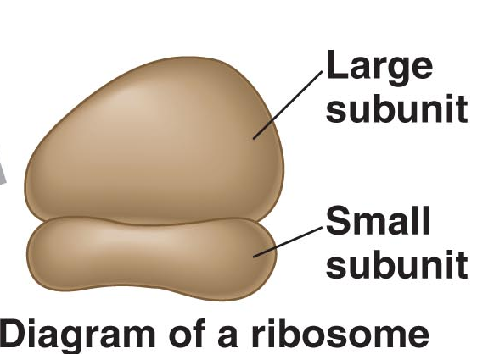
Ribosomes
Ribosomes are workbenches for protein synthesis. They are made from rRNA and proteins to form two subunits. They do not contain any membranes. Cells can have thousands.
Notes:
All cells contain ribosomes because all cells must synthesize proteins.

Slide 6
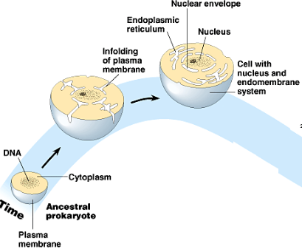
Evolution of Organelles
The endomembrane system includes all the organelles that are derived from one another, or are continuous with one another.
They have evolved from the folding in of the plasma membrane over time. The membrane system includes the nucleus, the E.R., the Golgi apparatus and the lysosomes.
Notes:
Graphic http://faculty.college-prep.org/~bernie/sciproject/project/Kingdoms/Protista4/Protists/Relationship%20to%20Evolution.htm

Slide 7
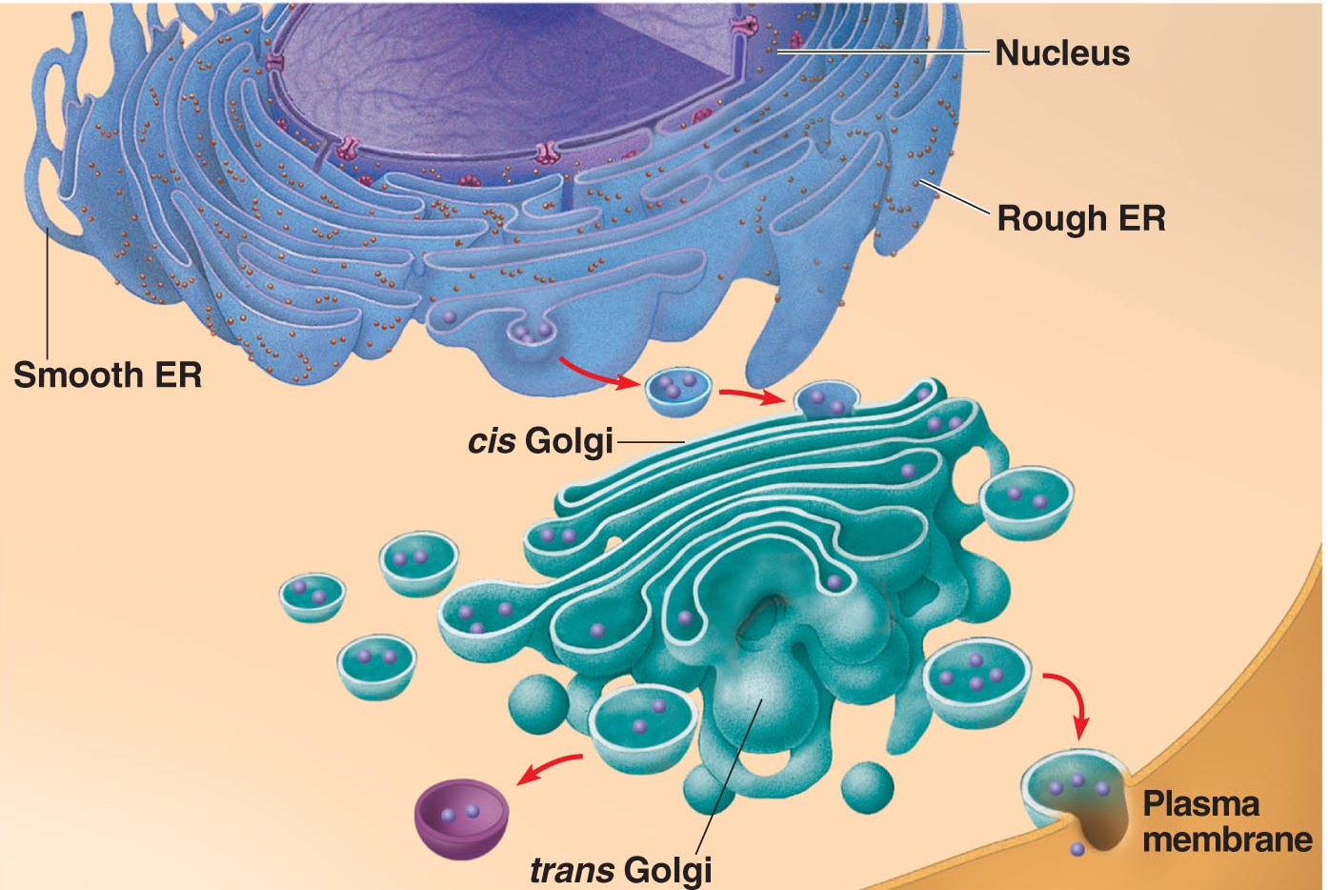
The Endomembrane System

Slide 8
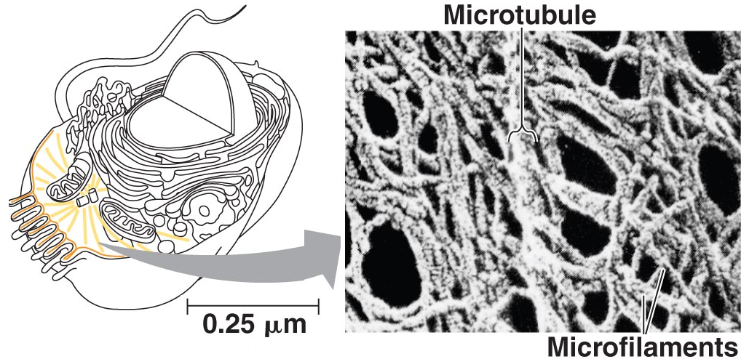
The Cytoskeleton
Gives the cell shape
Movement of organelles
Cytoplasmic streaming in plant cells
Notes:
The cytoskeleton found throughout the cytosol in eukaryotic cells.
Functions of the cytoskeleton
Move the cell.
Move organelles within the cell
Provide support and structure
Cytoplasmic streaming (not prokaryotic cells)
Types of structures-
microtubules and
microfilaments
intermediate filaments

Slide 9
Flagellated Cells
Flagellated sperm cells

Slide 10
Ciliated Cells
Paramecium moving Chlamydomonas moving
with cilia. with cilia.

Slide 11
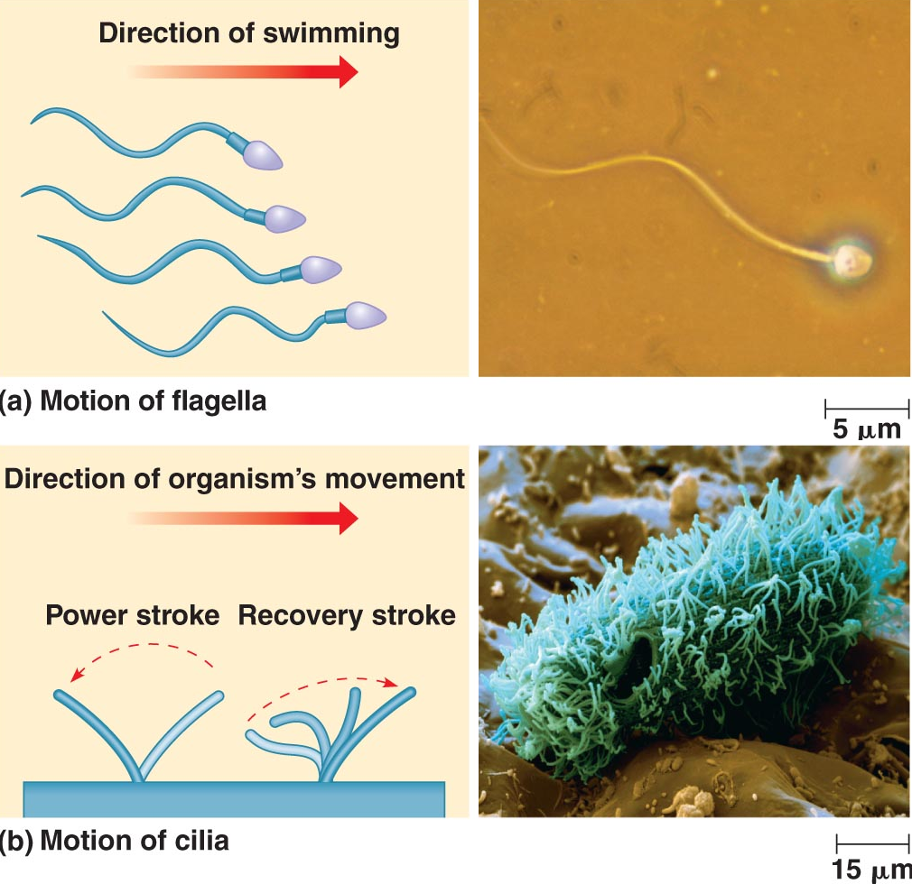
Difference Between Flagella and Cillia

Slide 12
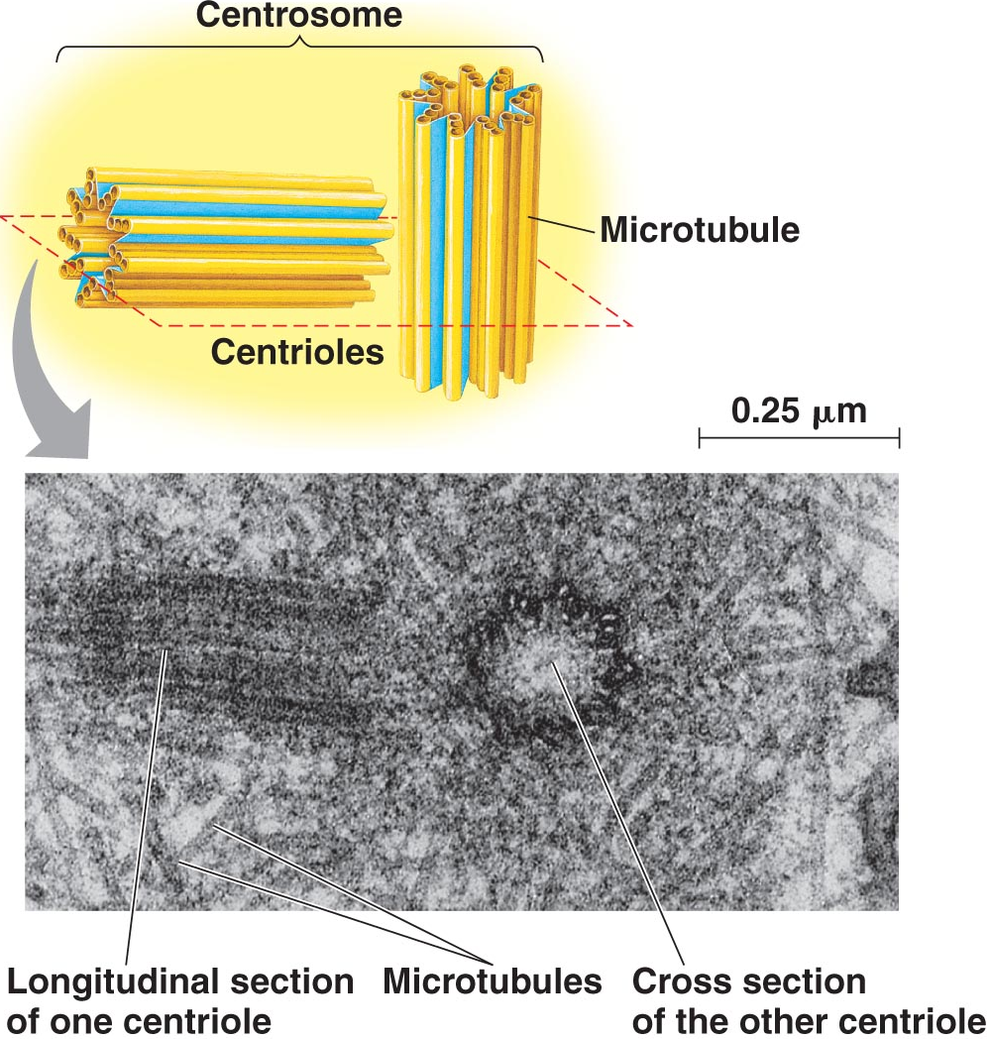
Centrioles and Microtubules
Centrioles are microtubule organizing centers for animal cells.
They are constructed of nine triplet microtubules.
Basal bodies anchor cilia and flagella.
Notes:
Centrioles are made of nine triplets of microtubules. This structure is also identical to the interior of a basal body which anchors flagella and cilia in the cell. Cilia and flagella are identical in structure but differ in length, movement, and number found on a cell.

Slide 13
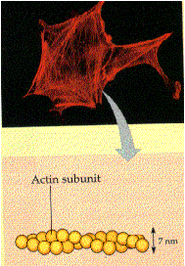
Microfilaments
Microfilaments are made from two intertwined strands of actin subunits. They are thinner than microtubules.
Notes:
Microfilaments are two strands of protein made of actin subunits and are used for supporting the cell shape and changing the shape of the cell. They are also involved in muscle contraction, movement of pseudopods, cytoplasmic streaming and microvilli of the small intestines. Microfilaments are used to bear tension, resisting pulling forces within the cell.

Slide 14
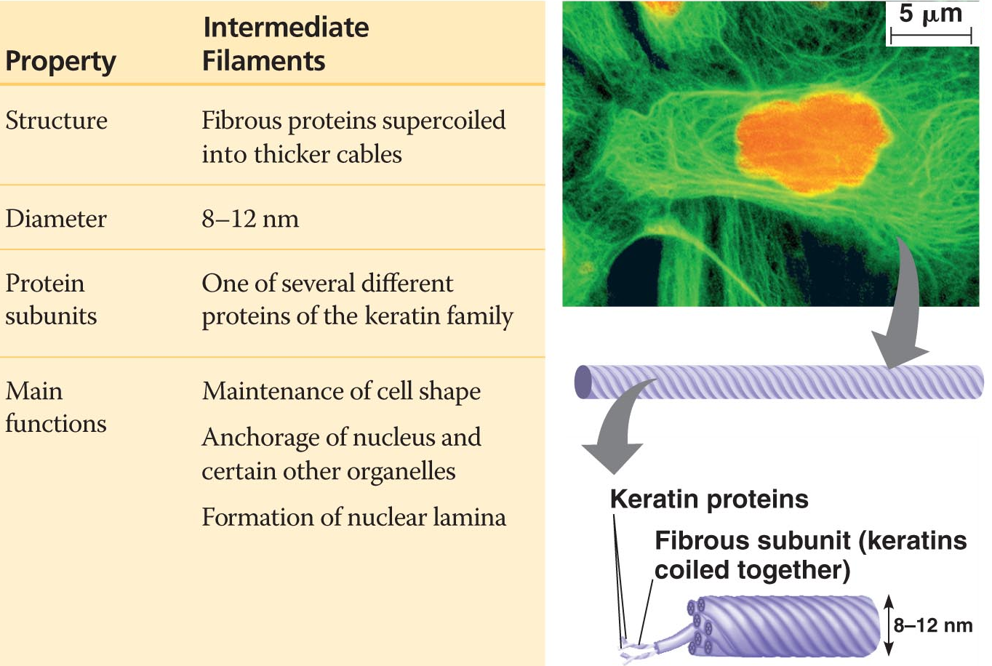
Intermediate Filaments

Slide 15
Cell Walls
Most cells have materials external to the plasma membrane.
Cell walls are found in prokaryotes, plants, fungi and some protists.
Cell walls of plants are made of cellulose; in fungi they are made of chitin; in prokaryotes they are murein (or muramic acid) and in protists they vary.
Notes:
Cell walls give shape and prevent turgid cells from bursting. Plant cells may have a primary cell wall (outer most walls) and a secondary cell wall (inside the primary). The middle lamella is a substance holds the walls together.

