Slide 1
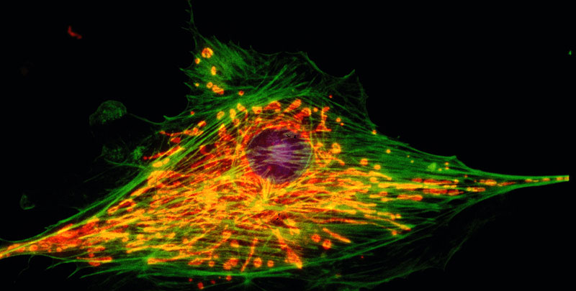
The Structure of
the Cell:
Part I

Slide 2
Cell Theory
Cell Theory
The cell is the basic unit of life.
All living things are composed of cells
Cells only come from preexisting cells.

Slide 3
Types of Cells
Prokaryotic: Cells without a nucleus or membrane bound organelles
Eukaryotic: Cells with a nucleus and membrane bound organelles (larger more evolved)
Cells are limited in their size
Notes:
Notes
Prokaryotic cells, in general, are smaller and considered more primitive.
Genomic DNA is smaller with no histone proteins and forms a circle of DNA.
These cells are found in the domains Archaea and Bacteria.

Slide 4
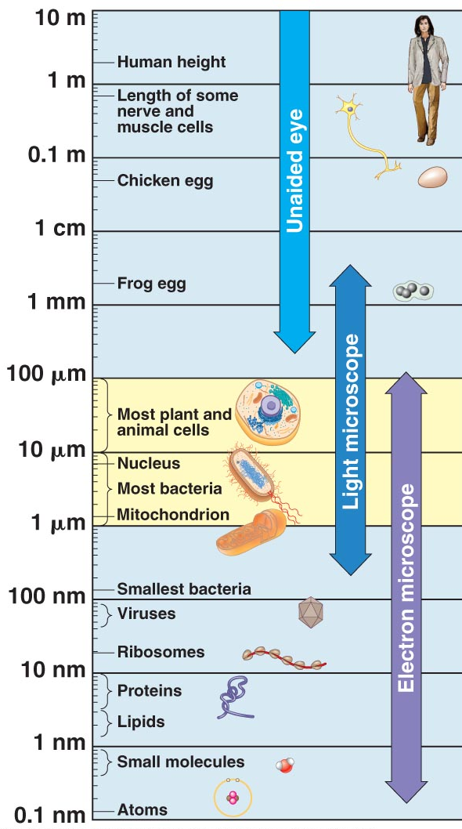
Relative Size of Cells
The size of a cell is limited by two factors:
The surface area increases at a slower rate than the volume for a sphere or cube shape.
The larger the cell the longer it takes for materials to diffuse to the center of the cell.

Slide 5
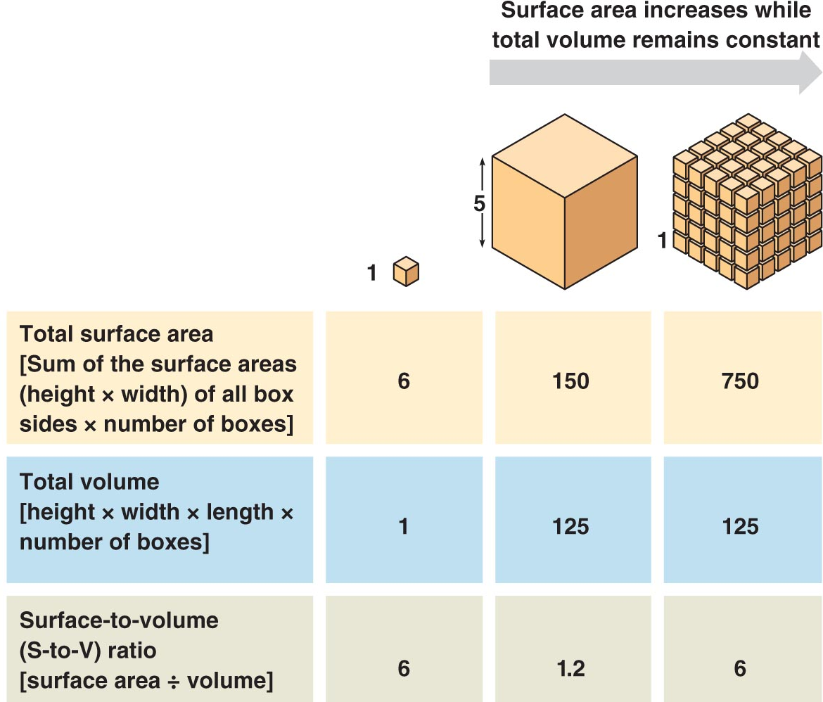
Surface Area to Volume Ratio
Notes:
Point out how increasing the number of cells in a given volume will increase the overall surface area that can be used for the exchange of material.

Slide 6
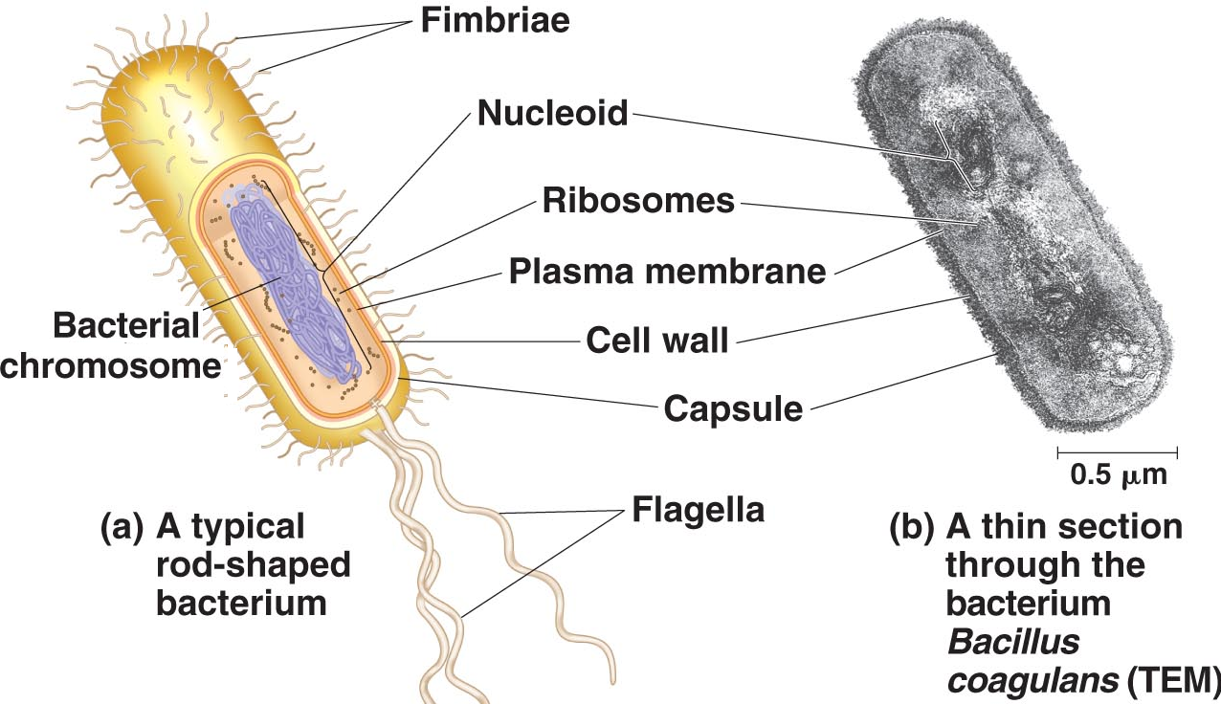
Prokaryotes
Prokaryotes were the first cells to evolve. This is an electron micrograph of an actual prokaryotic cell. It has a rod shape.
Notes:
Other characteristics of prokaryotic cells:
Cell wall-peptidoglycan, 3 basic shapes-cocci, bacilli, and sprilla. Used to prevent cells from bursting.
Capsule- Some prokaryotes have these outside the cell wall. Allows cells to adhere to substrates and offers additional protection.
Plasma membrane-regulates what crosses the cell membrane.
Nucloid region- Area where the circular DNA is found.
Mode of nutrition can vary
decomposing heterotrophs, pathogenic heterotrophs, phototrophic autotrophs or chemotrophic autotrophs
Biochemical pathways can vary
Photosynthesis
Obligate anaerobic respiration
Facultative aerobic respiration
Aerobic respiration

Slide 7
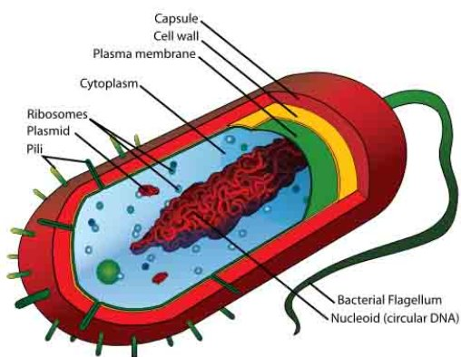
Prokaryote
Notes:
Ribosomes- Workbench where proteins are made, smaller than eukaryotic ribosomes
Flagella-made from a solid core of protein. They rotate like a helicopter rotor. Not all prokaryotes have flagella
Pili-Extensions that allow prokaryotes to adhere to one another for DNA exchange.
Lamella-If cell is photosynthetic, membrane where photosynthetic pigments are attached.
Capsule- Extra layer on top of cell wall for certain prokaryotes. Seems to add additional protection.
Plasmid- Small circle of DNA not included in the genome that can contain genes.

Slide 8
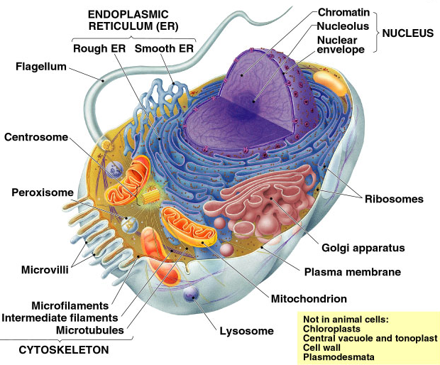
Eukaryotic Animal Cell
Notes:
Eukaryotic cells are more highly evolved. They have evolved with membrane bound organelles. These organelles allow for division of labor. Organelles evolved from the following:
The involution of cell membrane which gave rise to the nucleus, endoplasmic membrane, Golgi apparatus, and lysosome
When prokaryotic cells were engulfed by other prokaryotic cells and instead of being destroyed, they took up residence within the cell. This gave rise to the mitochondrion, the chloroplast and perhaps the flagellum.

Slide 9
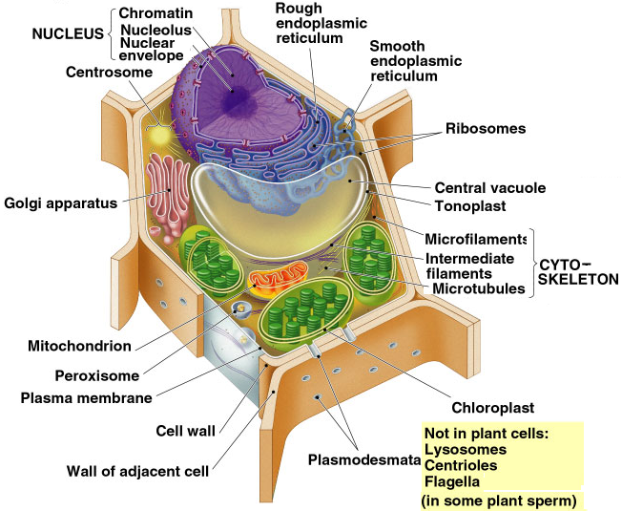
Eukaryotic Plant Cell
Notes:
Differences between plant cells and animal cells.
Organelle Plant Animal
Cell wall Yes No
Chloroplasts Yes No
Central Vacuole Yes No
Lysosome No Yes
Centrioles No Yes
Flagella No Yes
(some lower plants)

Slide 10
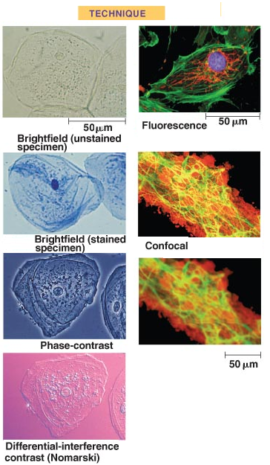
Cheek Cells with Different Stains

Slide 11
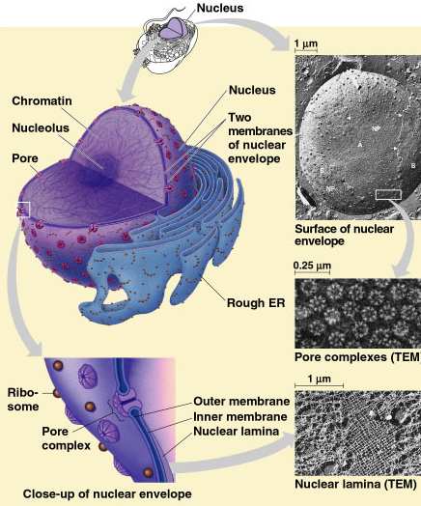
Nucleus
Notes:
The nucleus is surrounded by a double membrane called the nuclear envelope and is pitted with protein pores that allow materials in and out.
For example, the pores regulate which pieces of RNA can be transported out to the cytosol.
Contained in the nucleus:
Nucleolus
DNA (chromatin)which is the blue print for proteins. The photo is an actual electron micrograph of nuclear pores.
Proteins
RNA
Other materials needed for DNA replication and translation in which DNA is used as a template to make an RNA molecule.

Slide 12
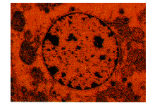
Nucleolus
The nucleolus is dark staining object in the nucleus. It contains DNA which codes for the production of ribosomal RNA.

Slide 13
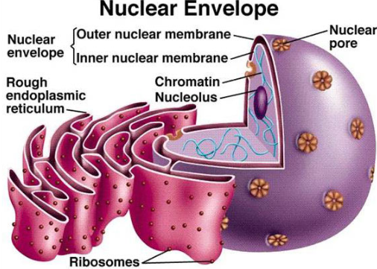
Nuclear Envelope and E.R. Connection.
Notes:
The endoplasmic reticulum is continuous with the nuclear membrane. There are two types of E. R.: rough and smooth. Rough E.R. is pitted with ribosomes. The attached ribosomes are making proteins and threading them into to the internal part of the E.R. These proteins will be packaged later by the E.R. and shipped to the Golgi apparatus for modification before being exported or becoming part of the cell membrane. The ribosomes on the E.R. are only attached when synthesizing proteins. Once protein synthesis concludes the ribosomes are detached from the E.R.

Slide 14
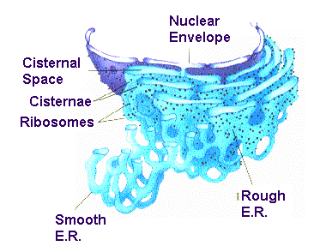
Smooth ER
The smooth ER is continuous with the rough ER. It is different from the rough ER in that it that lacks ribosomes.
Notes:
Functions of smooth E.R.:
1. Synthesis of lipids and phospholipids
2. Involved in the breakdown of glycogen.
3. Detoxification of drugs by adding a -OH to them making them more soluble.
4. Storage of calcium in muscles needed for contractions.

Slide 15
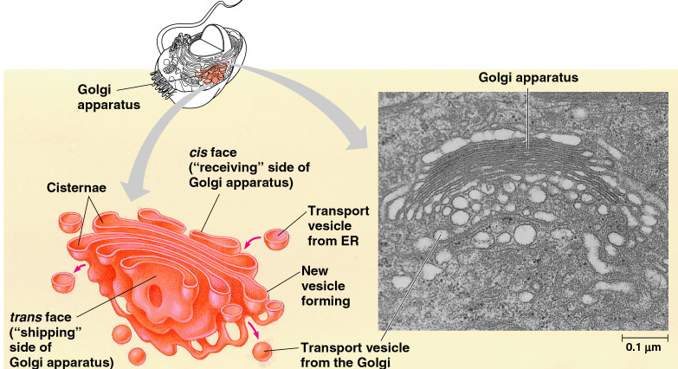
Golgi Apparatus
Notes:
The Golgi apparatus receives vesicles from the cell and its ER Proteins from the ER are modified and then sent out for export from the cell membrane. It is made of flattened membranes. It has a polarity in that there is a receiving face, cis-face and an exporting face, trans-face. Once the vesicle has deposited its material, the molecules may go through a series of membranes as they are modified. The Golgi apparatus is derived from membrane on the ER.

Slide 16
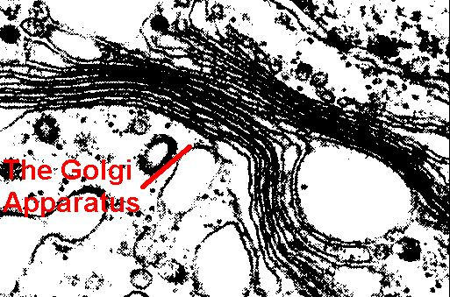
Electron Micrograph of the Golgi Appratus
Functions of the Golgi apparatus
Modifying proteins from ER.
Manufacturing certain poly-saccharides
Contributing to the plasma membrane

Slide 17
Golgi Apparatus Directing Secretions

Slide 18
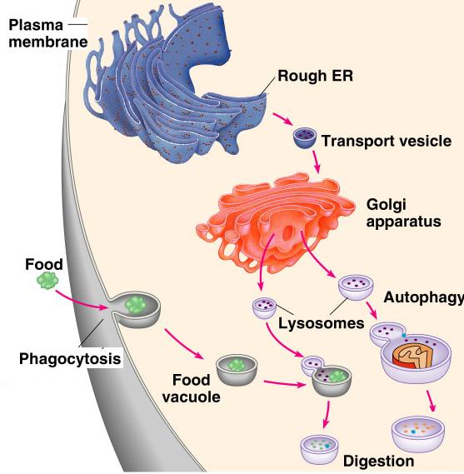
Lysosomes
There is flow or connection of organelle membranes in the formation of lysosomes.
Notes:
Lysosomes-membrane bound organelles that contain hydrolytic enzymes to break down materials (proteins, fats, polysaccharides, nucleic acids). These enzymes work best in a low pH. The lysosome pumps H+ into the interior. So if one breaks open, the high pH of the cell will denature these enzymes, but if a number of them break open, the cell will die. Lysosomes are used in the process of digestion of food particles and autophagy by breaking down and recycling old organelles.

Slide 19
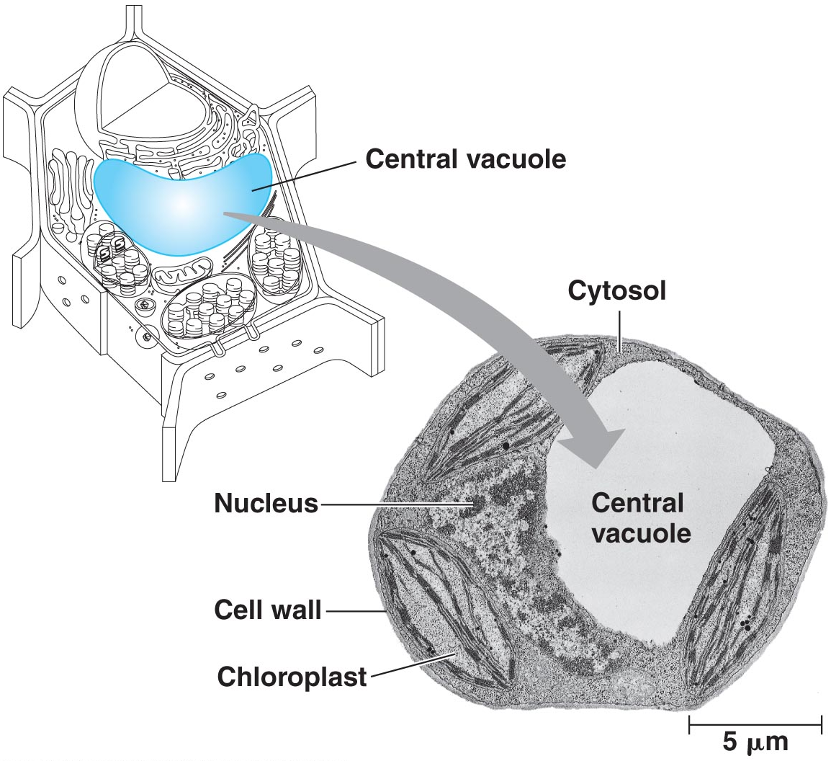
Vesicles and Vacuoles
Vacuoles and vesicles are membrane bound compartments used for storage. Vacuoles are larger than vesicles. Plants use a large central water vacuole to maintain their turgor and structure.
Notes:
There are water vacuoles found in certain freshwater protist that will expel excess water.

Slide 20
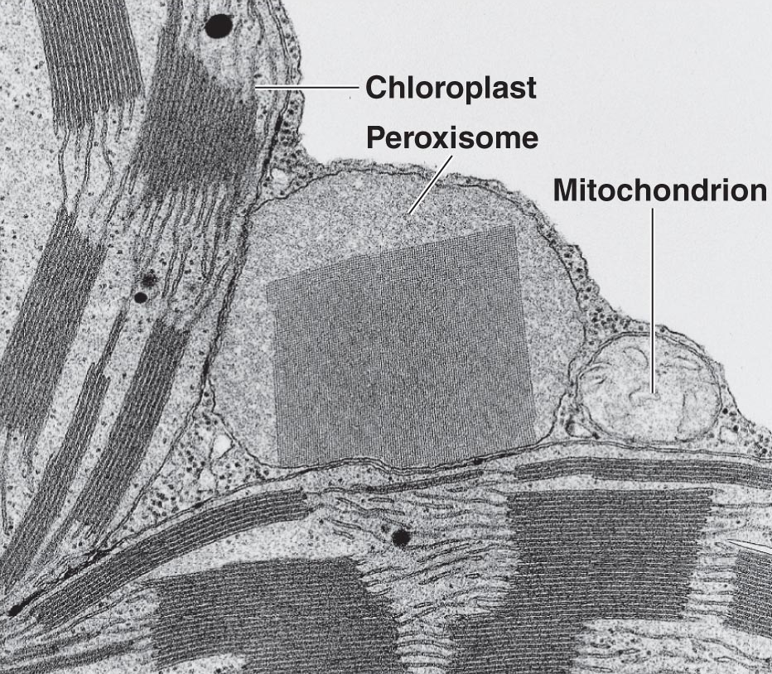
Microbodies- Peroxisomes and Glyoxysomes
Notes:
Microbodies-Collection of membrane bound organelles that contain enzymes that function in a certain manner. Ex. Peroxisomes will remove hydrogen from toxic substances and then combine the hydrogen with oxygen forming hydrogen peroxide. Hydrogen peroxide is toxic but peroxisomes contain catalase to break it down. Ethanol is detoxified in this way. Ex. Glyoxysomes are microbodies in plant cells that convert fatty acids to sugars. Microbodies are made from proteins and lipids from the cytosol.

Slide 21
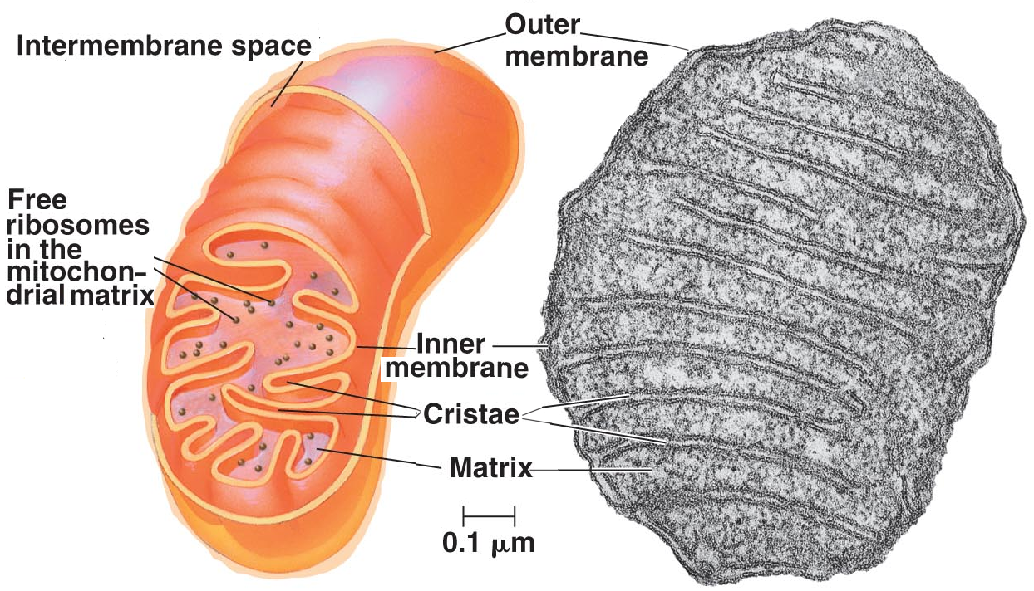
Mitochondiron and ATP Production
The mitochondrion is used to phosphorylate ADP to ATP (energy).
Notes:
Cells may have only one mitochondrion or many depending upon the function of the cell. Mitochondria have two membranes: the outer is smooth, and the inner is folded forming the cristae. The folding increases the surface area for enzymatic pathways. The inside of the cristae is the inner matrix which contain enzymes for cellular respiration.

Slide 22
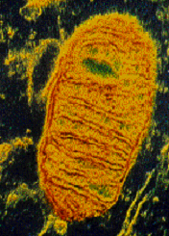
Mitochondria and Endosymbiosis
Mitochondria evolved from ancient prokaryotic cells through endosymbiosis. The evidence includes:
Has its own DNA that is circular like prokaryotes
Has prokaryotic like ribosomes
Replicates like a prokaryote
Does protein synthesis like a prokaryote
Notes:
The mitochondria, chloroplasts and the flagella evolved as the result of prokaryotic cells engulfing other prokaryotic cells. Instead of being destroyed, the prokaryotic cell took up residence replicating and dividing inside the host cell. Over time some of the genes of the engulfed cell were transferred to the host cell making them dependent on the host and becoming an organelle. This is the endosymbiosis hypothesis.

