Slide 1
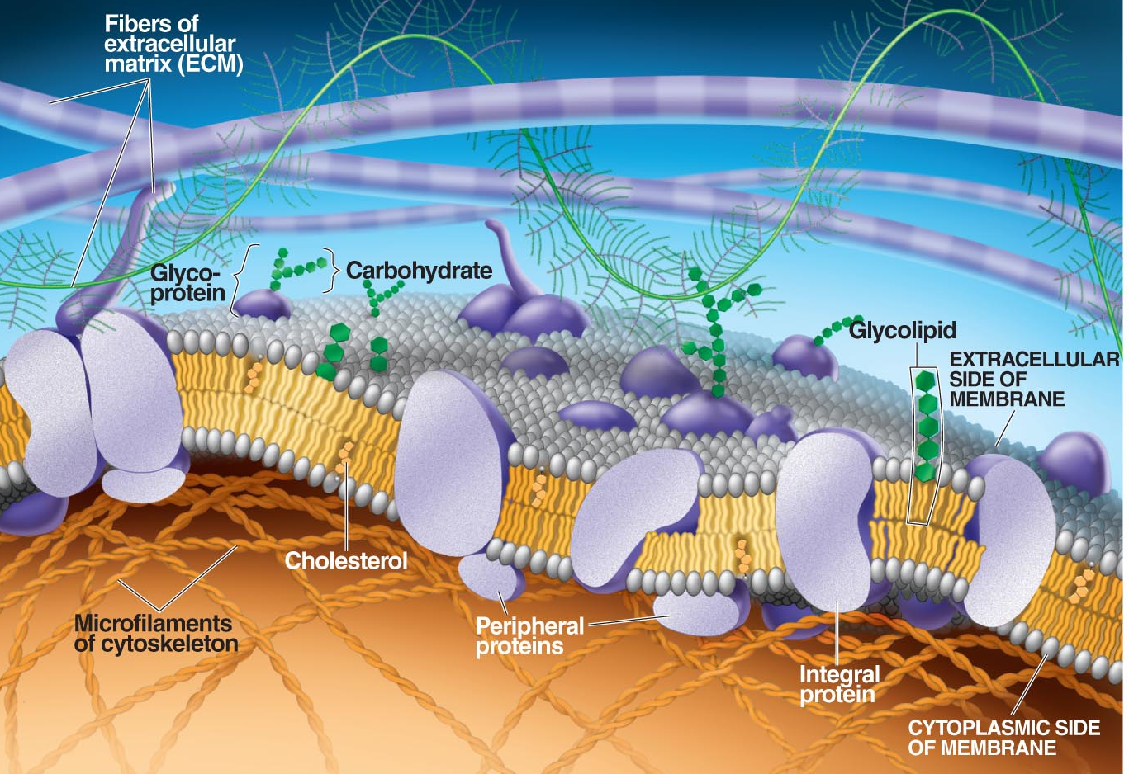
The Transport of Materials Across Cell Membranes:
Part V

Slide 2
The Plasma Membrane

Slide 3
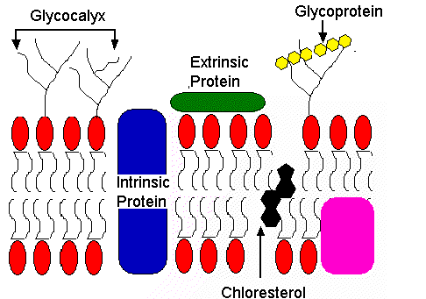
The Plasma Membrane
The cell membrane is said to be semi-permeable or selectively permeable because certain molecules can cross the membrane and others cannot. The membrane is said to be permeable to those that can cross and impermeable to molecules that cannot cross.

Slide 4
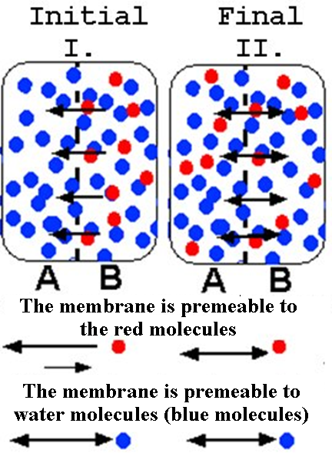
Passive Diffusion
The red molecules are initially more concentrated on side B. These molecules have more free energy.
The net movement of the red molecules is from side B to side A, or from a higher concentration to a lower concentration.
The water molecules (blue) are equally distributed and will move across at the same rate.
Notes:
Passive diffusion- the membrane is permeable to the molecules involved (CO₂, O₂, etc). Predicting the net movement is as if there was no membrane at all. The molecules move from high to low concentration.
Connect this movement to free energy. The red molecules in the final system are more disorganized. There has been an increase in entropy. Entropy is the driving force for the net movement of the molecules, if you will.

Slide 5
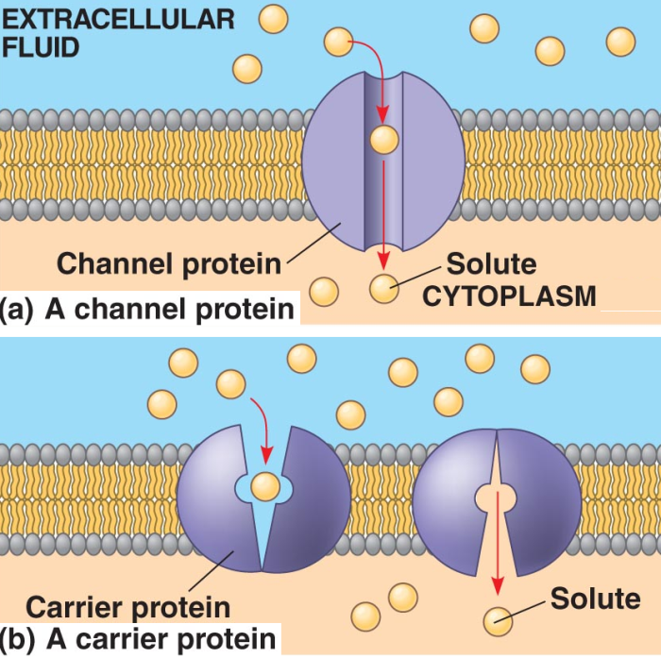
Facilitated Diffusion
The molecule is impermeable to the membrane.
The transport of the molecule requires a carrier protein or channel protein.
It requires no ATP. The driving force is an increase in entropy. The molecules are moving from an area of higher concentration to lower concentration or from higher free energy to lower free energy.
Notes:
Facilitated diffusion- the membrane is not permeable to the smaller molecules involved (glucose, amino acids etc.). These molecules need a transport protein to transport the molecule across the membrane.
Predicting the net movement of the molecules is like predicting the movement of molecules during passive diffusion. The net movement of the molecules is from an area of higher concentration to an area of lower concentration.
The protein carriers (permeases) may take the form of a channel that allows certain molecules with a certain shape to enter the cytoplasm and others may take the form of a carrier protein that changes conformational shape to move the molecules across. Facilitated diffusion and passive diffusion are also called passive transport since no energy in the form of ATP is needed.

Slide 6
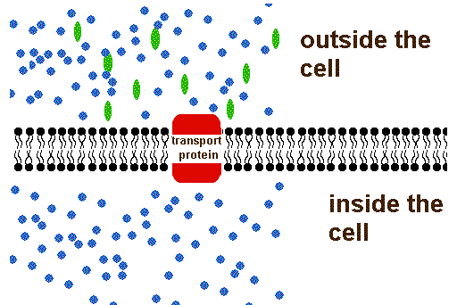
Facillitated Diffusion

Slide 7
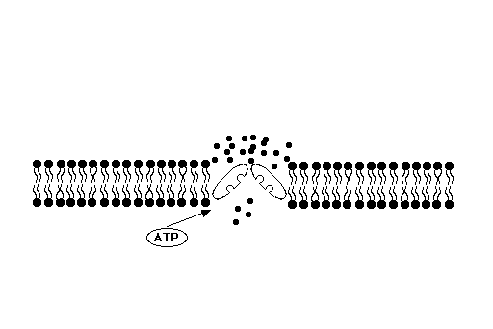
Active Transport
Membrane is impermeable to the molecules.
Molecules are moving against a concentration gradient (from low to high) or from low free energy to high free energy.
A transport protein and ATP are both needed.

Slide 8
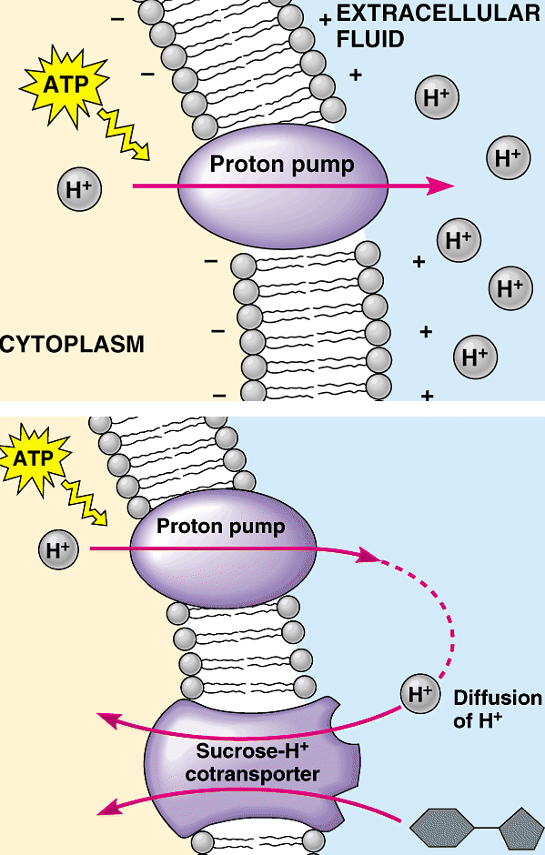
Electrogenic Pump
An electrogenic pump that pumps ions against a concentration gradient AND a charge gradient to create a separation of charge across the membrane.
Sometimes an electrogenic pump is combined with another protein carrier involved in facilitated diffusion.
Notes:
In the second example a proton pump is pumping out H⁺ by active transport. Those H⁺ ions are used in conjunction with sucrose to move sucrose back into the cell.
The driving force moving the H⁺ ions is the concentration gradient (high concentration to low concentration) and the attraction of the positive H⁺ ions to the negative charges on the other side of the membrane.

Slide 9
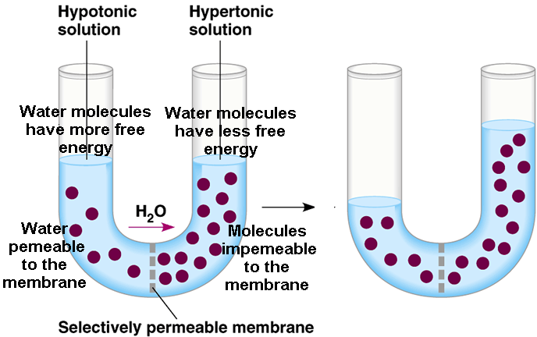
Osmosis
Notes:
Osmosis is a special case of diffusion involving the movement of water. When the membrane is impermeable to certain molecules and they are not in equilibrium, water will move across the membrane “to help reach equilibrium.” Water is moving from high free energy to low free energy.
"Water likes to dilute".

Slide 10
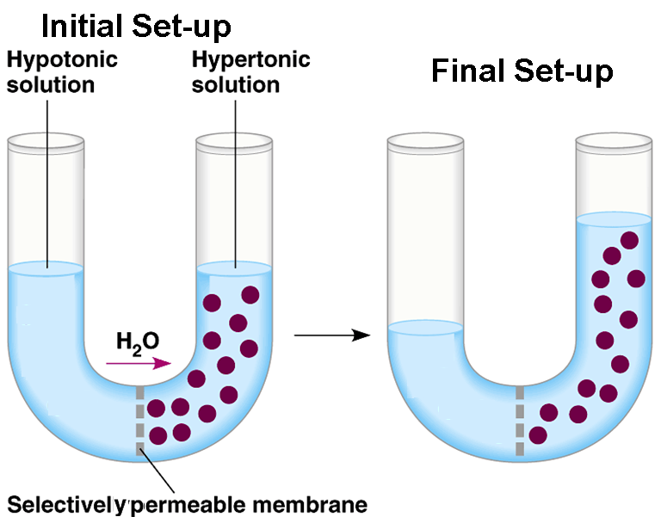
Osmosis
Notes:
Have the student examine this U-tube and try to explain why all the water does not go to the other side. The water still has more free energy on the left hand side, yet all the water does not go to the right hand side.
The students may answer that there is an opposing force or pressure and that is gravity pushing water molecules back to the other side.

Slide 11
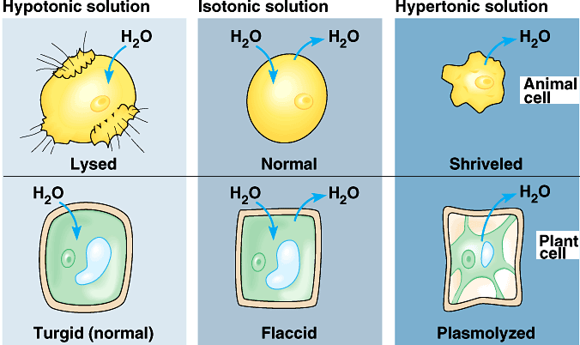
Osmosis in Plant Cells and Animal Cells
Notes:
Concentration refers to the amount of solute molecules dissolved in a given amount of solvent.
Cell submerged in a hypotonic solution-The solution outside the cell is less concentrated than the solution inside the cell and therefore the solution outside the cell is said to be a hypotonic solution.
If cells are submerged in a hypotonic solution like pure water, the net movement of water is into the cells. Animal cells may not be able to accommodate the water and subsequently burst. Plant cells become turgid because of a back pressure from the cell wall. Then the rate of the movement of water will be equal in both directions. (Point out that relative to the solution outside the cell, the solution inside the cell is hypertonic).
Isotonic- Two solutions found inside the cell and outside the cell have equal amounts of solutes on both sides of the membrane. Water moves across the membrane at the same rate. The cells are at equilibrium.
Cells submerged in a hypertonic solution-The solution outside the cells is more concentrated than the solution inside the cells and therefore the solution outside the cell is called a hypertonic solution.
If cells are submerged cells in a hypertonic solution like syrup, the net movement of water is out of the cells. Both types of cells will decrease in volume. The plasma membrane of plant cells will pull away from the cell wall or plasmolysis will occur. Then the rate of the movement of water will be equal in both directions. (Point out that relative to the solution outside the cell, the solution inside the cell is hypertonic).

Slide 12
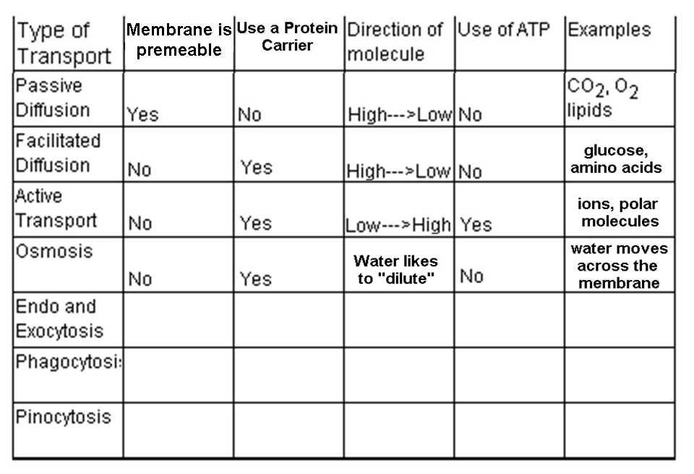

Slide 13
Three Types of Endocytosis
Endocytosis is the movement of larger particles into the cell by use of membrane vesicles.
Phagocytosis
Pinocytosis
Receptor Mediated Endocytosis

Slide 14
Phagocytosis
Phagocytosis “cell eating”- Larger molecules or particles are brought into the cell by engulfing them into a plasma membrane vesicle.

Slide 15
Phagocytosis
Notes:
These are yeast cells undergoing phagocytosis and engulfing food particles that are dyed red.

Slide 16
Exocytosis
Exocytosis is just the opposite of endocytosis. Material to be secreted usually moves through the compartments of the Golgi apparatus where it may be modified. The material is then surrounded by membrane forming a vesicle.

Slide 17
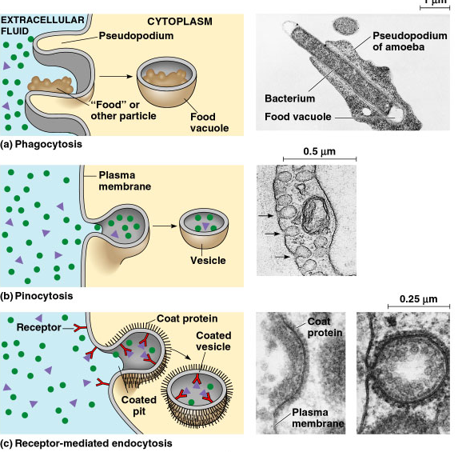
Review of Endocytosis
Notes:
This is a nice review of the different types of endocytosis.

Slide 18
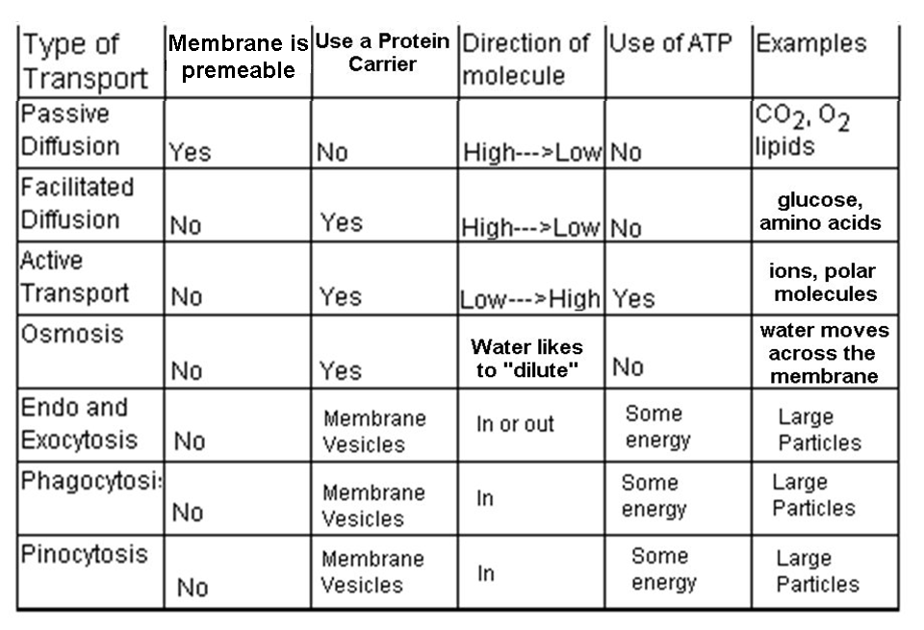

Slide 19
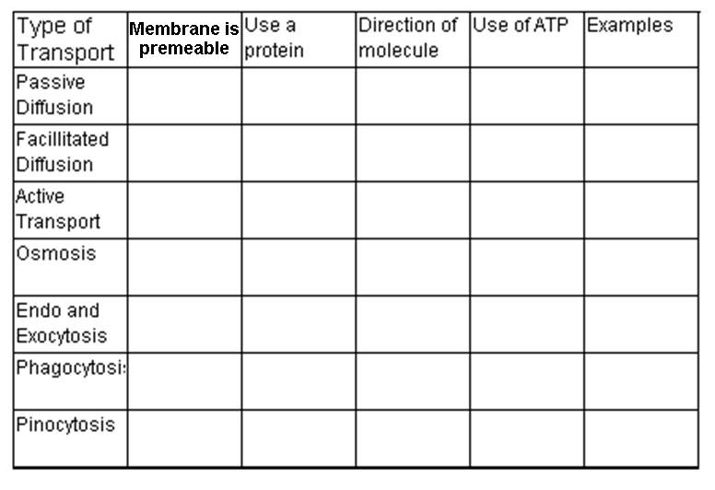
Notes:
Have students complete the chart without looking back at their notes…

