Slide 1
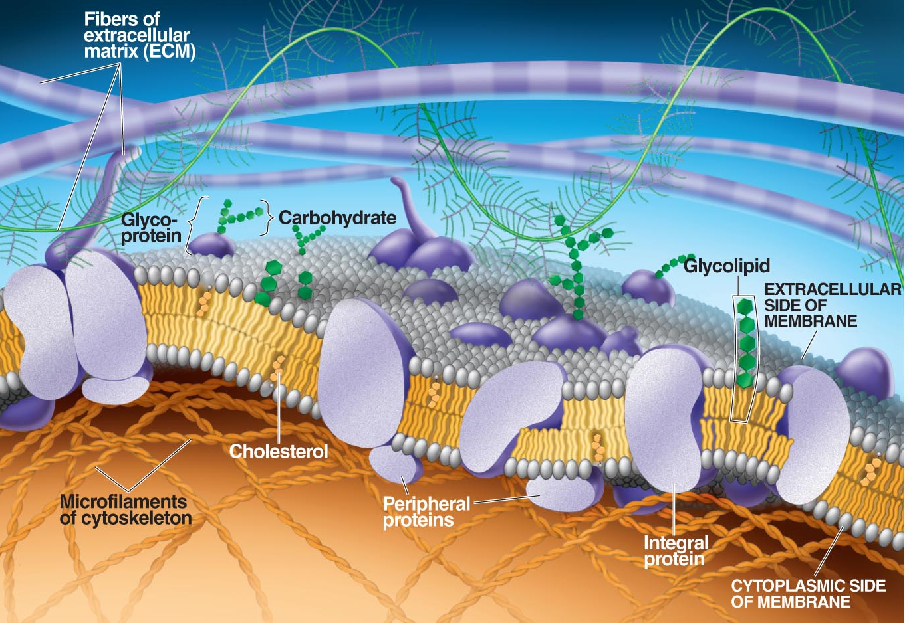
The Structure of Cell Membranes:
Part III

Slide 2
The Cell Membrane
The cell membrane is a dynamic and intricate structure that regulates material transported across the membrane. The membrane is selectively permeable (or semi-permeable) meaning that certain molecules can cross the membrane and others cannot.
Notes:
The roll of the cell wall is not the same as the cell membrane. Most cells, except for animal cells, have cell walls. They are composed of carbohydrates (polysaccharides which vary in composition depending on the kingdom). Cell walls are living material and are used to prevent the cells from bursting as well as to give them structures. Cell walls are porous and allow most everything to cross while the cell membrane is the barrier that regulates what "gets into and out of" the cell.

Slide 3
Selectively Permeable Membrane
Notes:
The cell membrane, not the cell wall, is the barrier that regulates what "gets into and out of" the cell.

Slide 4
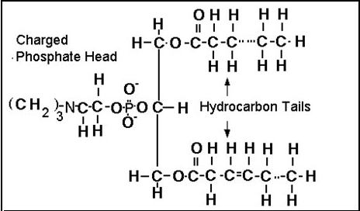
Phospholipids
All cells have plasma membranes and many of their organelles also have membranes. All membranes are made from a bilayer of phospholipids.

Slide 5
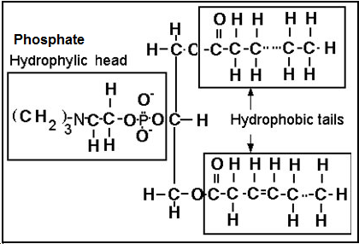
Hydrophilic and Hydrophobic Parts
Phospholipids have hydrophilic heads and hydrophobic tails.
Notes:
Hydrophilic head is attracted to water and the hydrophobic tails are attracted to one another as the tails are hydrocarbons and nonpolar so they do not mix with water.

Slide 6
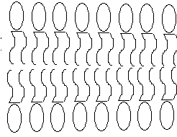
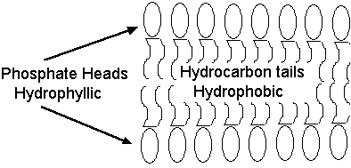
Arrangement of Phospholipids in Membranes
The cell membrane has two layers of phospholipids as shown below. The hydrophilic heads are facing an aqueous environment and the hydrophobic tails are facing one another.

Slide 7
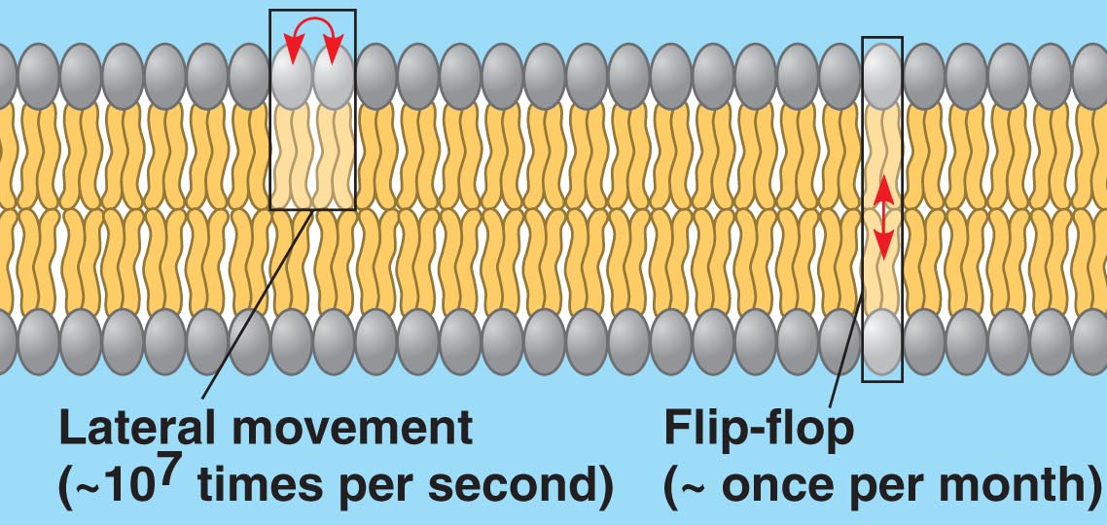
Movement of Phospholipids
Phospholipids have the ability to move laterally but only upon a rare occasion are able to make a 180º turn.

Slide 8
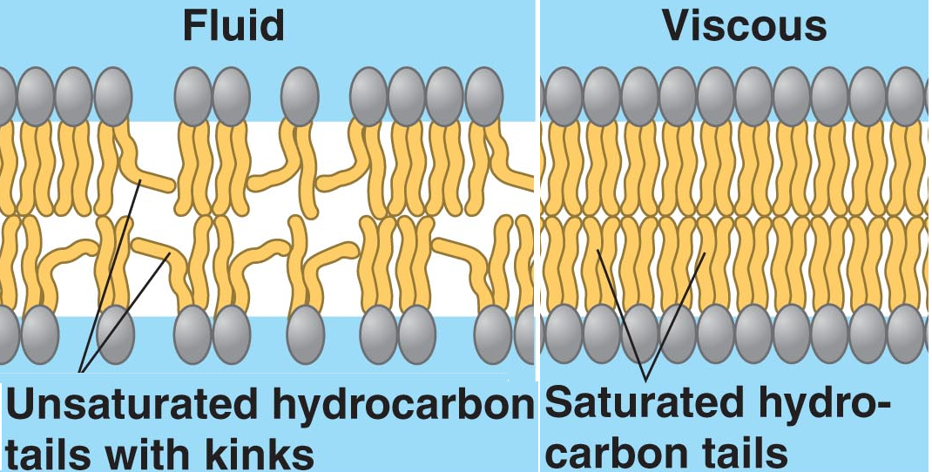
Saturated versus Unsaturated Phospholipids
Membranes are more fluid when they contain more unsaturated fatty acids within their phospholipids. More unsaturated fatty acids result in increased distance between the lipids making the layer more fluid.
Notes:
When preparing for winter, many organisms incorporate more unsaturated phospholipids into their plasma membranes so they do not solidify.

Slide 9
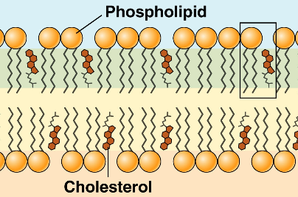
Cholesterol and Phospholipids
A word about cholesterol - It is found in the cell membranes of animals but not plants. It affects the fluidity of the membrane.
Notes:
Graphic
Cholesterol functions in the following ways:
It can weakly bind to hydrocarbon tails making it more difficult for smaller molecules to cross membrane.
If the phospholipids are saturated, it prevents them from being packed too closely, making the membrane more fluid.
However - if the phospholipids are unsaturated there are kinks in the tails where the cholesterol molecules can fill in and anchor them making the membrane less fluid.

Slide 10
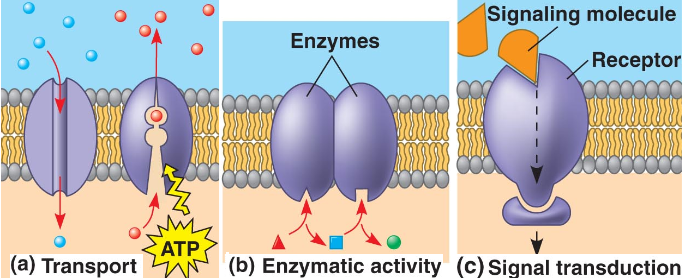
Proteins are Inserted into the Membrane
Function of Membrane Proteins
1. Transport proteins, or permeases, transport molecules across the membrane. Aquaporins are special protein channels used to move water across the membrane.
Notes:
Proteins are "stuck" in the membrane like a mosaic. Proteins can be on just the surface (extrinsic) or embedded in the membrane (intrinsic). It is the different proteins that are responsible for the uniqueness of different membranes (plasma, eukaryotic, prokaryotic, organelle etc.)

Slide 11
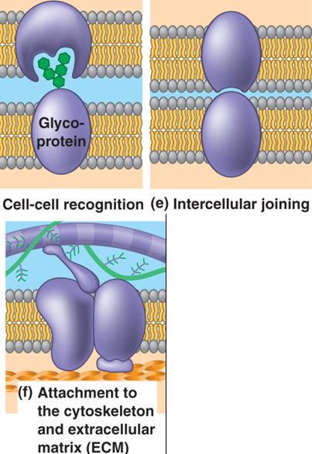
Functions of Other Membrane Proteins
2. Enzyme-Some proteins in the membrane may expose their active site to speed up a chemical reaction.
3. Receptor site-Ex. Insulin never goes into a cell but binds to a receptor site on the cell membrane
4. Cell to cell recognition.
5. Intercellular joining
6. Attachment to the cytoskeleton and extracellular matrix (ECM only in animal cells)

Slide 12
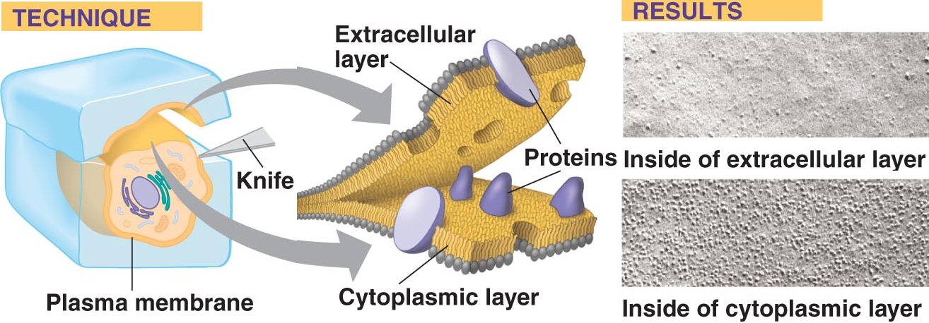
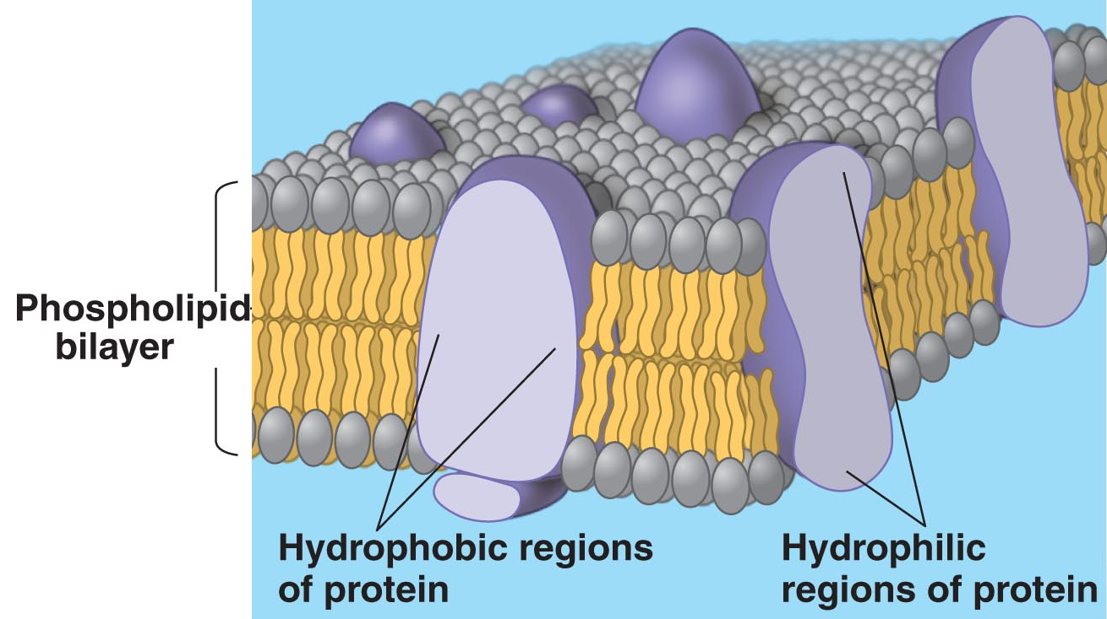
Evidence for the Fluid Mosaic Model
Notes:
The fluid mosaic model that represents the consensus view of the cell membrane’s structure is based on is the following:
The membrane is fluid as the phospholipids have lateral movement. Think of gasoline floating on water or Ping-Pong balls floating on water.
The membrane is a mosaic as proteins can be inserted at various locations in the membrane. Extrinsic proteins are those only on the surface of the membrane and intrinsic proteins are embedded within the membrane.
Point out that the intrinsic proteins are structured in such a way that the hydrophobic regions (nonpolar R groups) are facing the hydrocarbon tails of the layer and that the hydrophilic regions (polar and ionic R groups) are facing the aqueous region on the inside and outside of the cell.
Evidence for the fluid mosaic model can be seen when the plasma membrane split in half -- the proteins can been observed as little “bumps” in the membrane.

Slide 13
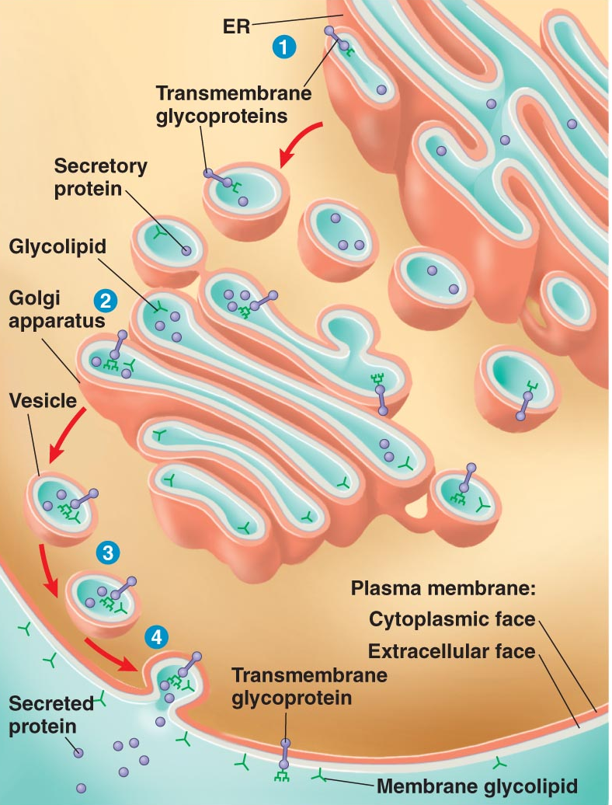
Plasma Membrane Synthesis
The size of the plasma membrane is increased and decreased with the interaction of vesicles. Vesicles bringing material to the membrane to be secreted increase the surface area of the plasma membrane; and through the process of endocytosis, the surface area of the cell membrane decreases.

Slide 14
The Plasma Membrane
Notes:
This is a nice illustration of the plasma membrane.
Ask if this this an animal cell membrane or plant cell membrane.
Answer-
Animal cell membrane because it contains the extracellular matrix and cholesterol is seen in the phospholipid bilayers.
Point out the following
The ECM found on the outside of the plasma membrane
Intrinsic (integral) and extrinsic (peripheral) proteins
The cytoskeleton
Glycolipids and glycoproteins are molecules containing sugar residues on them and are typically used in cell to cell recognition.

