Slide 1
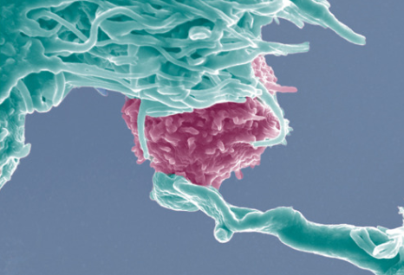
Immune System Part III:
Adaptive Immune System & Cell Mediated Immunity

Slide 2
Adaptive Immunity (Specific Immunity)
Develops after exposure to pathogens
Involves very specific response to pathogens
Much slower than innate immunity
Requires support of innate immunity to function
Two parts:
humoral immunity and
cell mediated immunity
2
Notes:
Updated Information:
There has been an explosion regarding emerging new information about the workings of the immune system. It is important that AP biology teachers keep current by obtaining new editions of university first year biology texts. Publishers will send you a “review copy” if you fill out their on-line form. Even the framework is outdated when it comes to certain terminology. Make your students aware of this and familiar with both the old and new terminology since AP test questions are often in development for two years and circulation on AP exams for far longer!
Outdated Terminology
Specific immunity or specific immune system is now referred to in all the new text books as adaptive immunity or the adaptive immune system. (Reece/Campbell, Raven and Johnson, Starr and Taggart, Hillis, & Solmon and Berg). The framework refers to the specific immune system rather than the adaptive immune system. Additionally, for a short while the specific immune system was called the acquired immune system. This was prior to the term adaptive immune system coming into our vocabulary.
Nonspecific immunity or nonspecific immune system is referred to in new text books as innate immunity or the innate immune system. (This was addressed in the second power point of this series.)
Virgin B and T cells are now called naïve B and T cells.
MHC receptors are now call T cell receptors.
Examine the EK 2.D.4.b and EK 2.D.4.b .1:
2.D.4.b
Mammals use specific immune responses triggered by natural or artificial agents that disrupt dynamic homeostasis.
Evidence of student learning is a demonstrated understanding of each of the following:
1. The mammalian immune system includes two types of specific responses: cell mediated and humoral.
This might give one the impression that only mammals possess an adaptive immune system. This EK is misleading as the adaptive immune system (specific immune system,) so far, has been found in all jawed animals. Cartilage fish do have lymphoid tissue (primitive compared to mammals) and do synthesize T cells. Jawless vertebrates such a hagfish and lampreys do not have an adaptive immune system.
2

Slide 3
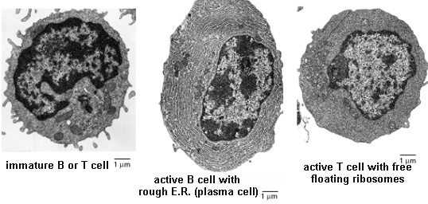
Adaptive Immunity
Lymphocytes—Specialized Cells
B cells- are synthesized and mature in the red bone marrow with characteristic plethora of rough E.R.
T cells- are synthesize in bone marrow but mature in the thymus with an abundance of free floating ribosomes
Immature B and T cells are virtually indistinguishable.
Notes:
There are two types of lymphocytes involved in the adaptive (specific) immune response, B cells and T cells. When immature, the two cells are indistinguishable. Both originate in the red bone marrow.
Naïve lymphocytes are those that have not been exposed to a matching antigen. Each lymphocyte is programmed to match a particular antigen to be activated. Until that match occurs and the lymphocyte is activated, it is termed a naive lymphocyte.
T cells mature in the thymus and have a large number of ribosomes. The thymus gland is located just above the heart. As an infant, the thymus is large but as time passes on, the thymus gland begins to shrink in size until adulthood. Adults retain their thymus but it is smaller in size than the thymus gland in infancy. There are different populations of T cells; including cytotoxic T cells, helper T cells, and memory T cells. T cells function in the cell-mediated response and are also important in the humoral response. (Humoral immunity is so named because it involves substances found in the humours, or body fluids.)
Different types of T cells
Naive T cells are those T cells that have not be activated or presented a matching antigen.
Helper T cells (T_{H}) activate the B cells in the humoral response
Cytotoxic T cells (T_{C}) destroy infected body cells
Memory T cells (T_{M}) are long lived T cells that have been initiated to a particular pathogen and kept in reserve. They are easily activated if the pathogen invades once again.
Effector cells are lymphocytes that have been selected and transformed to “fight” a pathogen.
B cells mature in red bone marrow and have a large amount of rough E.R. They are important in the humoral response production of antibodies, which is why they need so much rough ER.
Types of B cells
Naïve B cells are B cells that have not been activated or presented a matching antigen
Plasma B cells are activated B cells that produce copious amounts of free floating antibodies.
Memory B cells are long lived B cells that have been initiated to a particular pathogen and are kept in reserve. They are easily activated if the pathogen invades once again.
The cell on the left is an immature lymphocyte. The middle cell is a mature B cell with extensive E.R. The cell on the right is a mature T cell with its extensive amount of ribosomes.
Graphic http://dc235.4shared.com/doc/VQe1Ek5C/preview.html
3

Slide 4
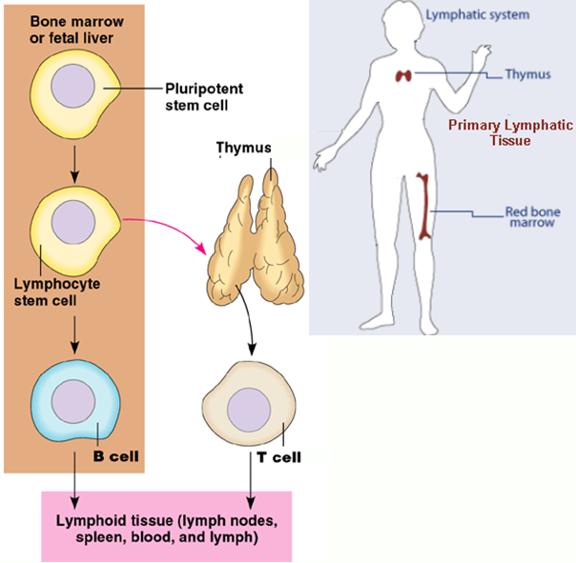
Adaptive Immunity and Primary Lymphatic Tissue
Primary lymphatic tissue
All lymphocytes originate in the red bone marrow. T cells then migrate to, and mature in, the thymus.
B cells remain in the marrow to mature.
4
Notes:
Lymphocytes, like the phagocytes, originate in the red bone marrow. They are descendants of lymphoid stem cells rather than the myloid stem cells that give rise to the red blood cells, platelets, and phagocytes. Refer back to the innate immune system information regarding the origin of cells of the immune system.
Graphic http://biologywarakwarak.wordpress.com/2012/03/18/role-and-components-of-the-immune-response/ and Campbell
4

Slide 5
Four Characteristics of Adaptive (Specific) Immunity
Diversity - There are potentially billions of different antigen receptors on B cells and T cells that recognize billions of different antigens.
Memory - Immune system is capable of “remembering” a pathogen once exposed.
Notes:
Emphasize that the memory characteristic will be discussed after going over the primary immune response of the cell mediated and humoral responses. Both cell mediated and humoral immunity have a “memory” to quickly respond to a second exposure to a certain pathogen.

Slide 6
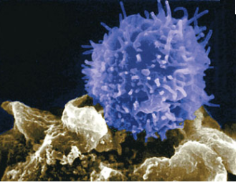
Adaptive Immune System (Specific Immune System): Cell Mediated Immunity
Adaptive Immune System: Two Components
Cell Mediated Immunity- Selected T cells recognize and destroy infected body cells and cancer cells.
Humoral Immunity- Selected B cells produce copious amounts of antibodies to fight pathogens.
Notes:
Graphic http://antiworldnews.wordpress.com/2012/02/25/a-killer-t-cell-in-action-as-it-attacks-a-cancerous-cell/

Slide 7
Homeostasis
Regulatory T cells (T_{reg}) help to halt the immune response.
Do not know how they are activated - possibly through antigens.
Thought to stop any further naïve B or T cells from being activated. Then the immune response stops because activated immune cells die due to their short life span.
Notes:
7
In summary, emphasize :
Homeostasis is maintaining a constant internal environment in an external environment that is in constantly changing.
Pathogens and toxins are a threat to homeostasis resulting in disease and cellular death.
The immune system is a response to that threat and maintaining a constant environment.
Once the immune system has been activated, there must be a way to halt the response.
In the innate immune system, as phagocytes remove the pathogens, then the response is halted. It is the presence of the pathogens that triggers the innate system, and it is the removal of the pathogens that halts the innate system.
The adaptive immune system is triggered by pathogens or toxins being presented to B and T lymphocytes.
The response includes selected T cells that recognize and destroy the body’s own infected cells.
The response includes selected B cells that produce free floating antibodies in the response to antigens.
The halting of this response is still being investigated however it seems to involve T-reg cells.

