Slide 1
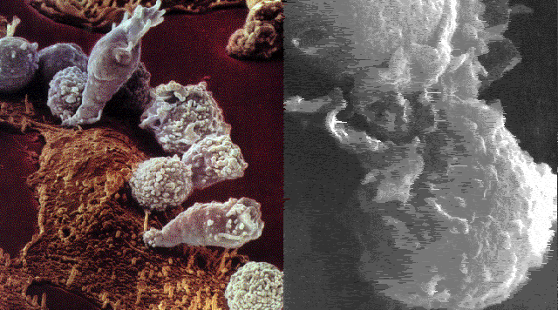
Immune System Part I:
The Evolution of the Immune System

Slide 2
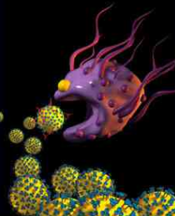
Immune System and Innate Immunity
The human body has over 100 trillion bacteria living on it or within it.
An immune system protects an organism from pathogens and other foreign material.
The innate immune system provides the first line of defense by
activating a small variety of immune cells to produce molecules that stop the invading pathogens and its resulting disease
providing physical barriers to stop a pathogen
Notes:
Point out that most bacteria living on humans are harmless and can even be beneficial. There are approximately five pounds of bacteria living in or on the human body.
The innate immune system was once called the non-specific immune system and there has been an explosion of knowledge in this area.
Graphic http://www.bluebananadesigns.com/illusMacrophageMed.html

Slide 3
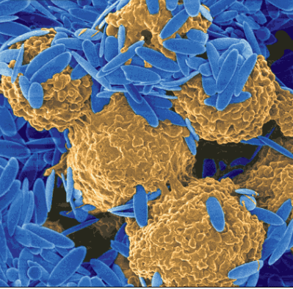
Adaptive Immune System
The innate immune system is immediate and utilized by many multicellular organisms.
In contrast, an adaptive immune system produces antibodies specific to a pathogen or foreign particle after the pathogen activates B- and T-lymphocytes.
The adaptive immune response is slower than the innate immune response and it may take days to become effective.
Present only in jawed vertebrates
Notes:
Graphic http://www.bluebananadesigns.com/illusMacrophageMed.html
The adaptive immune system used to be called the specific immune system. (emphasis on “adaptive”)
The innate immune system is thought to be an ancient conserved biochemical pathway when compared to the adaptive immune system.
Ask the students what that last fact tells them. Good student answers will address the fact that the innate immune system is thought to constitute an evolutionarily older defense strategy, and is the dominant immune system found in plants, fungi, insects, and in primitive multicellular organisms. (Students may not know that last part!)

Slide 4
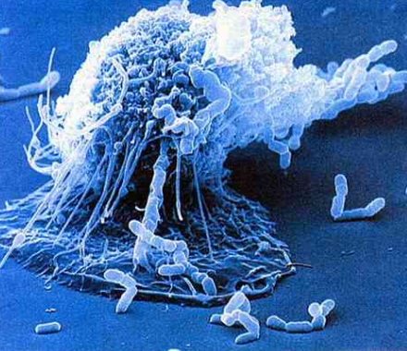
Homeostasis and the Immune System
Pathogens invade organisms because they are seeking:
a source of food or water
protection
a place for reproduction
Defense mechanisms evolved to rid the organism of pathogens and return the organism back to its original state.
Notes:
It may be useful to go over some terminology with the students:
Homeostasis -- the internal regulation of a system so that its properties remain constant. Homeostasis includes regulation of such things as pH, water, glucose, pathogens, temperature, etc.
Disease -- any abnormal condition in an organism that interferes with its vital physiological processes, caused by pathogenic microorganisms, parasites, unfavorable environmental, genetic, or nutritional factors.
Infectious disease -- a disease that is caused by pathogenic microorganisms that have gained entrance to the body and then multiply and potentially transfer to other organisms.
Pathogen -- an infectious organism or particle that can cause disease in another organism. Pathogens may be lethal.
Immune system -- a defense system that works against invading pathogens and resulting diseases.
The immune system is a method of maintaining homeostasis in an organism. The immune system defends the body against invading pathogens. Point out that the immune system used to be considered a system found only in vertebrates and was not associated with other organisms. It is now recognized that many organisms including sea anemone, fruit flies, and plants also have immune systems.
In this unit, there will be constant references to the evolution of the immune system, cell communication, and homeostasis.
Graphic http://www.bluebananadesigns.com/illusMacrophageMed.html

Slide 5
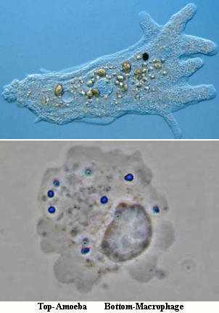
Evolution of the Immune System
Ancestral amoebas performed phagocytosis to obtain food.
It would be advantageous for these ancestral amoeba to be able to distinguish between self and non-self when ingesting other cells.
The interaction between receptors and signature molecules could provide this distinction mechanism.
Notes:
Point out to students that amoebas and immune system phagocytes are very similar. They both move with pseudopods (students may or may not have this prior knowledge and be familiar with amoebas). Both of these cells utilize phagocytosis and destroy other cells.
The ancestor to the amoeba lived in a freshwater environment. Phagocytosis allowed it to ingest other cells and extract nutrients from them. If the ancestral amoeba could not distinguish between other amoeba cells and foreign cells (other than amoeba), it is possible that amoeba cells could have completely disappeared.
It was advantageous for amoebas to distinguish between self and non-self cells. The best way to do this is by way of receptors and signature molecules.
Signature molecules are identifying molecules that are unique to a particular group of organisms. For example, cellulose is a signature molecule for plants, chitin is a signature molecule for certain fungi, muramic acid or murein is a signature molecule for bacteria (not Archaea), and double-stranded (DS) RNA is a signature molecule for certain RNA viruses. This list is not exhaustive. Signature molecules would have allowed the amoeba to distinguish between another amoeba and a foreign cell or potential food.
Graphic-
http://www.microscopy-uk.org.uk/mag/indexmag.html?
http://www.microscopy-uk.org.uk/mag/artsep01/amoeba.html

Slide 6
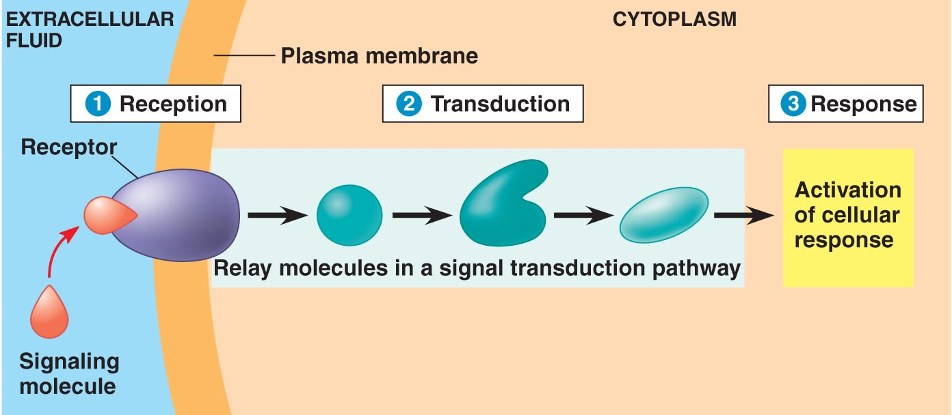
General Cell Communication
Propose a cell communication mechanism that ancestral amoeba may have used to distinguish between foreign cells and other amoeba cells.
Notes:
Graphic-Campbell
Point out that the immune system is involved in cell communication. There are three features of cell communication as shown in the diagram.
Reception occurs between a membrane receptor and a signaling molecule or, in this case, a signature molecule on the pathogen.
Once reception occurs, the receptor activates a signal transduction pathway.
The final result of the signal transduction pathway is some sort of cellular response. In the case of ancestral amoeba, it is assumed that the response was phagocytosis. Explain to students how this mechanism could also be used by multicellular organisms to defend the body against pathogens.
Q: Propose a cell communication mechanism that ancestral amoeba may have used to distinguish between foreign cells and other amoeba cells.
A: The ancestral amoeba probably had several receptors for different signal or signature molecules of foreign cells. If a receptor was activated, it then engaged a transduction pathway that resulted in phagocytosis of the attached cell. If a cell did not attach, it may have been another amoeba and would be ignored.

Slide 7
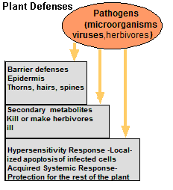
Plant Defenses
Plants, like animals, must defend against pathogens and herbivores with:
physical barriers
secondary metabolites
immune responses
Notes:
Emphasize that plants, unlike animals, cannot escape potential consumers. Unlike many animals (echinoderms and flatworms are some notable exceptions), plants have the ability to regenerate or replace parts.
Ask students to suggest strategies for defense. Possible suggestions follow:
An epidermis with a waxy cuticle making it more difficult for bacteria and fungi to penetrate into the inner body of the plant. Thorns and spines that discourage herbivores from eating parts of a plant.
Secondary metabolites that can make herbivores ill or poison them.
An immune response that includes apoptosis (cell suicide) of infected cells (also called the hypersensitivity response) and release of chemical signals to protect the rest of the healthy plant.

Slide 8
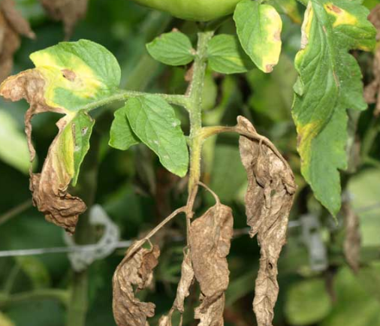
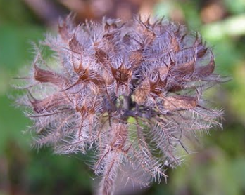
Plants’ Physical Defenses
Pathogens can invade plants.
Plants’physical defenses include:
hairs that insects cannot penetrate
thorns or spines that large herbivores avoid
waxy cuticles that bacteria and fungi cannot penetrate
Notes:
Q: Ask the students to come up with any other physical adaptations that might prevent plant injury or disease.
A: leaf shedding (protects against disease and pests), autumn leaf coloration (warning signal for insects that migrate feed on the plant), thigmonastic movements as in the mimosa leaf (leaf closes as predator touches it), etc.
Q: Ask the students how pathogens might enter a plant.
A: Pathogens might enter the plant via stomates or lenticels or wounds on a plant.
Q: Ask the students the purpose of wound dressing when trimming a tree.
A: It is to prevent pathogens from entering the plant.
Graphic-http://bluejaybarrens.blogspot.com/2009/11/wild-basil.html
http://www.veggiegardeningtips.com/plant-disease-prevention-in-the-vegetable-garden/

Slide 9
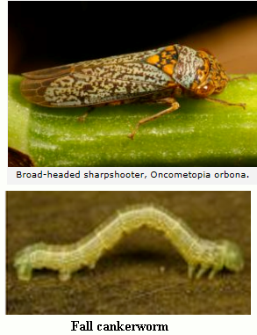
Plant Defenses Against Herbivory
Herbivores harm plants by eating them.
Defenses against herbivory include production of secondary metabolites.
Notes:
Graphic- http://arthurevans.wordpress.com/page/2/
Point out the following-
Many plants have indeterminate growth. They continue to grow. If the plant is damaged, it simply regrows the part that is damage. Some herbivores however, can completely destroy a plant.
A secondary metabolite is a metabolite that is not necessary for the plant to live, reproduce or function. It has some other use or function.
Production of secondary metabolites can be a defense against herbivory. Secondary metabolites can
Act on the nervous system of insects and mollusks or mammals
Mimic the natural hormones of insects so that the larvae do not develop correctly.
Damage the digestive tracts of herbivores
Some are fungicides.
Examples of effects of secondary metabolites
1. Canavanine made by a plant is similar to the amino acid arginine.
Secondary metabolite is a metabolite that is not necessary for the plant to live, reproduce or function.

Slide 10
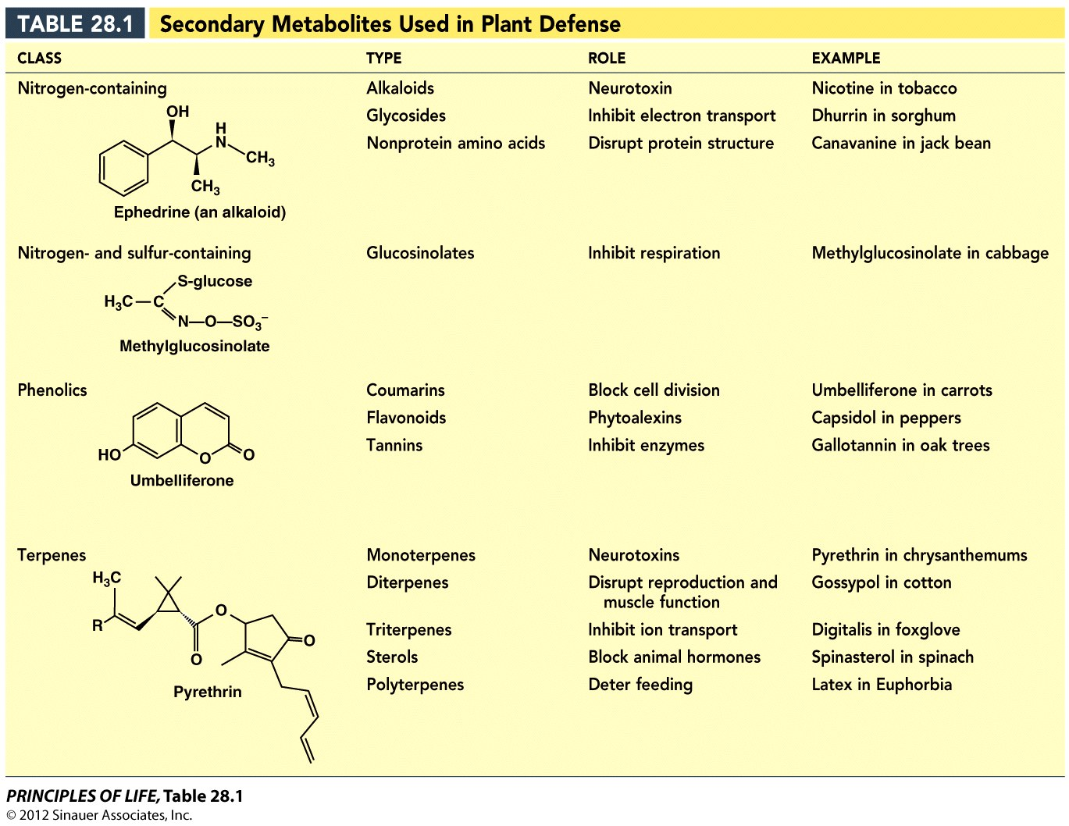
Plant Defenses Against Herbivory
Notes:
This table lists various secondary plant metabolites involved in plant defense. It is not important that students know this list of secondary metabolites, but it is wise to emphasize the “role” column as illustrative examples. There are over 10,000 identified metabolites!
Students need to know that secondary metabolites are not necessary for the existence of the plant, but can function in chemical defense mechanisms.
Some secondary metabolites have BENEFITS for humans:
Morphine- pain killer; from the poppy plant
Salicylic acid- (aspirin) antiflammatory and headache reliever; found in willow trees
Quinine- antimalarial drug; found in the bark of the cinchona tree.
Taxol-anticancer drug; found in the berries of the Pacific yew
Genistein- birth control mimics estrogen; found in soybeans
Caffeine- increases metabolism; found in coffee bean and tea leaves (and a favorite among AP Biology teachers!)

Slide 11
Plant Defenses Against Herbivory
Notes:
Graphic- Hillis
This table lists some various secondary metabolites of plants that are used in defense of the plant. Students do not have to know the list of secondary metabolites. There are over 10,000 identified metabolites.
Students need to know that secondary metabolites are not necessary for the existence of the plant but can function in the chemical defense of a plant.
Some secondary metabolites have benefits for humans
Morphine- pain killer from the poppy plant
Salicylic acid- (aspirin) antiflammatory and headache reliever found in willow trees
Quinine- antimalarial drug found in the bark quinine
Taxol-anticancer drug found in the berries of the Pacific yew
Genistein- birth control mimics estrogen found in soybeans
Caffeine- increased metabolism found in coffee bean and tea leaves

Slide 12
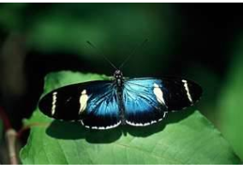
Coevolution of Herbivores and Plants
Certain herbivores and plants have coevolved with one another.
This butterfly can breakdown the secondary metabolite produced by the passion vine and use a nitrogen by-product in protein metabolism.
Notes:
Let students propose may have happened. Prod them along an evolutionary pathway…
While this metabolite may have been harmful at first, there may have been a butterfly with a mutation that allowed it to sequester the metabolite, break it down, and utilize the by-products.
Graphic- http://www.harkphoto.com/hsara2.jpg

Slide 13
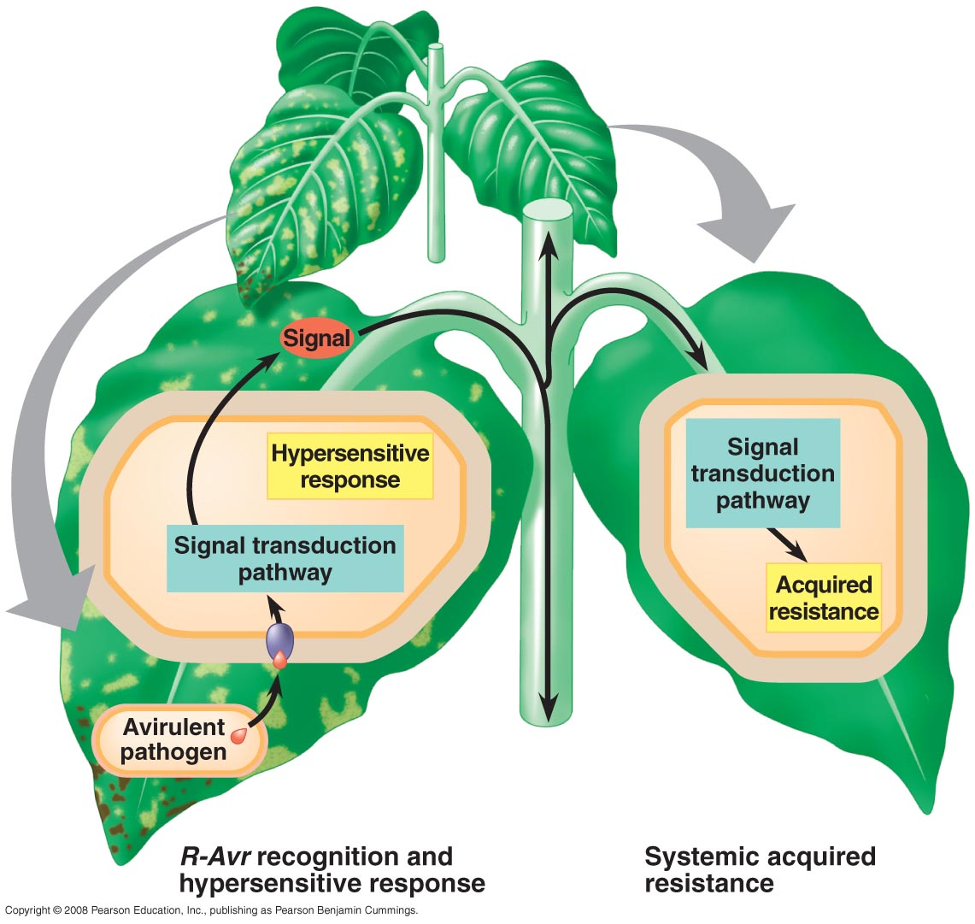
Systemic Acquired Resistance
Methyl salicylate from the HR is spread to rest of the plant.
Once converted to salicylic acid, a transduction pathway is activated causing systemic acquired resistance (SAR) for the entire plant that lasts for several days.
Notes:
SAR is caused by the signal molecule, salicylic acid (acetylsalicylic acid is found in aspirin). Salicylic acid causes the production of pathogen-related proteins (PR proteins). These proteins protect the whole plant from invaders for several days. It is not permanent immunity like the adaptive immune system.
Point out that natives used to chew willow bark to ease pain like a tooth ache or muscles ache. Acetylsalicylic acid is the active ingredient in aspirin. Historical note: Aspirin was first isolated by Felix Hoffmann, a chemist with the German company Bayer in 1897.

Slide 14
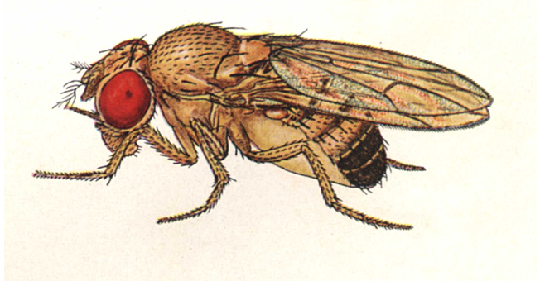
Immunity and Invertebrates -- Physical Barriers
Examples of innate immunity in Drosophila:
First line of defense is the exoskeleton made of chitin.
Chitin also lines the digestive tract.
The enzyme lysozyme found in the gut breaks down the cell walls of bacteria.
Notes:
Emphasize that having the gut lined with chitin confers a physical barrier to large pathogens like bacteria. Lysozyme is the enzyme that is found in tears, saliva, and milk. Lysozyme breaks down the cell walls of bacterial cells.
Hemocytes phagocytize microbes like macrophages and amoebas.
Graphic-http://rice.bio.indiana.edu:7082/images/Drosophilidae/Drosophila_melanogaster_m/index.html

